Slide 1
Unit 5
Friends
WWW.PPT818.COM

Slide 2
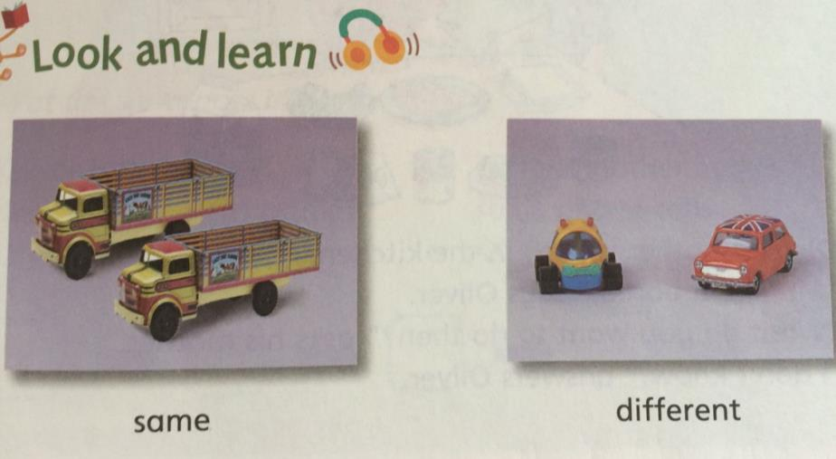
[seɪm]
[dɪfrənt]

Slide 3
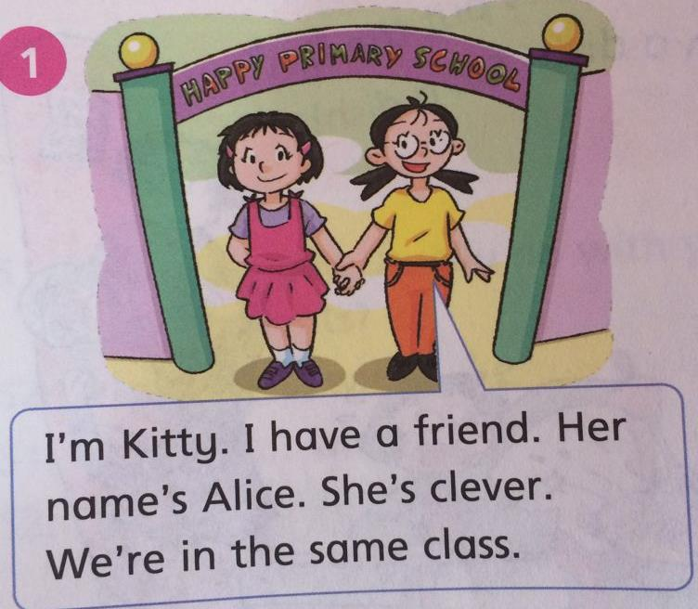

Slide 4
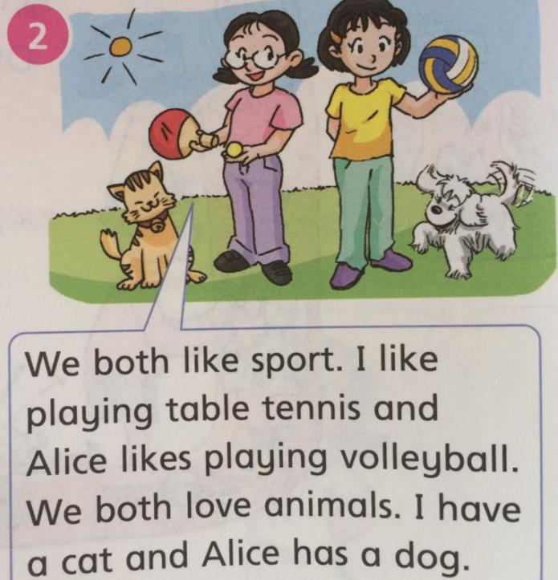
[bəʊθ] adj.二者，两者都
like+ doing
[vɒlibɔ:l]
n.排球

Slide 5
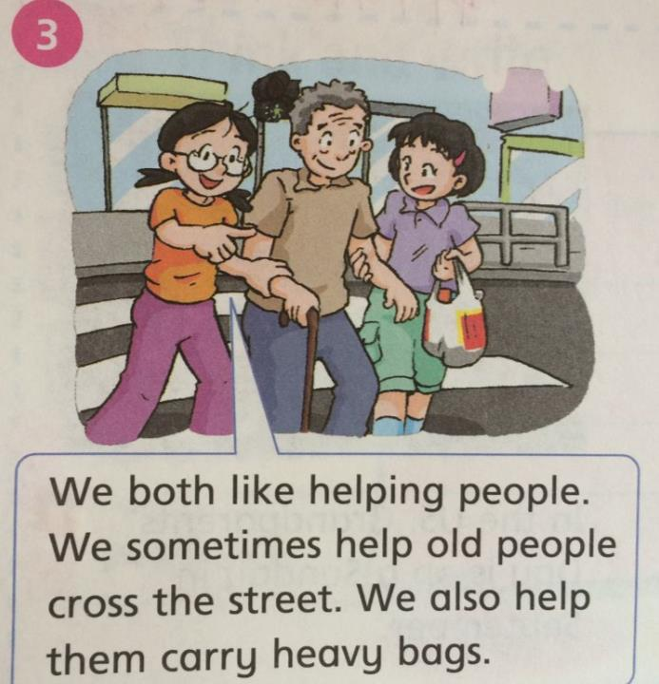
[krɔ:s]
[kæri] 携带
[hevi] 重的

Slide 6
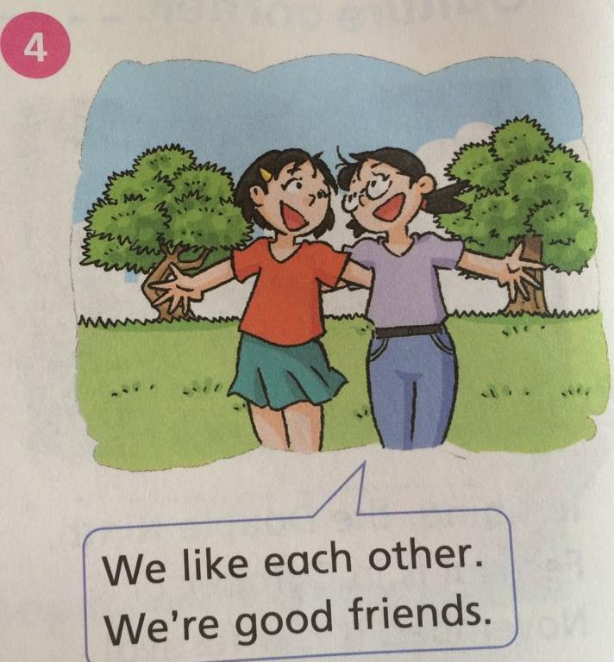

Slide 7
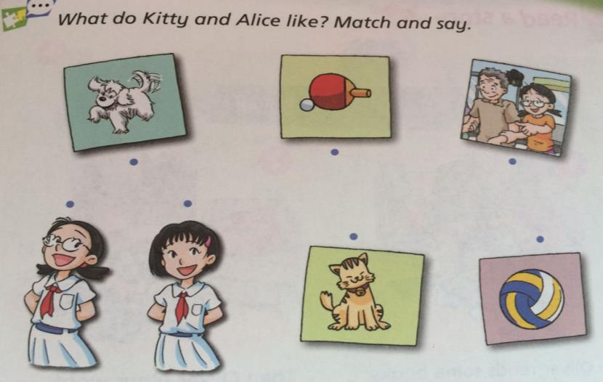
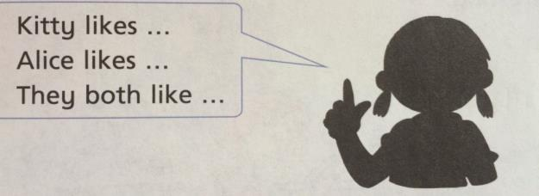

Slide 8
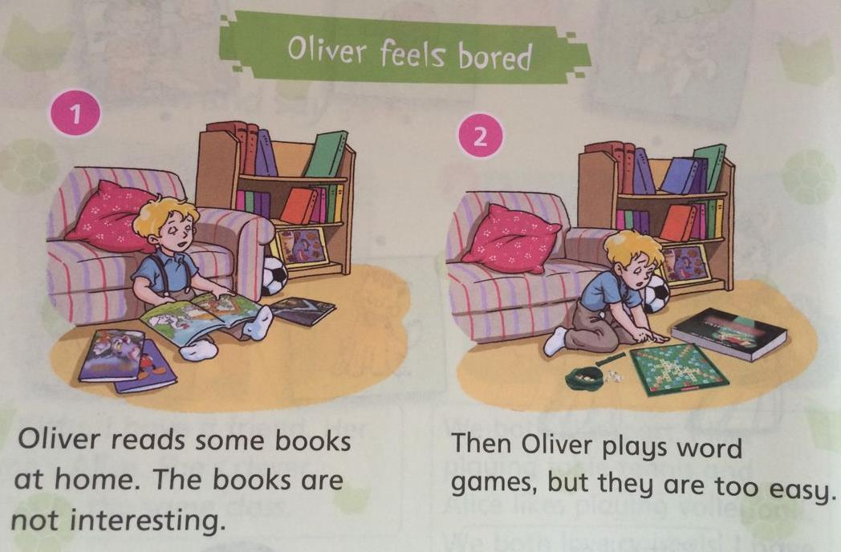

Slide 9
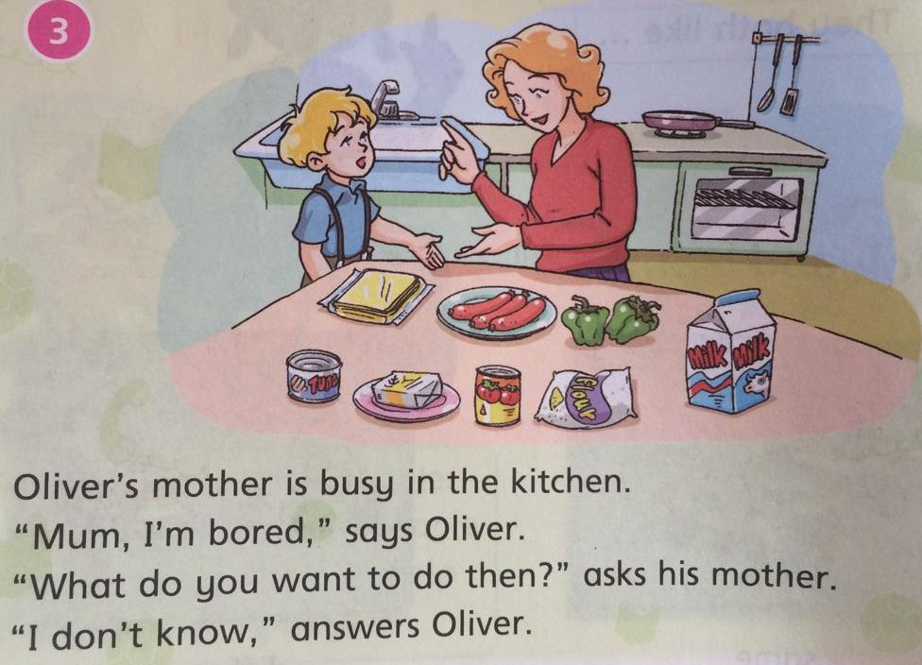
[bɔ:rd]
[ænsə(r)]

Slide 10
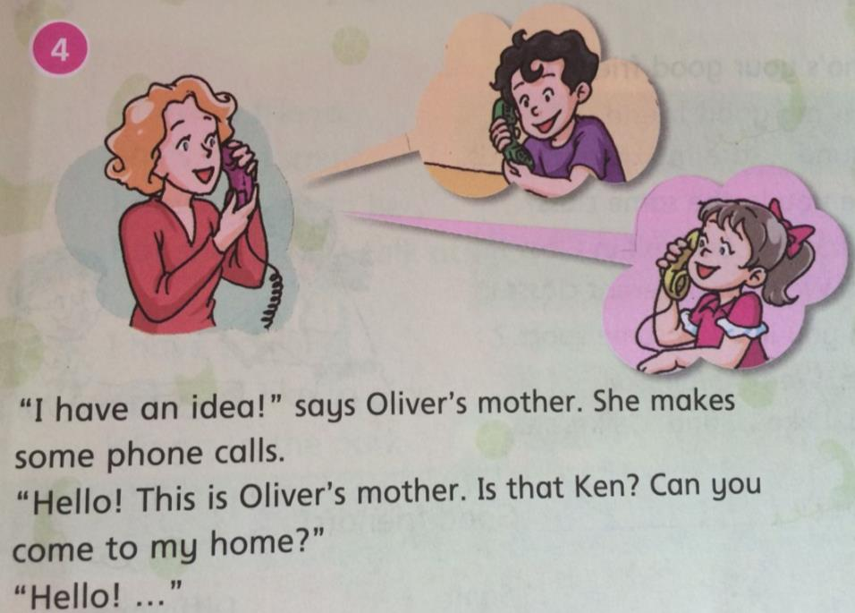
[aɪdɪə]

Slide 11
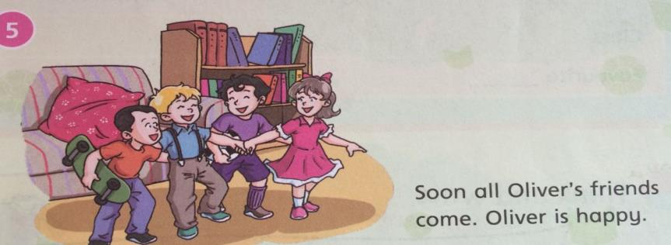
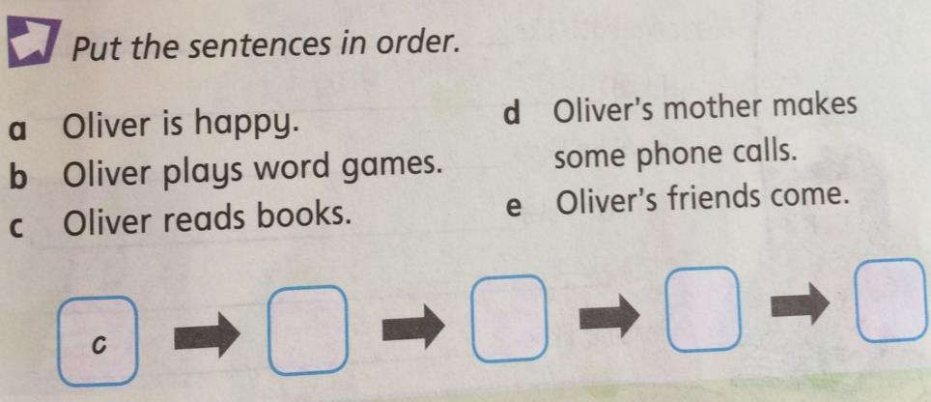
a
d
e
b

Slide 12
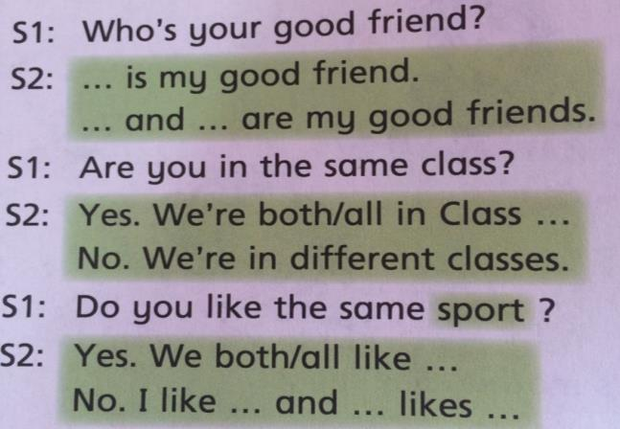
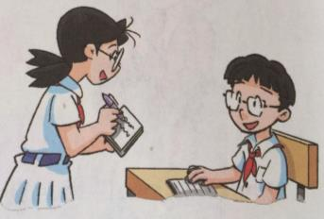
Name________ Good friend(s)_______
 | same | different
class
Favourite ______

Slide 13
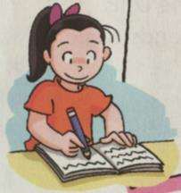
_________is my good friend.
We both like_____________.
I like___________.
He\She likes_________.
We both like _____________.
I like________.
He\She likes__________.

Slide 14
Eenjoy
I have a friend. She’s very small.
I always talk to her,
But she doesn’t talk at all.
I have a friend. We both like to play.
We go to the park almost every day.
not….at all 根本不
[ɔ:lməʊst]几乎，差不多;

Slide 15
Sounds
The princess has a dream.
In her dream, she puts on a pretty dress.
She walks into the forest
And meets a handsome prince.
[prɪnses] 公主
[dri:m] 梦想
[dres]
[prɪti] adj.漂亮的
[prɪns] n.王子
Pr-- [pr] dr-- [dr]

Slide 16
soon 立刻,马上,不久
same 相同
different 不同
bored 无聊的，厌烦的
answer回答
almost 几乎，差不多
pretty dress 漂亮的裙子
both 两者都
princess 公主
dream 梦，梦想
prince 王子 volleyball 排球

