Slide 1
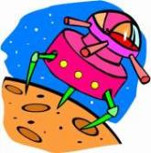
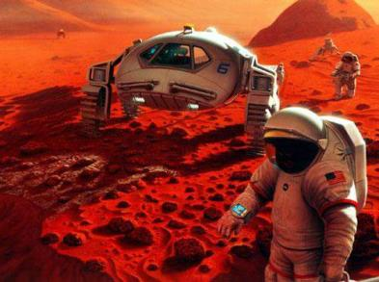
Unit 4
WWW.PPT818.COM

Slide 2
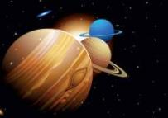
Words and
Expressions
Mars
helmet
air tank
dried food
power pack
sleeping bag
gravity
n. 火星
n. 头盔
n. 氧气罐
n. 干粮
n. 电源包
n. 睡袋
n. 重力

Slide 3
Eddie and Hobo are also talking about life on Mars.
Listen to their dialogue.

Slide 4
Listen and answer the questions.
1. Where are they?
They are on Mars.
2. How does Eddie like life on Mars?
Why?
Eddie hates Mars. Because of the helmet, he can't get to his food.

Slide 5
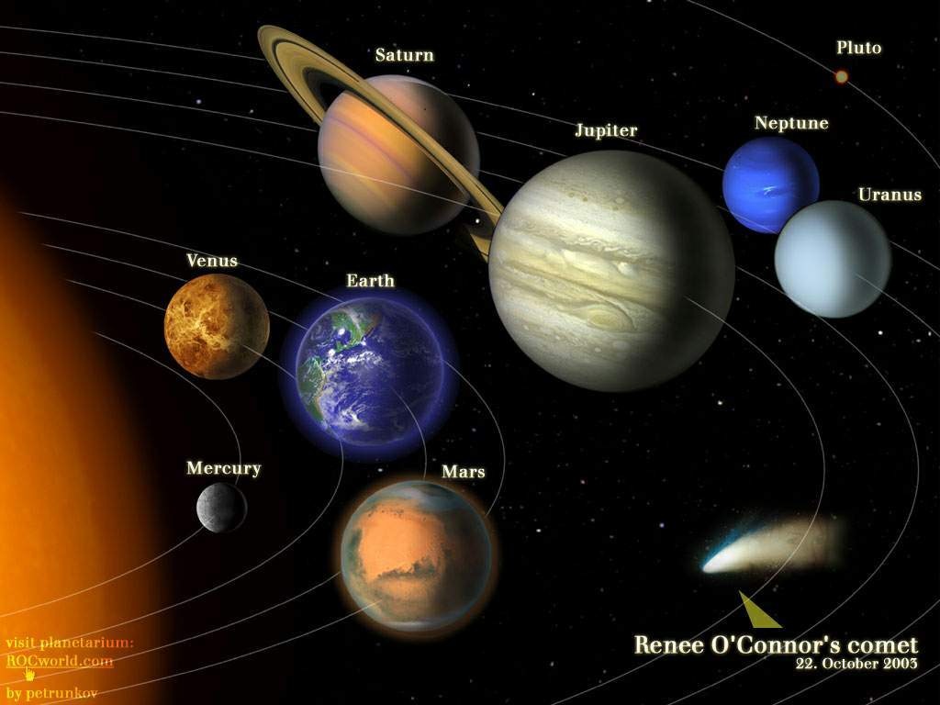
Where is Mars?
1111
Solar System

Slide 6
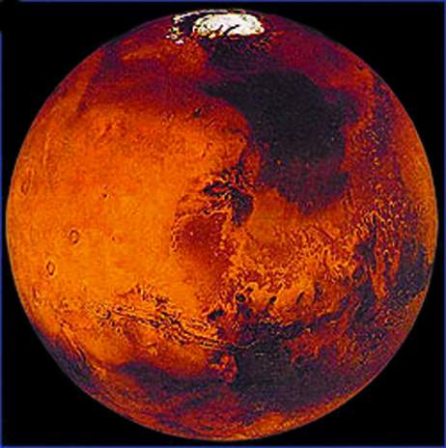
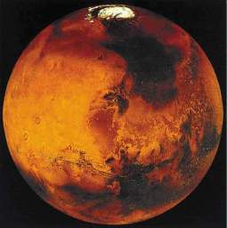
It’s more like the Earth than the other planets in solar system.
Do you know anything about Mars? What does it look like?
火星：太阳系八大行星之一，按离太阳由近而远的次序计为第四颗，比地球小，公转周期约687天，自转周期约24小时37分。
公转周期：约687天
自转周期：24小时37分22秒
It looks red. So it is also called the Red Planet.
行星直径：6794 千米
质量：6.4191e20吨
Mars

Slide 7
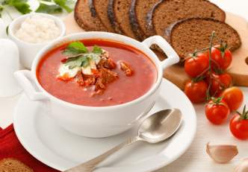
What’s the life like on Mars?
on Earth
on Mars
food
pills

Slide 8
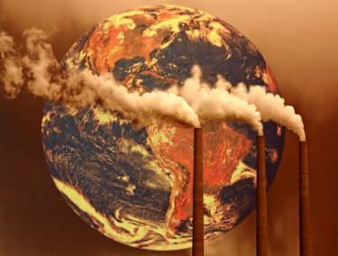
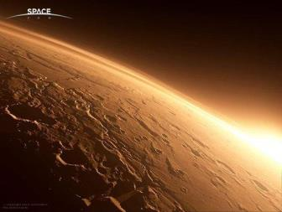
What’s the life like on Mars?
on Earth
on Mars
pollution
no pollution

Slide 9
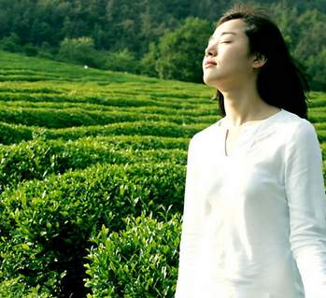
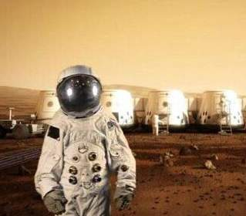
What’s the life like on Mars?
on Earth
on Mars
breathing oxygen
We must wear space helmets to go outside.

Slide 10
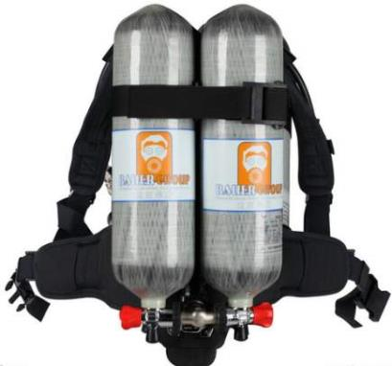
Do you know what the following things are? They are necessary when we live on Mars.
air tank

Slide 11
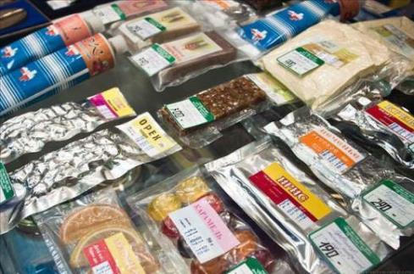
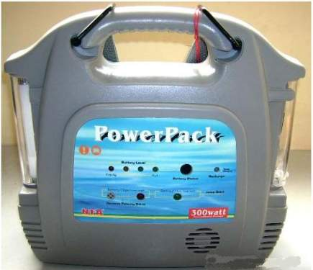
dried food
power pack

Slide 12
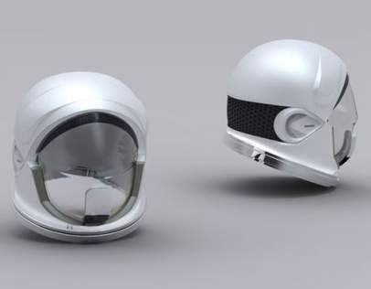
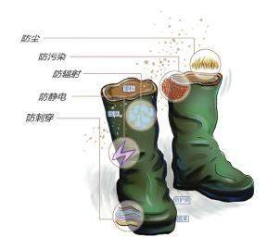
space helmet
special boots

Slide 13
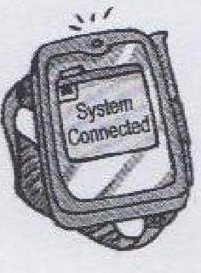
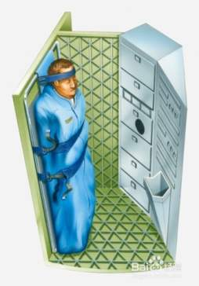
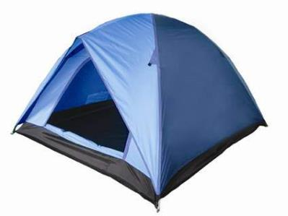
computer
sleeping bag
tent

Slide 14
Read the conversation and answer the questions.
Because there’s less gravity on Mars.
1. Why do we need to wear special boots on Mars?
2. We might need sleeping bag too.
gravity [U] (force): the force that attracts objects towards one another, especially the force that makes things fall to the ground
2. What else do we need to live on Mars?
3. Why do we have to eat dried food on Mars?
3. Because there is no fruit or vegetables.
4. We don’t know. Amy hopes that there is no pollution on Mars.
4. Is there any pollution on Mars?

Slide 15
Language points
1. I can’t get to my food.
我吃不到我的食物了。
get to 到达；开始；接触到
What time does this train get to New York?
这列火车什么时候到达纽约?
How can I get to Hilton Hotel?
我要如何才能到达希尔顿饭店?

Slide 16
2. We’d probably need to wear special boots.
我们可能需要穿特殊的靴子。
wear
穿着，戴着；面露；留着（胡须等）
When we drove through the gates, she wore a look of amazement.
我们驶过大门时，她流露出惊讶的神情。
She wears very little makeup.
她基本上不化妆。
When she's working she wears her hair in a ponytail.

Slide 17
Read and try to recite the conversations in 5-10 minutes.

Slide 18
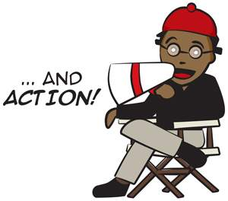
Role-play
We’ll see which group does the best.
1. Role play in groups;
2. Role play in front of the class

Slide 19
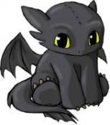
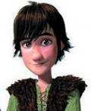
What would it be like to live on Mars. Work in pairs and discuss with your partner. Use the conversation on page 51 as a model.
For example:
Well, there’s less oxygen on Mars. We would need space helmet and air tank.
Yes, but there would be no pollution on Mars.
I agree with you. And we would have to eat dried food. I think dried food is not quite delicious.
Right, and we would need special boots, too.
What would it be like to live on Mars?
Well, that’s quite nice.

Slide 20
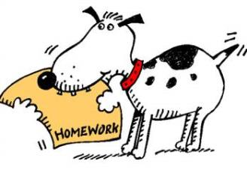
Homework
1. Learn the new words and expressions by heart.
2. Preview the article:
Moving to Mars

