Slide 1
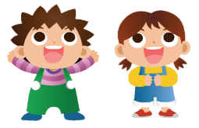
Unit 2 Good habits
WWW.PPT818.COM

Slide 2
Wang Bing and Liu Tao are good boys.
1....gets up…
2. He brushes his teeth…
3. he always puts...
4. He finishes...
1.... listens to …
2. He keeps his room…
3. He helps…
4. He often does ...
5. He sometimes feels...

Slide 3
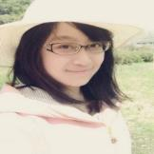
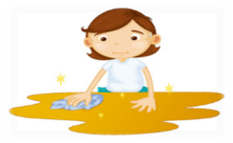
My name is Tracy. I have some habits.
Do you want to know?
Have my meals
Read books
Keep room clean

Slide 4
（倡议书）
Step1 ：How to ask
Step 2：How to make
Step 3：Do a survey
Step 4：Make a good habit proposal
according to your survey form

Slide 5
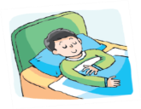
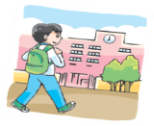
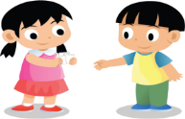
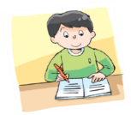
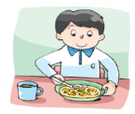
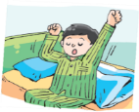
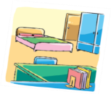
Fun time
Pick and say
Pick one!
OK.
Do you go to bed early?
Yes, I do.
That’s a good habit.
Thank you!

Slide 6
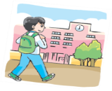
Pair work
Tip: Pick one picture from the envelope and practice in pairs. (请从信封里挑出一张图片，同桌练习。)

Slide 7
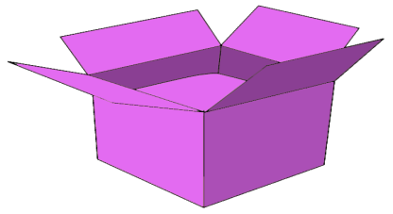
Play a game
从盒子中请选出四张不同颜色的纸条。
小组内讨论，将纸条上的内容拼成一句话
先在小组内读一读，再以自己小组的方式展示。

Slide 8
Review
I
always
have my meal
on time.
usually
We
finish our homework
before dinner.
They
often
do their homework
in the evening.
He
sometimes
feels sleepy
in the morning.
She
never
goes to bed
late.
人称代词
频度副词
动词
时间/地点

Slide 9
Grammar time
请在表格里填入单词让这个句子变成一个好习惯！
Let’s make a survey form
Name | Activities | How | When/Where
 | go to bed |  | at night
early
Name | Activities | How | When/Where
 | go to school |  | in the morning
 | do |  | at home
 | go to bed |  | at night
early
well
early

Slide 10
Do a survey
What good habits do your group members and you have?
Work in groups.
Name | Activities | How | When/Where
 | go to bed | early | at night
Tip: 如果是第三人称，不要忘记动词的变化哦!
Name | Activities | How | When/Where
 | go to school | early | in the morning
 | do | well | at home
 | go to bed | early | at night

Slide 11
Let's make !
What good habits should we have?
同学们，让我们一起来做一张好习惯倡议书吧！

Slide 12
Good habit proposal
如果你觉得always做某件事很困难,可以选择usually/often/sometimes…
Tips:
1.选择合适的频度副词。
2.把信封里的图片装饰在倡议书上。
3.还可以把小组获得的贴画装饰在倡 议书上哟！
I never stay up late.
I always keep room clean.
I often save money(省钱) on Taobao.

Slide 13
Good habit proposal
Tips | Award
Everyone says one sentence
小组成员每人说一句
All group members say together
小组成员一起说
Only group leader says
小组选一个代表说
Tip:
你还能再想出一个好习惯吗？请写在空白纸条上吧！

Slide 14
Thank you!

