Slide 1
Unit 6
When was it invented?
Section A 1a-1c
WWW.PPT818.COM

Slide 2
Objectives
To learn to understand and use the passive voice.
To listen and speak about the history of inventions using passive voice.
To listen and speak about what inventions were used using passive voice.

Slide 3
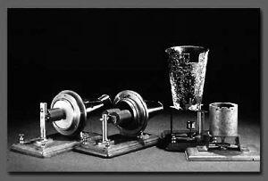
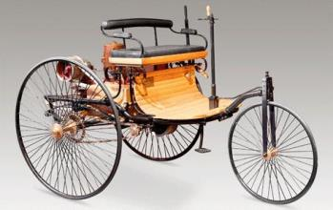
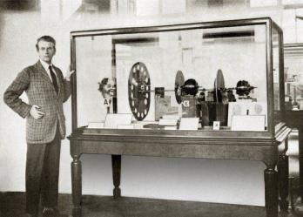
Do you know what these inventions are?

Slide 4
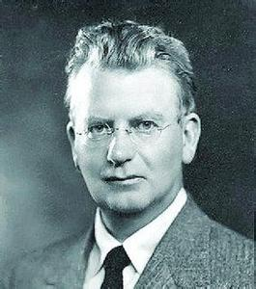
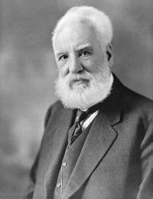
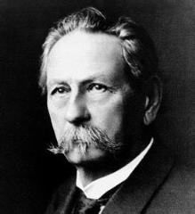
Do you know who these inventors are?
Karl Benz
Alexander Bell
J. L. Baird

Slide 5
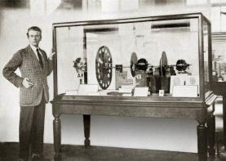
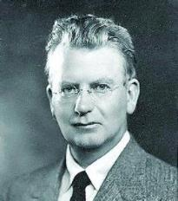
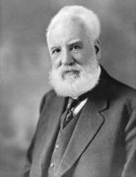
Can you match the inventions with the right inventors?

Slide 6
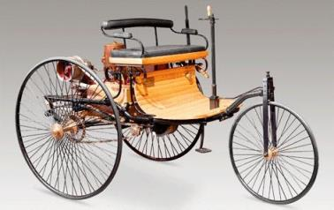
Karl Benz invented the first car in 1885.
The first car was invented (by Karl Benz) in 1885.

Slide 7
Bell invented the first telephone in 1876.
The first telephone was invented (by Bell) in 1876.

Slide 8
J. L. Baird invented the first television in 1927.
The first television was invented (by J. L. Baird) in 1927.

Slide 9
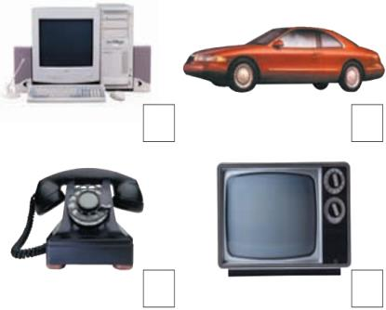
1a Look at the things below. In what order do you think they were invented? Discuss them with your group. Then number them [1–4] (1 = first, 4 = last).
A: I think the TV was
invented before the
car.
B: Well, I think the TV
was invented after
the car.
4
2
1
3

Slide 10
I think the TV was invented before the car.
Well, I think the TV was invented after the car.

Slide 11
I think the telephone was invented before the computer.
Well, I agree with you.

Slide 12
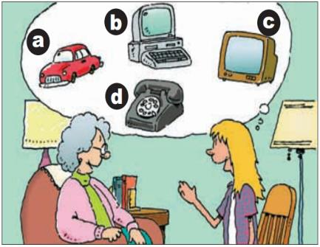
1b Listen and match the inventions with
the years.
____ 1876
____ 1885
____ 1927
____ 1971
d
a
c
b

Slide 13
1c Student B, cover the dates. Student A,
ask Student B when the things in the
picture in 1b were invented. Then
change roles and practice again.
A: When was the telephone invented?
B: I think it was invented in 1876.
c

Slide 14
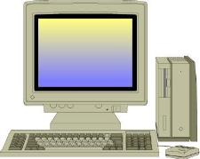
When was the computer invented?
Let me see…

Slide 15
When was the car invented?
It was invented in 1885.
When was the TV invented?
It was invented in 1927.

Slide 16
When was the computer invented?
It was invented in 1971.

Slide 17
Exercise
单词拼写
1.I wasn’t ________ (邀请) to the party, so I was angry with him.
2.To everyone’s _________ (惊奇), the laziest boy won the competition.
invited
surprise

Slide 18
3.He teaches ________ (我) English.
4.Lesson Five is the _______(容易) of Book
III.
5 The machine was ________(发明) in the
1980s.
6.He look forward to ________ (成为) a ___________(科学家)
me
easiest
invented
becoming
scientist

Slide 19
Homework
Make dialogues with your partner. Ask
each other about these inventions in
the textbook. Find out more
information about them.

