Slide 1
外研版三起点小学英语六年级下册
Module 6 Unit 1
It was Daming’s birthday yesterday.
WWW.PPT818.COM

Slide 2
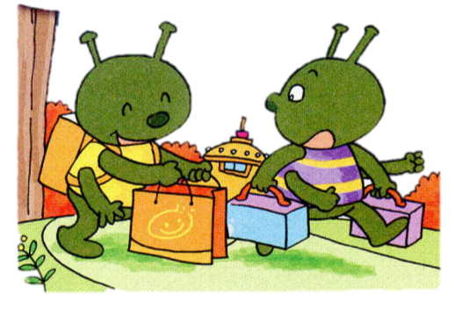
Who are they?
They are aliens.

Slide 3
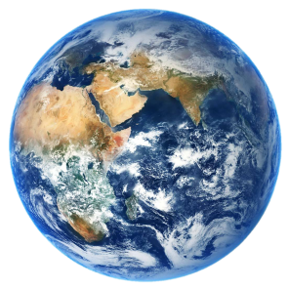
The alien went to the earth.
Where did the alien go?
earth 地球
on the earth：在地球上

Slide 4
What did the alien buy on the earth?
The alien bought a lot of things.
Welcome home! What did you buy on the earth?
I bought a lot of things.
过去式
buy
bought
点拨：
当动作发生在过去，则用动词的过去式。

Slide 5
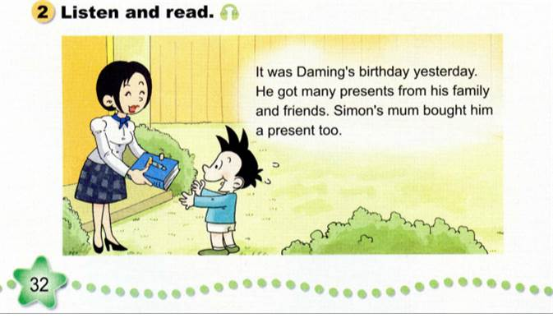

Slide 6
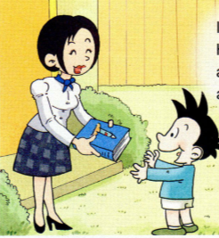
Read and answer.
1. It’s for Daming. Why?
___________________________
2. What was the book about?
___________________________
It was Daming’s birthday yesterday.
It was a book about space travel.
is
过去式
was

Slide 7
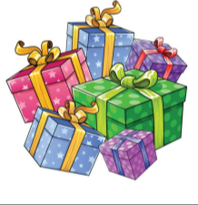
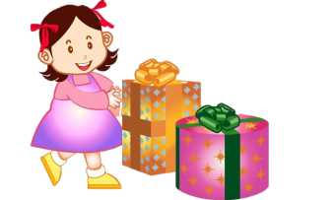
Let’s learn
get – got 得到
She got many presents from his family and friends.
他从家人和朋友那得到了很多礼物。
What did you get on your birthday?
__________________________________________

Slide 8
Let’s learn
用法点拨：
给某人买某物：buy sb. sth.
Simon’s mum bought him a present.
也可以这样说：buy sth. for sb.
Simon’s mum bought a present for him.
buy – bought 购买

Slide 10
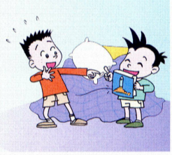
Read and answer.
It was a book about space travel. Daming is very interested in space travel. He loves the present very much.
Daming showed Simon his birthday present. Simon was interested in the book too. Daming asked him to read the book with him.
1. Does Daming like the book? Why?
______________________________________________
2. What did Daming ask Simon to do?
______________________________________________
Yes, he does. Because he is very interested in space travel.
He asked Simon to read the book with him.

Slide 11
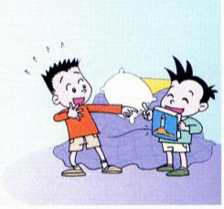
Let’s learn
Daming is very interested in space travel.
be interested in: 对……感兴趣
练一练：
我对游泳感兴趣。
____________________________
李先生对足球感兴趣。
____________________________
I’m interested in swimming.
Mr Li is interested in football.

Slide 12
Let’s learn
Daming asked him to read the book with him.
ask：询问
He asked:” Where is my ruler?”
他问道：“我的尺子在哪儿?”
用法点拨：
ask sb. to do sth: 请某人做某事
Daming asked him to read the book with him.
大明请他和自己一起读这本书。

Slide 13
Read and answer.
It was a book about space travel. Daming is very interested in space travel. He loves the present very much.
Daming showed Simon his birthday present. Simon was interested in the book too. Daming asked him to read the book with him.
1. Does Daming like the book? Why?
______________________________________________
2. What did Daming ask Simon to do?
______________________________________________
Yes, he does. Because he is very interested in space travel.
He asked Simon to read the book with him.

Slide 14
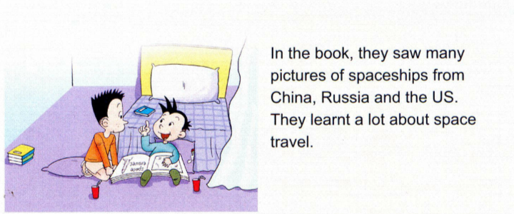
Read and find
see – saw：看见
learn – learnt：学习
3. What did they see in the book?
______________________________________________
They saw many pictures of spaceships.

Slide 15
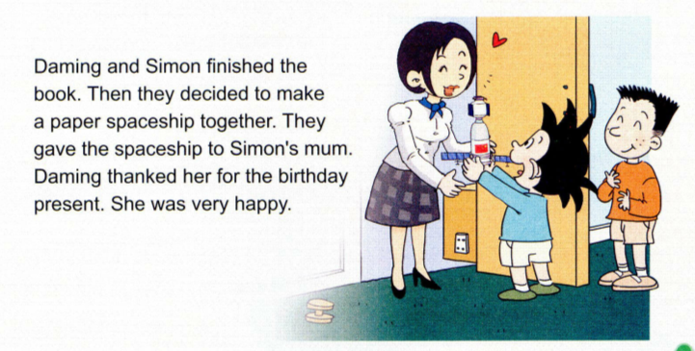
Read and find
4. What did they decide to make together?
______________________________________________
They decided to make a paper spaceship.

Slide 16
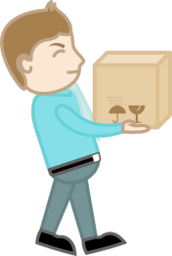
Let’s learn
用法点拨：
a) give sth. to sb：给某人某物
They gave the spaceship to Simon’s mum.
他们把这架纸飞船送给了西蒙的妈妈。
b) give sb. sth：给某人某物
give – gave：给
They gave Simon’s mum the spaceship.

Slide 17
word list
规则动词
ask – asked
finish – finished
thank – thanked
decide - decided
不规则动词
is – was
buy – bought
get – got
see – saw
learn – learnt
give - gave

Slide 18
Let’s play
finished
thanked
get
give
is
bought
saw
decide
ask
learnt

Slide 19
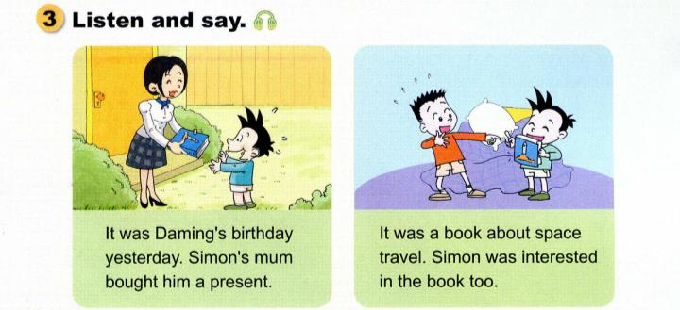
was
was
It ____ Daming’s birthday yesterday. Simon’s mum bought ____ ___ _______.
It ____ a book ______ space travel. Simon ___ ________ ___ the book too.
about
was
interested
him
a
present
in

Slide 20
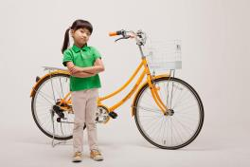
Let’s practice
It _____ Meimei’s birthday yesterday. Her mum bought _____________.
It was a book _____ football. Dongdong ____ _________ ___ the book too.
was
about
was
interested
her a new bike
in

Slide 21
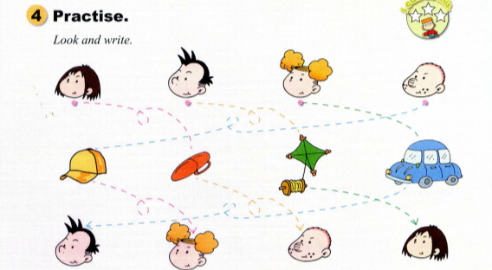
1 ___________________________________________________
2 ___________________________________________________
3 ___________________________________________________
4 ___________________________________________________
On Sam’s birthday, Lingling bought him a present. It was a red pen.
On Lingling’s birthday, Daming bought her a present. It was a green kite.
On Daming’s birthday, Amy bought him a present. It was a blue car.
On Amy’s birthday, Sam bought her a present. It was an orange cap.

Slide 22
1.词汇：space, interested, finish, spaceship, decide, thank for, buy—bought, be-was/were, see—saw, give—gave, finish—finished, see – saw
2.句型：
buy sb. sth./buy sth for sb.
be interested in
ask sb. to do sth.
give sth. to sb. /give sb. sth

Slide 23
Homework
1. Read and imitate the dialogue three times.
2. Remember the past tense of the verbs.
3.Try to talk about your birthday present.

Slide 24
Thank you!

