Slide 1
陕旅版英语五年级上册
Unit5 Can You Tell Me the Way to the Supermarket?
第1课时
WWW.PPT818.COM

Slide 2
教学目标：
1. 复习表示方位的介词：in, on, under, near，并进一步学习使用介词beside, behind, between。
2. 能听、说、读、写词汇：supermarket, Children’s Park, take a bus, get off the bus。

Slide 3
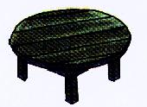
Listen and draw
Draw a book on the desk.
Draw a dog under the table.
Draw a cat in the sofa.
Draw a bed near the window.

Slide 4
Hello, boys and girls!
My name is Lily.
I’m a fairy.
Can you find me?

Slide 5
Where is Lily?
in
在……里面
Lily is in the bag.

Slide 6
Where is Lily?
on
在……上面
Lily is on the bag.

Slide 7
Where is Lily?
under
在……下面
Lily is under the bag.

Slide 8
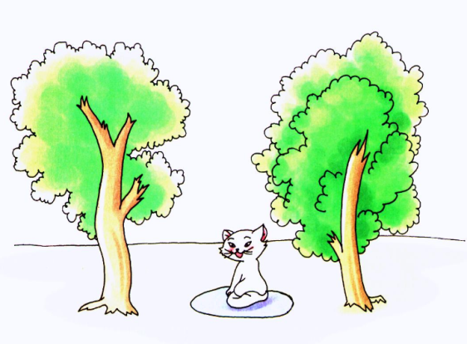
Let’s learn
Where is the rabbit?
It’s between the trees.

Slide 9
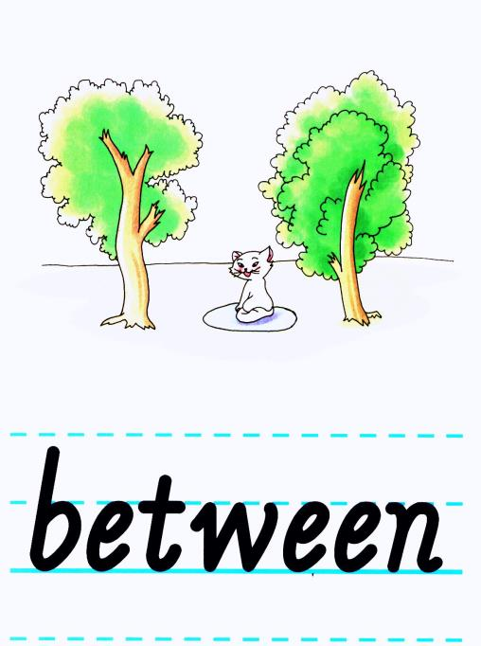

Slide 10
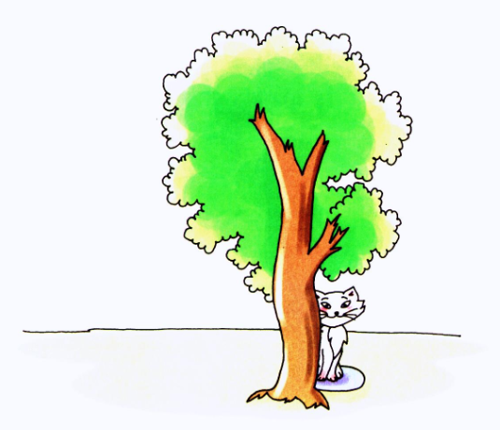
Where is the rabbit?
It’s behind the trees.

Slide 11
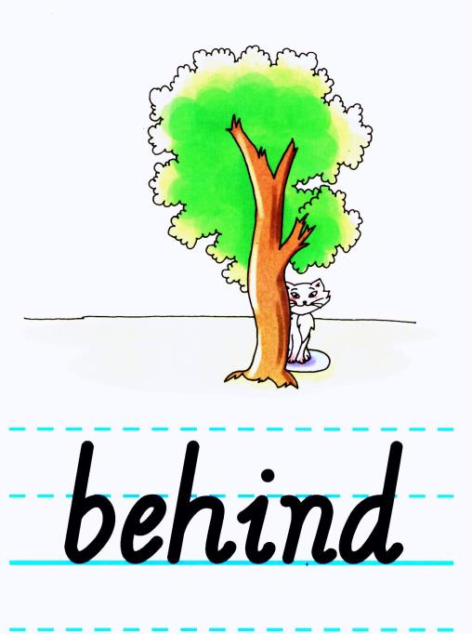

Slide 12
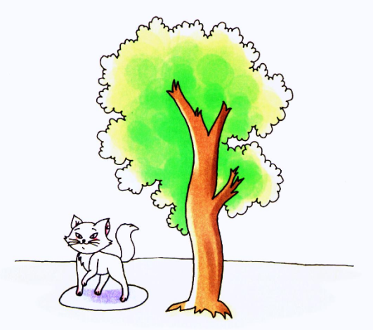
Where is the rabbit?
It’s beside the trees.

Slide 13
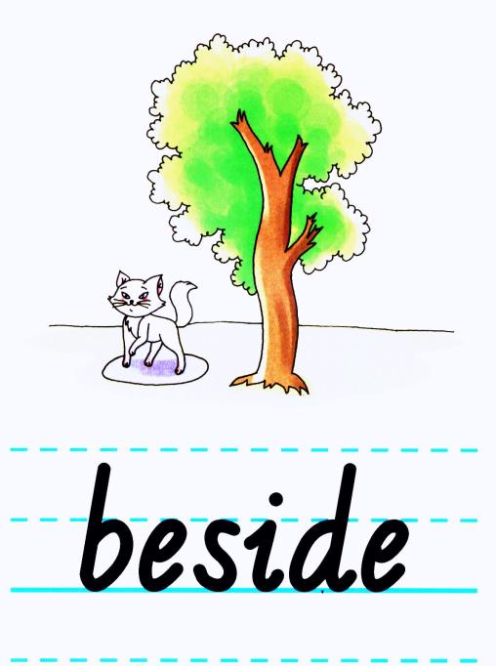

Slide 14
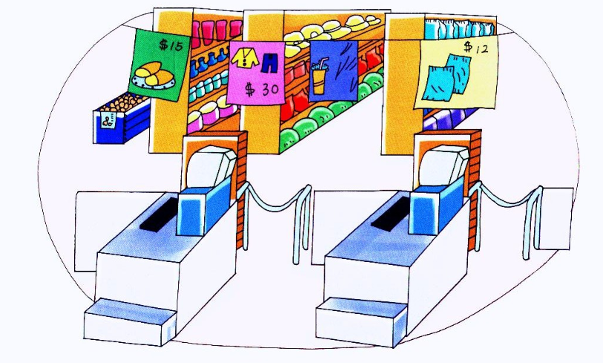
猜一猜

Slide 18
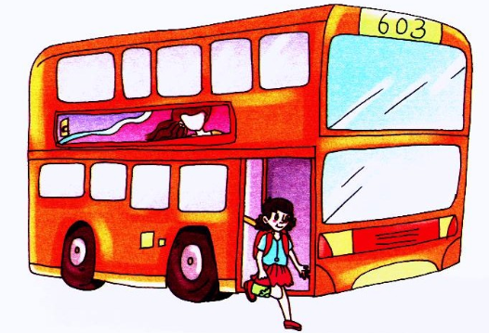
What’s this?

Slide 19
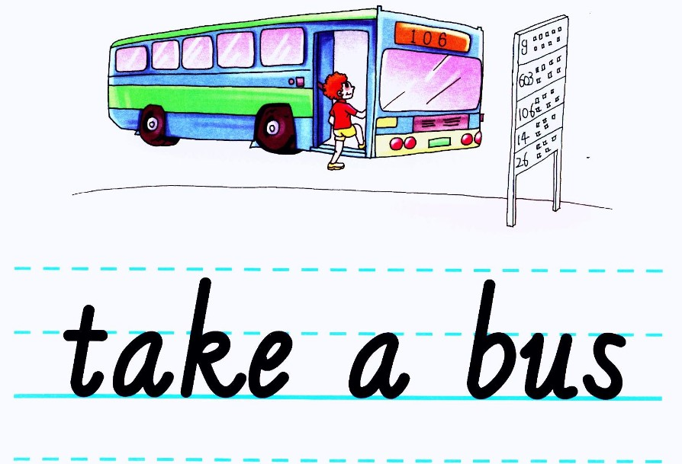

Slide 21
听一听，读一读

Slide 22
Listen and do
There is a ball between the chair and the box.
There is a rabbit behind the door.
There is an apple in the box.
There is a chair near the window.
There is a book beside the teacher’s desk.

