Slide 1

They're lovely!
WWW.PPT818.COM
Notes:
1

Slide 2
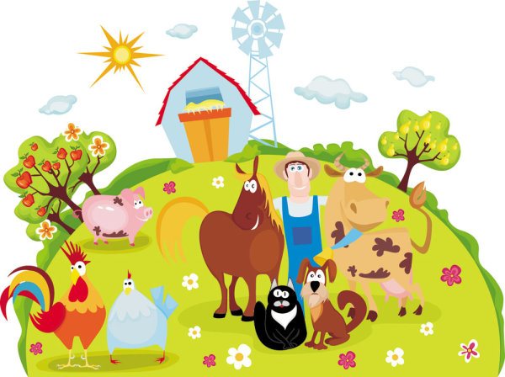
They’re lovely.

Slide 3
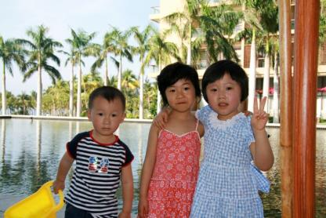
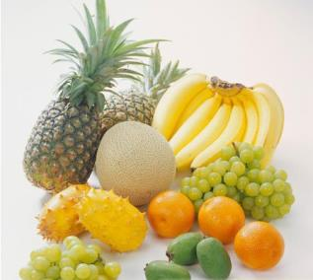
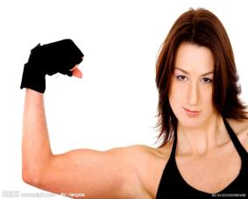
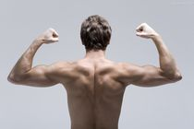
造句兵工厂
1、They’re lovely.
They’re… =They are …他们是…
你能够根据图片说出句子吗？
lovely.
good.
strong.

Slide 4
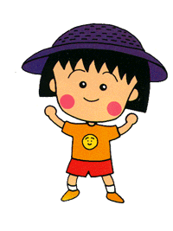
我是小演员

Slide 5
Let’s chant（要表演动作哦）
小猫cat 喵喵喵，cat，cat，小花猫
小鸭duck嘎嘎嘎，duck，duck是小鸭
小狗dog汪汪汪，dog，dog是小狗
小鸡chicken叽叽叽，chicken，chicken是小鸡
小猴monkey会上树，monkey，monkey树上住
鱼儿fish游啊游，fish，fish是小鱼
小兔rabbit蹦又跳，rabbit，rabbit真可爱
鸟儿bird飞呀飞，bird，bird是小鸟

Slide 6

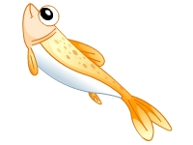

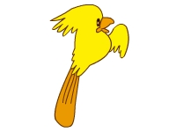

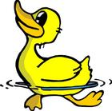
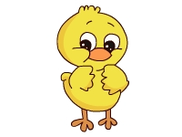
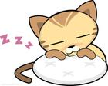

4). Play a game
What’s missing? 缺了谁
bird
fish
monkey
duck
chicken
cat

Slide 7
bird
monkey
rabbit
duck
cat
chicken

Slide 8

dog
rabbit
monkey
duck
cat
chicken

Slide 9

rabbit
dog
monkey
duck
bear
cat

Slide 10
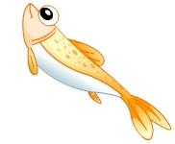
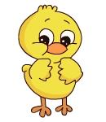
fish
dog
monkey
cat
rabbit
bird
bear
chicken
duck

Slide 11
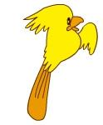
3). Check: connect with word and picture（把动物图片和相应的单词连线）
cat
monkey
fish
bird
duck
chicken

Slide 12

Rhyme time
Cats are cute, cats are fun,
Cats are friends for everyone.
Please, Mum, Please, Mum,
Can I have one ?
OK, son, OK, son,
You can have the little white one.

Slide 13
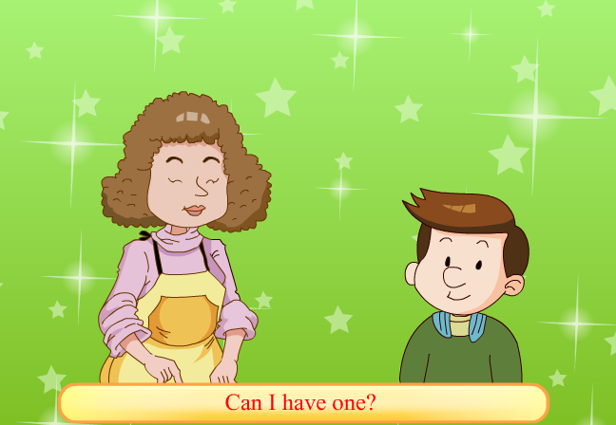

Slide 14
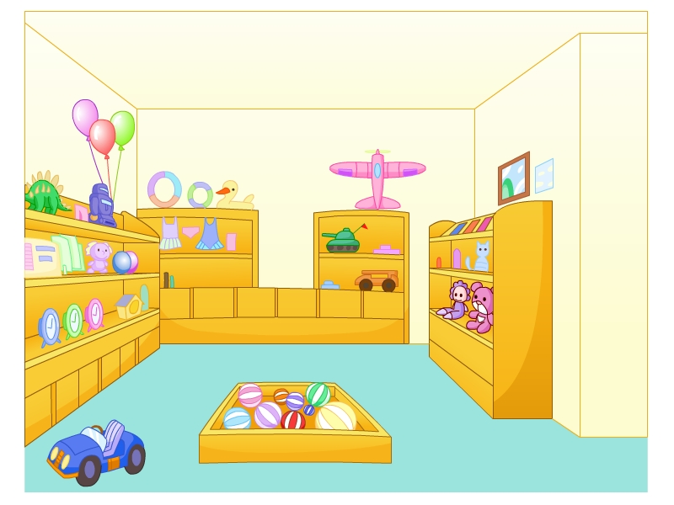
toy
shop

Slide 15
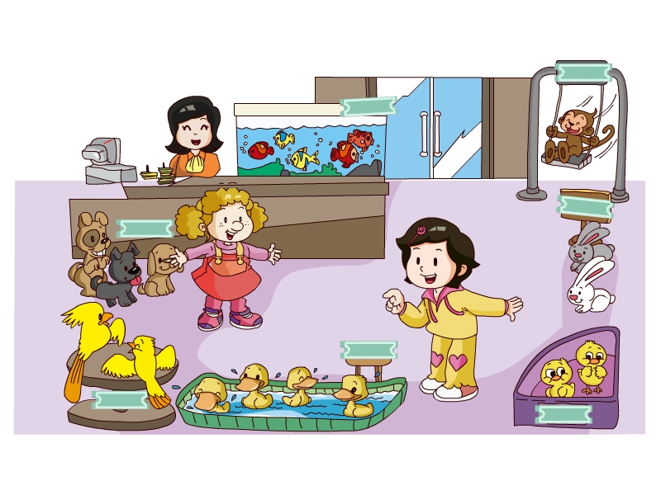
pet shop

Slide 16
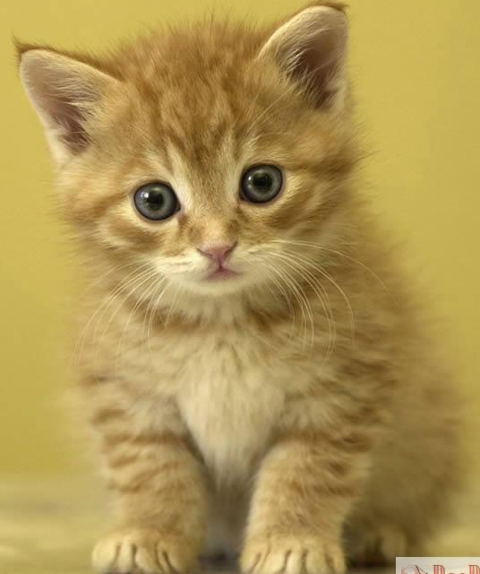
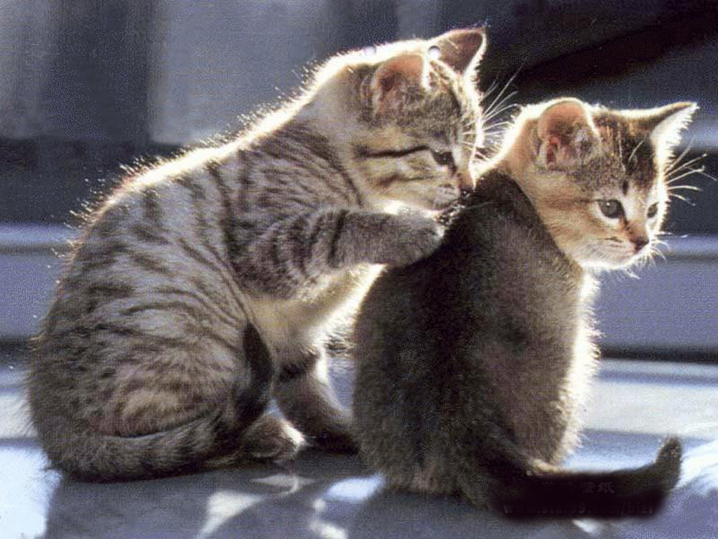
What’s that?
What are those?
a cat
cats

Slide 17
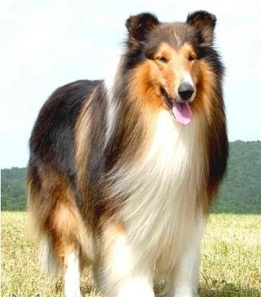
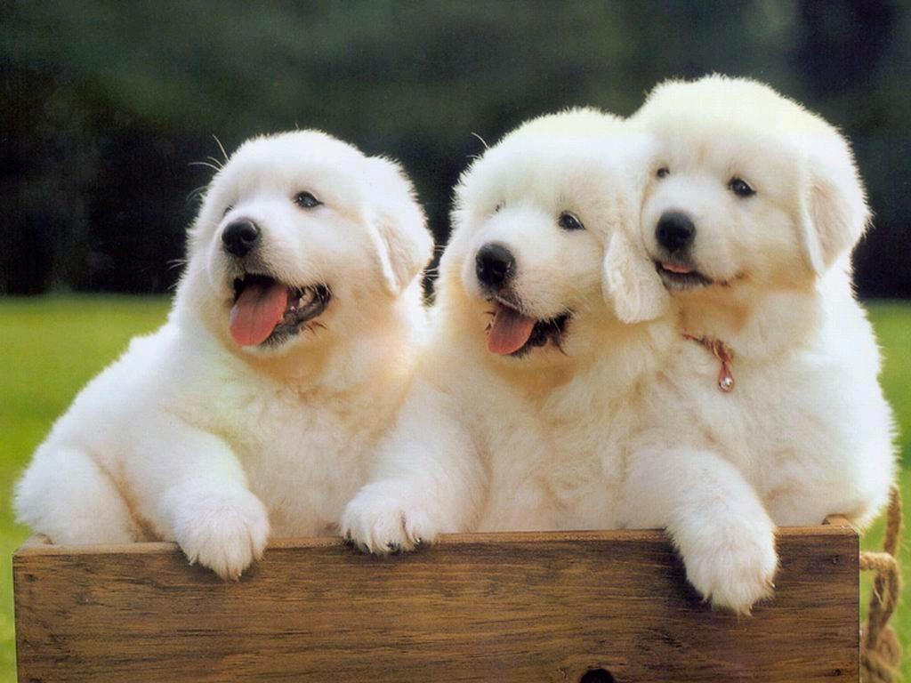
What’s that?
What are those?
a dog
dogs

Slide 18
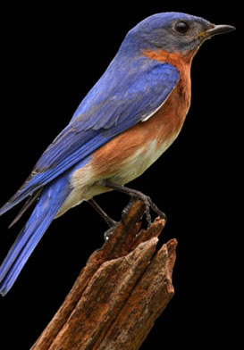
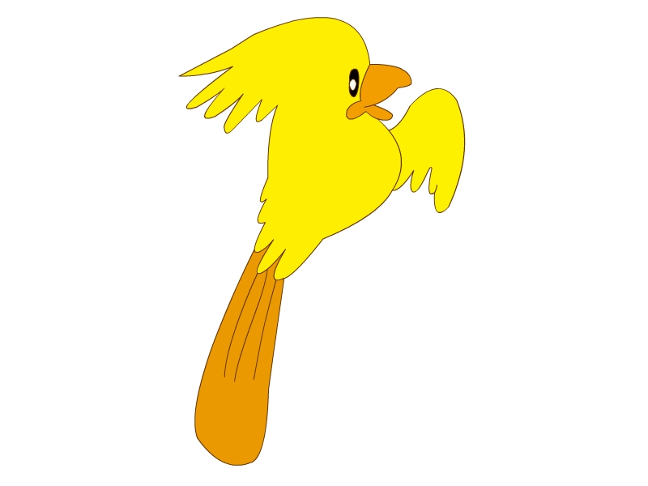
a bird
three birds

Slide 19
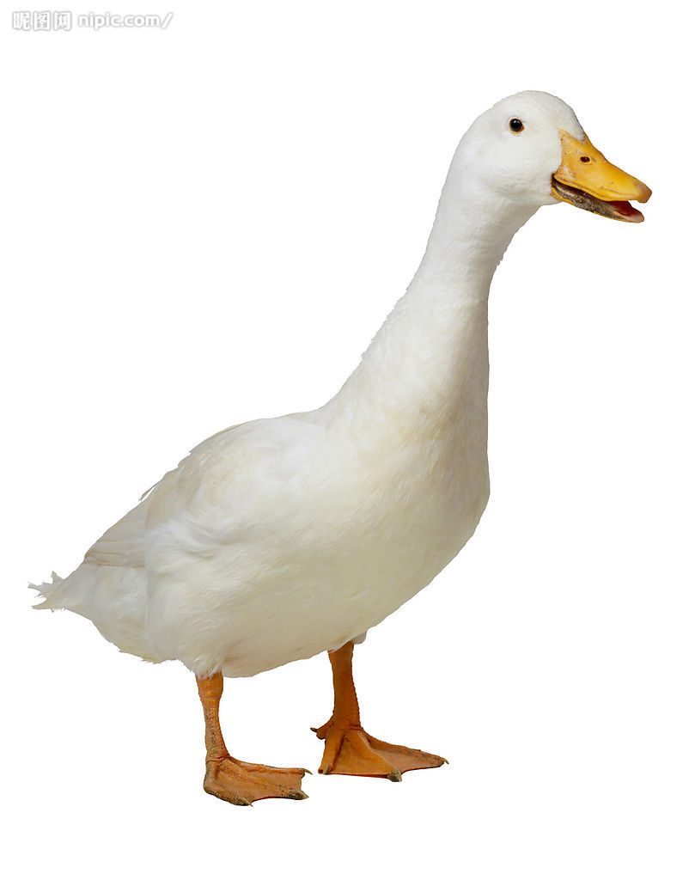
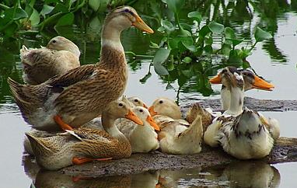
What’s that?
What are those?
a duck
ducks

Slide 20
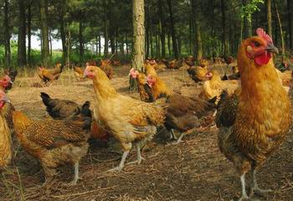
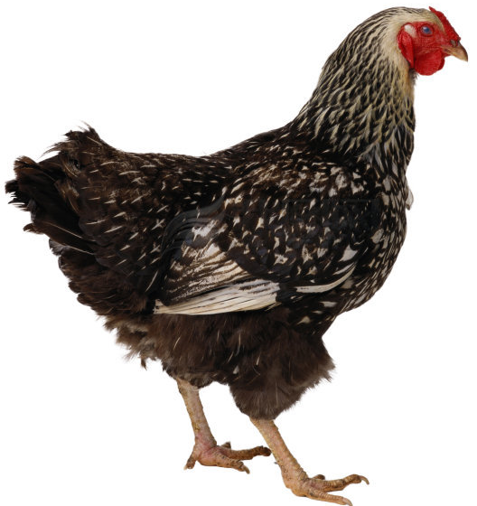
What’s that?
What are those?
a chicken
chickens

Slide 21
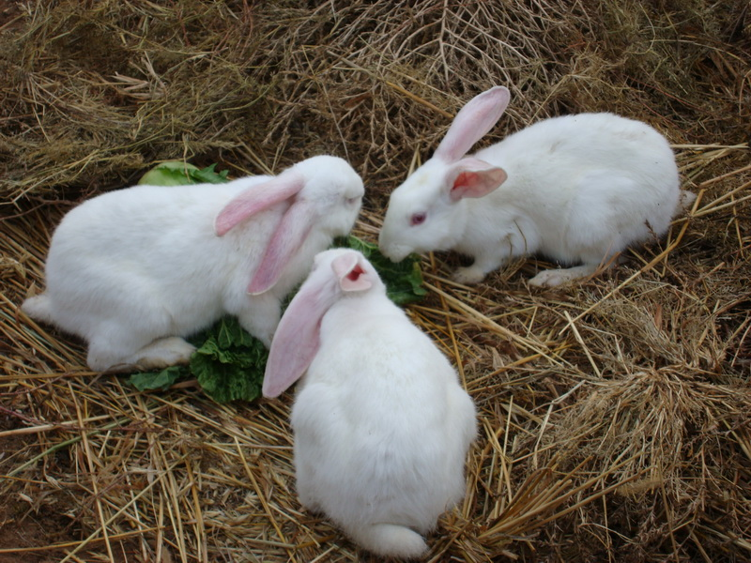
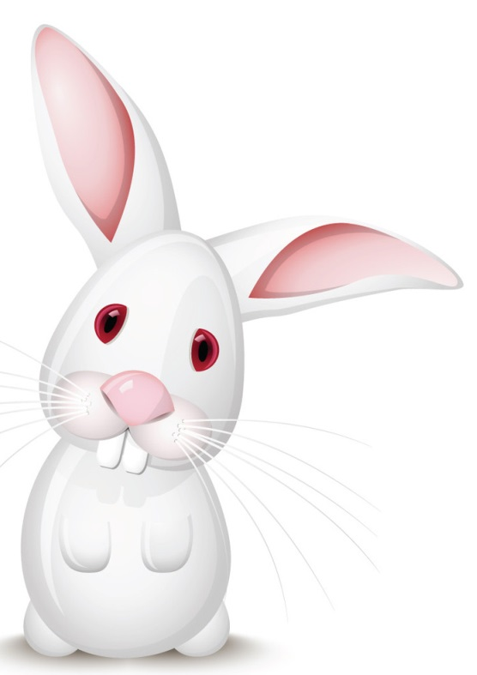
What’s that?
What are those?
a rabbit
rabbits

Slide 22
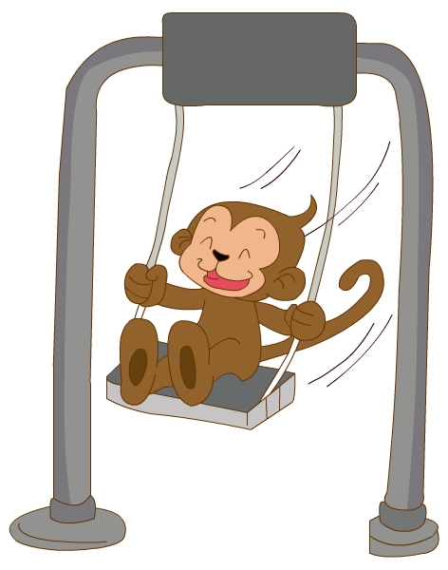
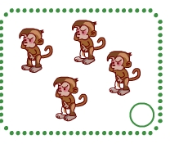
a monkey
four monkeys

Slide 23
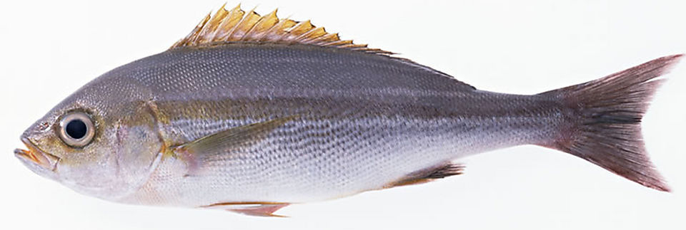
two
a fish

Slide 24
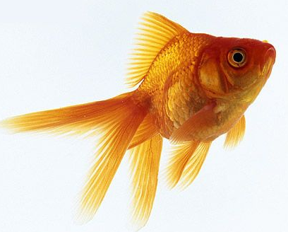
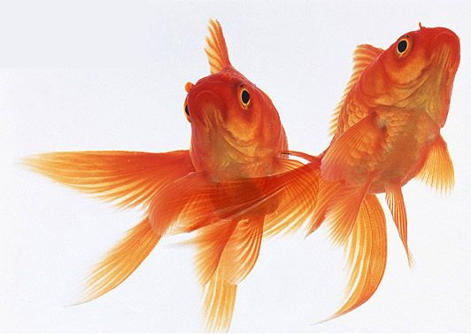
a goldfish
two goldfish

Slide 25
Let’s talk

Slide 26
Answer
Q1：Who are the two girls?
They are Janet and Xiaoling.
Q2: Where are they?
They’re in the shop.
Q3: Are there any cats in the shop?
No, there aren’t.
Q4: How many …are there in the shop?
There are….
Q5: So Janet wants to buy```
She wants to buy a duck.

Slide 27
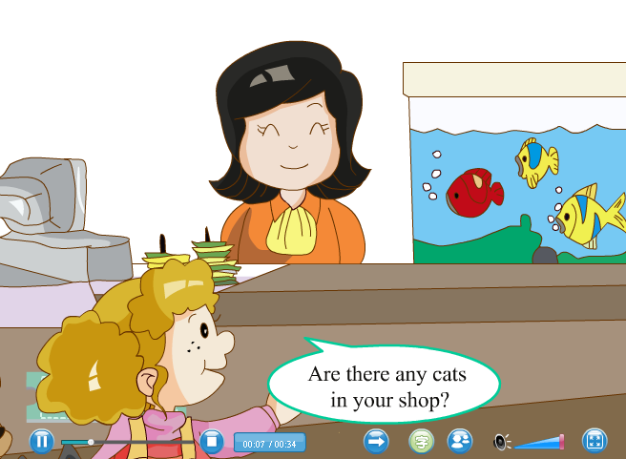

Slide 28
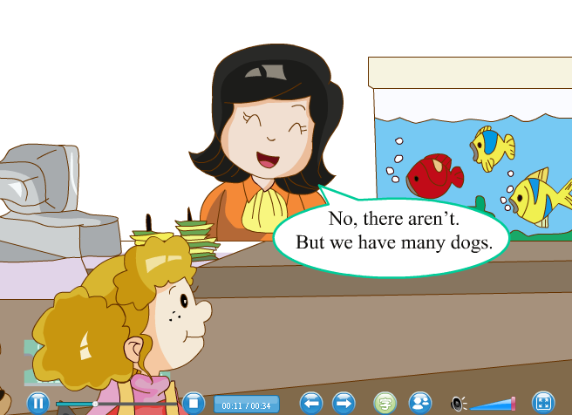

Slide 29
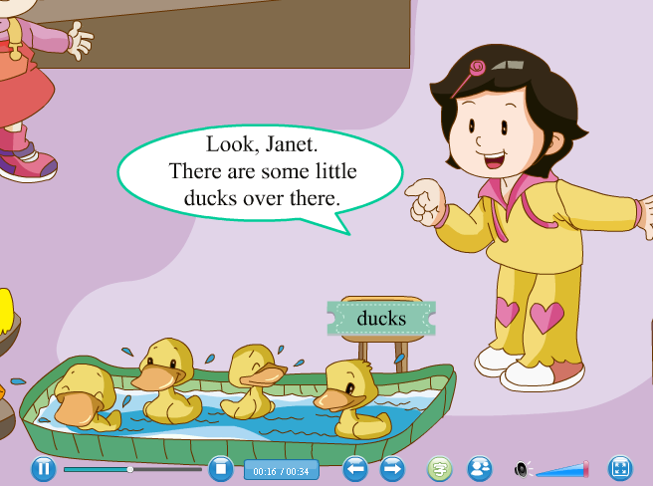

Slide 30
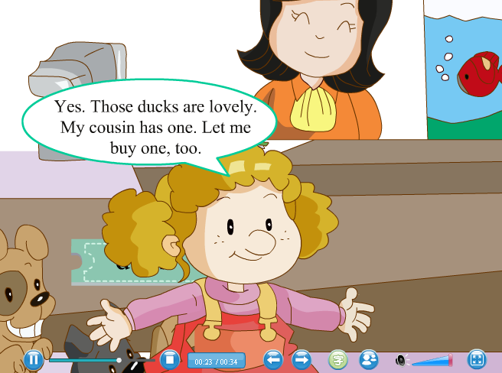

Slide 31
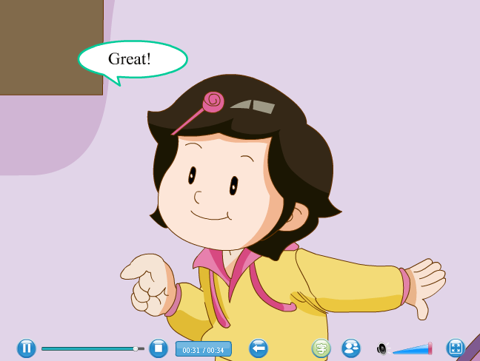

Slide 32
Is there a ……?
有用的句子
Yes , there is. 有
单数
No , there isn’t. 没有
Are there any ……s?
Yes , there are. 有
复数
No , there aren’t. 没有

Slide 33

some any
的用法

Slide 34
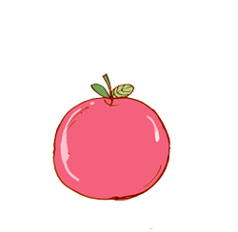
apples on the table.
There are some rabbits behind that box.
bananas in the basket .
books on the desk.

Slide 35
apples on the table?
Are there any rabbits behind that box?
bananas in the basket?
books on the desk?

Slide 36
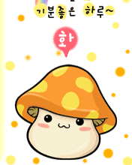
some 与any后面跟着可数名词复数，表示“一些···”。
some使用于肯定句中；
any使用于疑问和否定句中。

Slide 37
have/has的用法
I
you
they
we
复数
he
she
it
单数
have
has

Slide 38
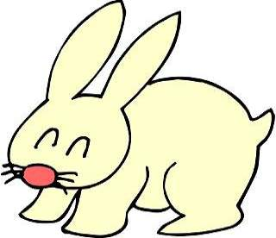
have
I a rabbit.

Slide 39

We a dog
have

Slide 40
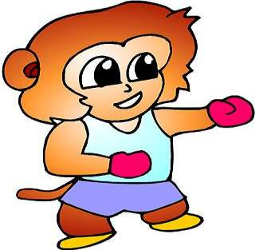
Oh! You a monkey.
have

Slide 41

They two birds.
have

Slide 42

He a cat.
has

Slide 43
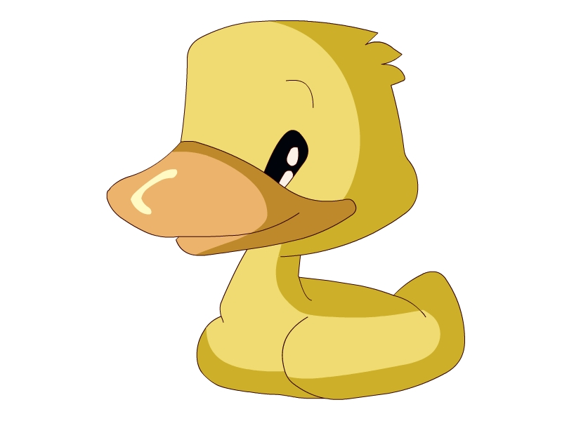
has
She a duck.

Slide 44

has
Look! It a big eye.

Slide 45

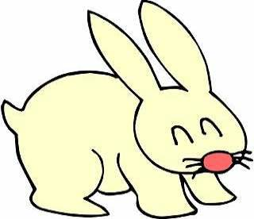
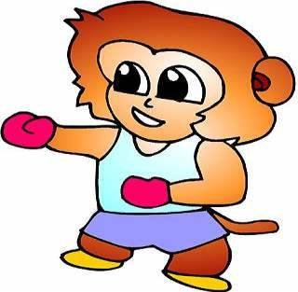
Ms. Xiao has many pets.
Ms. Xiao and Ms.Lin have many pets.

Slide 46
Homework 作业
1、完成书本P65 第4小题（做在书本上）。
2、完成书本P64第2小题，在英语练习本上回答这些问题。
3、读、背U11的课文和单词一次，明天堂听。

