Slide 1
Unit 1 Topic 2
The population in developing countries is growing faster.
Section A
WWW.PPT818.COM

Slide 2
Fill in the blanks with the different forms of the verbs.
e.g. jump—jumped—jumped
called called
hated hated
chatted chatted
were been
went gone
liked liked
watched watched
studied studied
was been
found found
made made
had had
call _______ _______ watch _______ _______
hate _______ _______ study _______ _______
chat _______ _______ am/is _______ _______
are _______ _______ find _______ _______
go _______ _______ make _______ _______
like _______ _______ have _______ _______

Slide 3
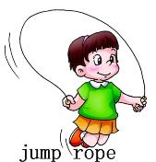
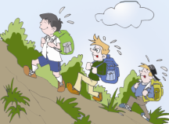
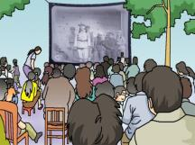
Make up conversations similar to the example with your partner.
ever
A: Have you ever jumped rope?
B: Yes. I have jumped rope.
/ No. I have never jumped rope.
never
chat online
go climbing
watch a movie in the open air

Slide 4
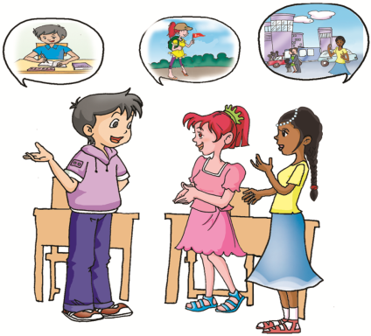
Where have they been in the holiday？
ever
Kangkang _____ ______ to an English summer school.
Jane _____ ______ to Mount Huang.
Maria _____ ______ to Cuba.
has been
has been
never
They have already come back.
has been
just
She has just come back.
already

Slide 5
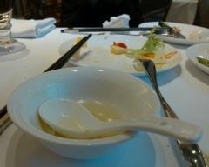
ever
Have you had supper yet?
I’m full. I have already had supper .
never
just
I’m hungry.
I haven’t had supper yet.
already
yet

Slide 6
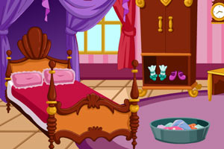
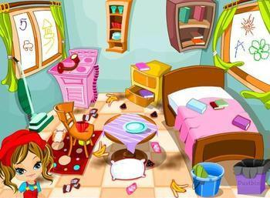
ever
Have you cleaned your room yet?
I have already cleaned it . It’s clean.
never
just
already
It’s very dirty. I haven’t cleaned it yet.
yet

Slide 7
ever
Fill in the blanks with the words
never
ever
A: Have you ______ been to France?
B: No, I’ve ______ been to any European countries,
but Michael has. He has ______ come back from
France. He likes it very much. He says he has
______ been to such a beautiful country before.
A: Have you seen him ______?
B: Yes, I have seen him ________.
never
just
just
never
already
yet
already
yet

Slide 8
1b Listen to 1a and mark T (True) or F (False).
1. Michael has just been to a shopping center.
2. Michael hates to go to the place because he
couldn’t buy anything.
3. Kangkang and Michael went back home
together.
4. Maria likes going there.
( )
( )
( )
( )

Slide 9
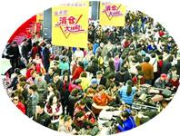
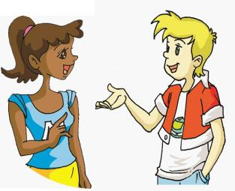
I really hate going to a place like that.
So do I.
= I hate going to a place like that, too.
A: Jane was late for school today.
B: Ann was late for school, too. =
So was Ann.
So + be/情态动词/助动词+主语

Slide 10
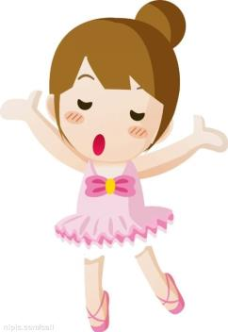
So do I.
I dance well.
— Lucy dances very well.
— ____________
A. So Lily is. B. So Lily does.
C. So is Lily. D. So does Lily.
D

Slide 11
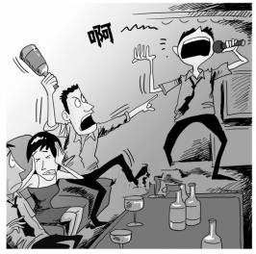
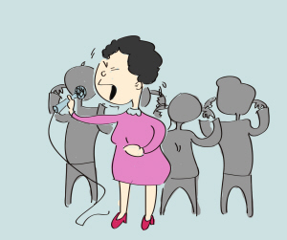
I am not good at singing.
Neither am I.
Neither / Nor + be/情态动词/助动词+主语
— Mr. Zhang is not good at singing .
— ____________
A. Neither is she. B. So does she.
C. So is she. D. Neither does she.
A

Slide 12
1c Read 1a and correct the five mistakes in the passage.
Michael and Kangkang have just gone to a shopping center. They
have never been there before, but they don’t want to go there some more
because there were such many people that they couldn’t find each
other. Michael hasn’t found Kangkang already. Maybe Kangkang has
been home already. Both Michael and Maria hate going to a place like
that.
1. been
2. _____
3. _____
4. _____
5. _____
any
so
yet
gone
Correcting a passage is a good way to develop writing skills.

Slide 13
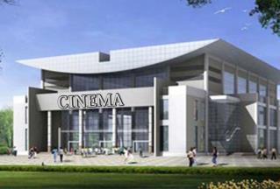
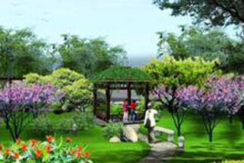
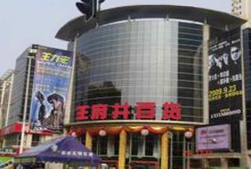
2 A. Look at the pictures and listen to the conversation. Then tick the places Steve has visited.
shopping center
cinema
central park
department store

Slide 14
B. Listen again and fill in the blanks. Then practice the conversation with your partner.
(Steve and Helen are talking on the phone.)
Steve: I have just been living here for a few days. Could you tell
me some interesting places around here?
Helen: Have you ______ been to the new shopping center?
Steve: No. I’ve ______ been there before. But I’ve ______ been to
a department store.
Helen: Then you can go there to do some shopping. By the way,
have you ______ been to the cinema nearby?
Steve: Yes, I’ve _______ watched a movie there. It is wonderful.
Helen: Have you been to the central park?
Steve: No, I haven’t been there ______.
Helen: Then, you can have a walk there.
Steve: Thank you.
ever
never
just
ever
already
yet

Slide 15
3 Read and understand the first sentence. Then complete the second one.
1. I always lose my way in New York.
I always _________in New York.
2. Yesterday Maria made a telephone call to Michael,
but he wasn’t at home.
Yesterday Maria _______ Michael ____, but he
wasn’t ____.
3. Mr. Brown is such a kind teacher that we all like him.
This teacher is so _____ that we all like him.
4. I don’t like to go to such a crowded place.
I _____ going to a crowded place _____ this.
get lost
called
up
in
kind
hate
like

Slide 16
Exercises
Choose the best answer.
1. — Have you returned the book _______?
— Yes, I’ve _______ returned it.
A. already, already B. yet, yet
C. yet, just D. just, already
2. Jim, Maria _______ just now, but you were not at home.
A. called up you B. called you up
C. calls up you D. calls you up
3. — I find it very important to learn English well.
— _______.
A. So I am B. So do I C. So I do D. So am I
4. China is _______ that my mother likes it very much.
A. such beautiful a country
B. so a beautiful country
C. such a country beautiful
D. such a beautiful country
C
B
B
D

Slide 17
Exercises
Complete the following sentences.
1. She’s already been to Beijing. (改为一般疑问句)
________ she ________ to Beijing ________?
2. I have seen the film. (改为否定句)
I ________ ________ the film.
3. Kate will read this book no more. (改为同义句)
Kate ________ read this book _______ _______.
4. 孩子们在动物园里迷路了。
The children _______ _______ ________ in the zoo.
Has been yet
haven’t seen
won’t any more
lost their way

Slide 18
summary
1. Some words:
yet, probably, cinema, department, nearby
2. Some phrases:
not…any more, get lost, lose one’s way, call sb. up,
make a telephone call to sb. , department, store
3. Some sentences:
Have you found him yet?
So do I.
We learn:
We can:
Use the Present Perfect Tense with just, already, yet, ever and never.

Slide 19
Homework
1. Read 1a aloud.
2. Make five sentences , using ever, never, yet, already and just.
3. Finish Section A in your workbook.
4. Preview Section B.

