Slide 1
Unit 6 Birdwatching
第5课时
WWW.PPT818.COM

Slide 2
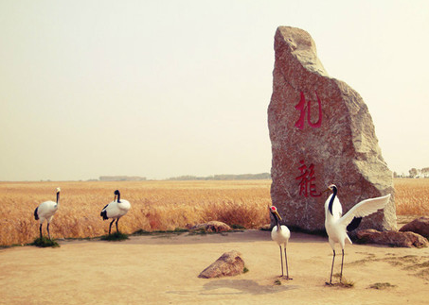
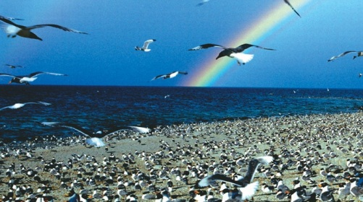
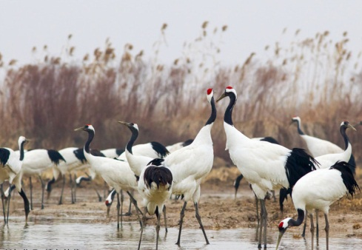
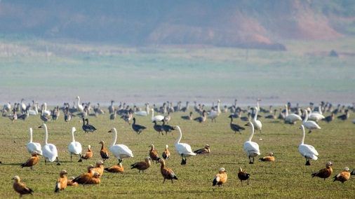
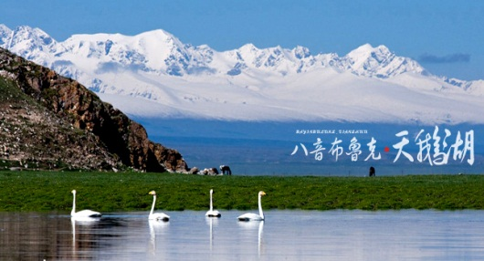
我国的鸟类自然保护区
青海湖鸟岛自然保护区
黑龙江扎龙丹顶鹤保护区
盐城丹顶鹤自然保护区
江西鄱阳湖越冬候鸟保护区
新疆巴音布鲁克天鹅保护区

Slide 3
Integrated skills
A Yancheng Nature Reserve
A1)Daniel found a quiz about the wetlands in Jiangsu Province on the website of the Birdwatching Society. Read the quiz below and help him choose the correct answer to each question.

Slide 4
Facts about Yancheng Nature Reserve
1. Yancheng Nature Reserve is in _______Province in _______ China.
a. Heilongjiang, North­east b. Hainan, South c. Jiangsu, East
2. Yancheng Nature Reserve is a perfect place to ________．
a. buy the birds b. hunt the birds c. watch the birds
3. The reserve covers an area of over ________ square kilometres.
a. 453 b. 4，530 c. 45，300
c
c
b

Slide 5
4. Yancheng is the ________ home to red­crowned cranes in China.
a. largest b. second largest c. third largest
5. About _______ red­crowned cranes fly to Yancheng Nature Reserve every year to spend the winter.
a. 100 to 300 b. 300 to 1,000 c. 1,000 to 3,000
6. In ________， Yancheng Nature Reserve became one of the world's most important wetlands.
a. 1997 b. 2002 c. 1992
b
b
b

Slide 6
A2)The Class 1, Grade 8 students are now listening to the first part of a radio programme. Check whether you chose the correct answers in Part A1.

Slide 7
A3)Daniel is writing a report on Yancheng Nature Reserve. Listen to the whole radio programme and help him complete the report.
Yancheng Nature Reserve is in Jiangsu Province in (1)________ China. It covers an area of over (2) _______ square kilometres. It became one of the world‘s most important wetlands in (3) ________.
Yancheng Nature Reserve is home to different kinds of plants and rare birds. There are not many (4)___________________ in the
East
4,530
2002
red-crowned cranes

Slide 8
world, but there are some in Yancheng Nature Reserve. It is a perfect place to go (5)______________. People celebrate World Wetlands Day on (6)____________ each year. We should protect the wetlands not only because they are home to many plants, birds and (7)________, but also because they are important to the (8)________ of people all over the world.
birdwatching
2 February
animals
health

Slide 9
知识点
advice / əd'vaɪs/ n. 建议；不可数名词
1
a piece of advice一条建议
/ two pieces of advice 两条建议
拓展
information 信息 news消息 与advice一样，都为不可数名词：a piece of information/ news
advise v. 建议，劝告 advise sb. (not) to do sth.

Slide 10
知识点
cover an area of... “占地面积……”
2
与“be＋面积＋in area”同义。
eg: The national park covers an area of about 100 square kilometers.＝The national park is about 100 square kilometers in area.
这个国家公园的占地面积约为100平方千米。

Slide 11
知识点
3
tour /tʊə(r)/ n．旅行
eg: They are on a wedding tour.
他们正在新婚旅游。
考向
tour后加­-ist变成表示人的名词。
英语中类似的词还有： art→artist等。

Slide 12
Study skills
The suffixes ­-er, ­-or and -­ist
We can add ­-er, ­-or and ­-ist to some words to form nouns for people.
Verb/Noun ＋ Suffix → Noun
speak ＋ er → speaker
visit ＋ or → visitor
tour ＋ ist → tourist

Slide 13
A)Change the following words into nouns for people by adding the correct suffixes. You may use a dictionary to help you.
1 act ________
2 art ________
3 drive ________
4 farm ________
5 paint ________
6 play ________
7 report ________
8 science ________
9 work ________
10 write ________
actor
player
artist
reporter
driver
scientist
farmer
worker
painter
writer

Slide 14
B)Complete the following sentences with the correct nouns of the words in brackets. Use the plural form if necessary.
Birds are ________ (sing). They can make beautiful sounds. Some ________ (act) can make different bird sounds. It is very interesting.
A lot of ________ (tour) go to the wetlands to watch the birds every year. There are many ________ (visit) at bird shows too. Some ________ (art) like to paint birds. The birds in their pictures are really beautiful. Some ________ (write) like to include birds in their poems too.
Birds are part of our lives. They are our friends.
singers
actors
tourists
visitors
artists
writers

Slide 15
用所给词的适当形式填空
1．Cranes are not only beautiful singers but also wonderful ________(dance)．
2．Many Chinese ________(art) like to paint cranes and pines (松树) together.
3．Some French ________(visit) are going birdwatching with us next week.
4．A ________(write) called Jiang Rong wrote the book.
dancers
artists
visitors
writer

Slide 16
5．David Beckham is one of the greatest football ________ (play)in the world.
6．My parents hope I can be a ________(science) when I grow up.
7．We were the ________(win) of the basketball match last week.
8．A ________(report) from CCTV is interviewing a number of students in our school.
players
scientist
winners
reporter

Slide 17
9．Local ________(farm) are happy with that policy.
10．The ________ (speak) is giving us a talk on how to learn English well.
farmers
speaker

Slide 18
本节课主要学习了以下知识点，请同学们及时巩固练习：
advice ，tour
cover an area of...

