Slide 1
陕旅版英语五年级上册
Unit8 Where Are You from?
第3课时
WWW.PPT818.COM

Slide 2
教学目标
1. 能听懂、会说、会用句型Where do you come from? I come from… Australia is
far away. Is it far from here? Not very far.
2. 复习前两节所学的四会词汇和重点句型，能在教师创设的情境下进行问答，熟练运用所学知识。
3. 能在教师的引导下，完成Part B Let’s play部分的活动。

Slide 3
游戏玩法：教师发问：Where are you from? 并把小纸袋丢出去给任意一个学生，接到小纸袋的学生抽出一张纸片，并根据该纸片上的国旗卡片回答：I’m from...答对问题后该学生把小纸袋丢出去给另一个学生，并继续发问：Are you from China? Where are you from? 超时或答错则被判出局。
Let’s play a game

Slide 4
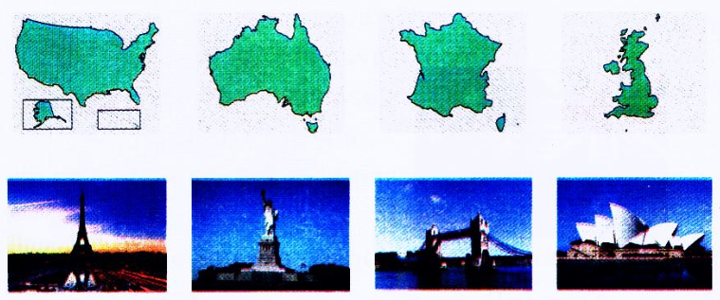
Think and match

Slide 5
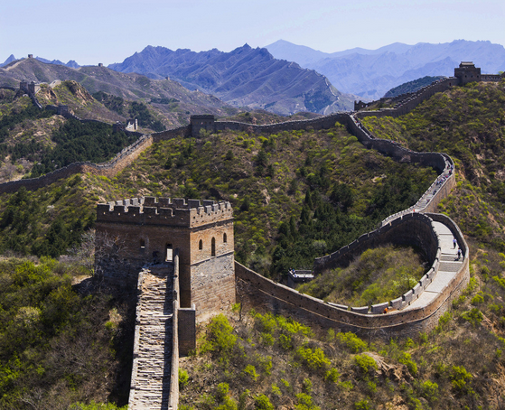
What’s this?
教师可采用让学生提问老师的方式导入本节课的新授内容

Slide 6
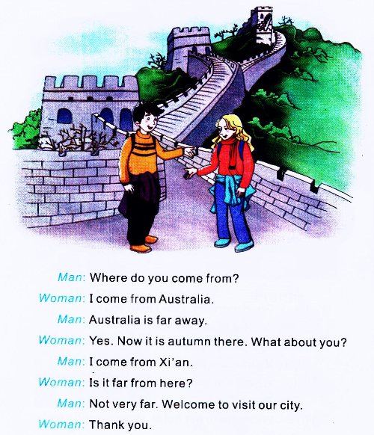
Let’s learn more
Q1: Where does the woman come from?
Q2: Is Australia far from here?
Q3: What’s the season now in Australia?
Q4: Where does the man come from?
Q5: Is Xi’an far from here?

Slide 7
听对话，并模仿其语音语调跟读课文

Slide 8
Let’s answer the questions
Q1: Where does the woman come from?
Q2: Is Australia far from here?
Q3: What’s the season now in Australia?
Q4: Where does the man come from?
Q5: Is Xi’an far from here?

Slide 9
Role play
A: Where do you come from?
B: I come from…
A: What about you?
B: I come from…

Slide 10
Let’s make
制作一张关于各自家乡的手抄报，要求图文并茂。提示：
(1) 准备A3纸一张，写上主题：My Hometown。
(2) 收集一些典故、代表建筑、风俗习惯、风味小吃的图片。
(3) 用几句简单的英语对家乡做个描述或评价。如：It’s a big / small city. It’s a small town. It’s near / far from the city. It’s beautiful. I love my hometown.等。

Slide 11
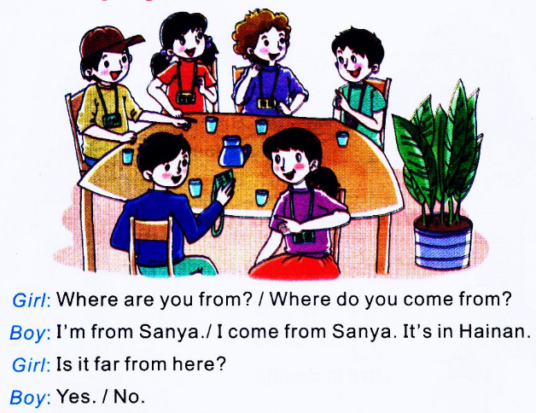
Part B Let’s play

