Slide 1
Unit3 What subject do you like best?
人教精通版四年级下册
WWW.PPT818.COM

Slide 2
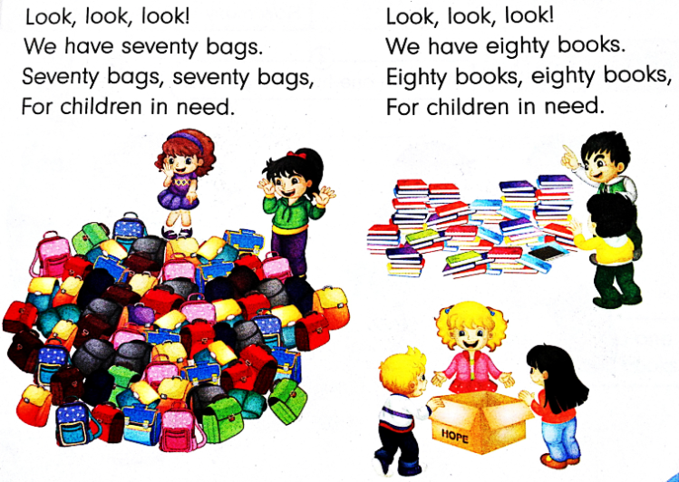
Warm-up
Let’s sing

Slide 3
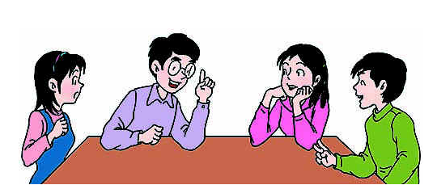
Lead-in
Free talk
Do you like reading books?
How many books do you have?
What are they?

Slide 4
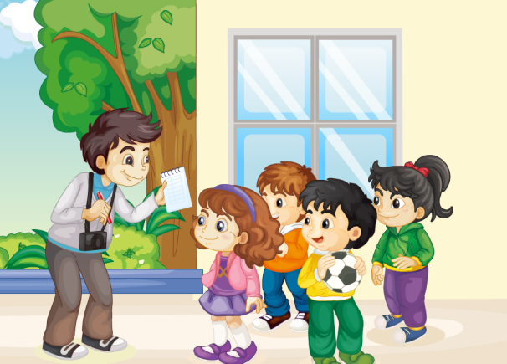
Presentation
Who is the man?
What does he want to know?

Slide 5
Presentation
1. How many lessons do they have today?
They have six.
2. How many lessons do they have in the
morning?
They have four.
3. What are they?
They are maths, Chinese, English and PE.

Slide 6
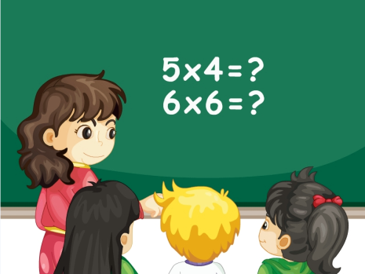
Presentation
Key points
How many maths lessons do you have today?
maths

Slide 7
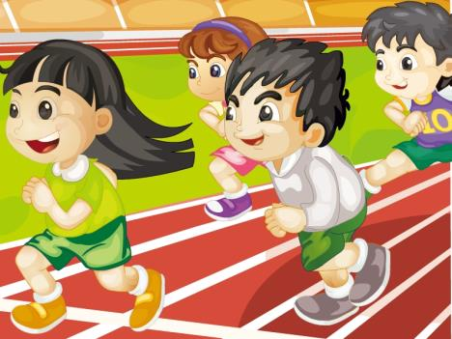
Presentation
Key points
How many PE lessons do you have today?
PE
(Physical Education)

Slide 8
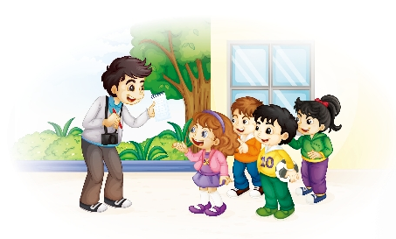
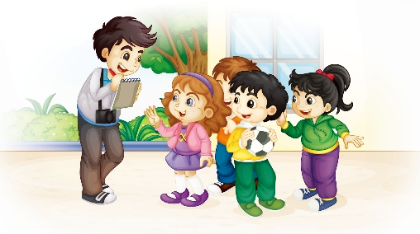
Presentation
Look and read
How many lessons do you have today?
We have six.
How many lessons do you have in the morning?
We have four.
What are they?
They’re maths, Chinese, English and PE.

Slide 9
Presentation
Listen and read
 | How many lessons do you have today?
 | We have six.
 | How many lessons do you have in the morning?
 | We have four.
 | What are they?
 | They’re maths, Chinese, English and PE.

Slide 10
Practice
Super Mary:表演我最棒！
小组合作：
1.三人一小组
2.根据剧本分角色练习
3.适当加上一些动作辅助表演

Slide 11
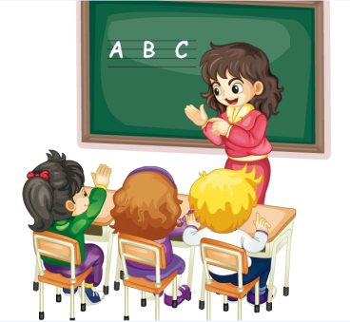
Practice
Think and say
How many English lessons do you have in the morning？
We have ...

Slide 12
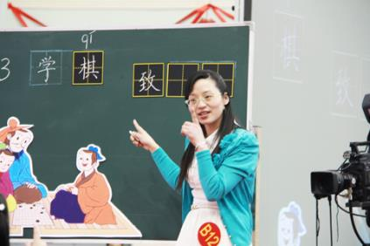
Practice
Think and say
How many Chinese lessons do you have in the morning？
We have ...

Slide 13
Practice
Let’s do a survey
We have four.
How many lessons do you have in the morning?

Slide 14
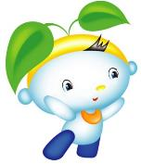
Summary
1. 本课的重点单词：
maths
PE (Physical Education)
2. 本课的重点句型：
—How many lessons do you have
in the morning?
—We have … They are …

Slide 15
Homework
跟读课文Just talk部分的录音，注意语音、语调。
在四线三格中正确抄写本课对话，不少于3遍。
预习Lesson 14。
Close

