Slide 1
2 0 3 0
岗位竞聘简历
GANG WEI JING PIN JIAN LI MU BAN
竞聘人：PPT818 时间：2030.12.12

Slide 2
前 言
我是一个爱学习，有计划，乐观向上的人。拥有较强的自制能力和适应能力，并且有较强的管理策划与组织管理协调能力
The user can demonstrate on a projector or computer, or print the presentation and make it into a film to be used in a wider field

Slide 3
目 录
CONTENTS
个人简介
工作成效
履职能力
未来规划
GANG WEI JING PIN
GANG WEI JING PIN
GANG WEI JING PIN
GANG WEI JING PIN

Slide 4
0 1
个人简介
GANG WEI JING PIN

Slide 5
姓 名：包小图
学 历：大学本科
专 业：信息技术开发
通讯地址：上海市虹口区某某路888号
政治面貌：中国共产党员
自我评价：我是一个爱学习，有计划，乐观向上的人。拥有较强的自制能力和适应能力，并且有较强的管理策划与组织管理协调能力
包小图
BAO XIAO TU

Slide 6
个人简介
GANG WEI JING PIN
岗位经历
岗位经历
The user can demonstrate on a projector or computer, or print the presentation and make it into a film to be used in a wider field
The user can demonstrate on a projector or computer, or print the presentation and make it into a film to be used in a wider field
2017-2018
2018-2019
2019-2020
2020-2021
岗位经历
岗位经历
The user can demonstrate on a projector or computer, or print the presentation and make it into a film to be used in a wider field
The user can demonstrate on a projector or computer, or print the presentation and make it into a film to be used in a wider field

Slide 7
个人简介
GANG WEI JING PIN
65%
创新能力
50%
策划能力
82%
执行能力
43%
管理经验

Slide 8
个人简介
GANG WEI JING PIN
所获荣誉
The user print the presentation and make it into a film to be used in a wider field
所获荣誉
The user print the presentation and make it into a film to be used in a wider field
所获荣誉
The user print the presentation and make it into a film to be used in a wider field
所获荣誉
所获荣誉
The user print the presentation and make it into a film to be used in a wider field
The user print the presentation and make it into a film to be used in a wider field

Slide 9
个人简介
GANG WEI JING PIN
岗位经历
The user can demonstrate on a projector or computer, or print the presentation and make it into a film to be used in a wider field
岗位经历
The user can demonstrate on a projector or computer, or print the presentation and make it into a film to be used in a wider field
岗位经历
The user can demonstrate on a projector or computer, or print the presentation and make it into a film to be used in a wider field

Slide 10
0 2
工作成效
GANG WEI JING PIN

Slide 11
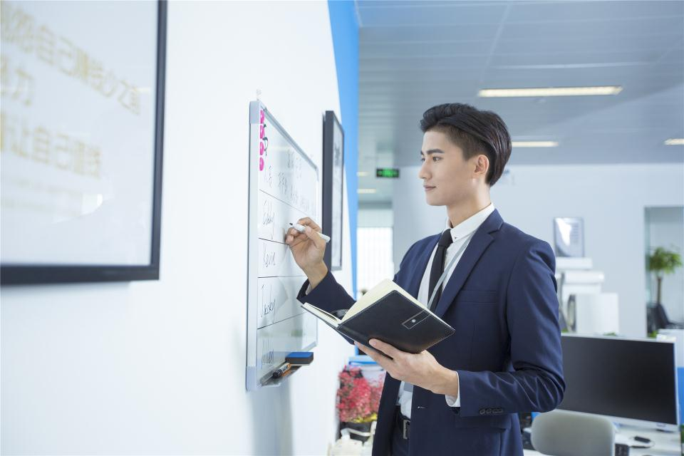
工作成效
GANG WEI JING PIN
持续学习
逐步成熟
The user can demonstrate on a projector or computer, or print the presentation and make it into a film to be used in a wider field
The user can demonstrate on a projector or computer, or print the presentation and make it into a film to be used in a wider field

Slide 12
工作成效
GANG WEI JING PIN
工作成效
工作成效
The user print the presentation and make it into a film to be used in a wider field
The user print the presentation and make it into a film to be used in a wider field
工作成效
The user print the presentation and make it into a film to be used in a wider field

Slide 13
工作成效
GANG WEI JING PIN
工作成效
工作成效
The user print the presentation and make it into a film to be used in a wider field
The user print the presentation and make it into a film to be used in a wider field
工作成效
工作成效
The user print the presentation and make it into a film to be used in a wider field
The user print the presentation and make it into a film to be used in a wider field
工作成效
工作成效
The user print the presentation and make it into a film to be used in a wider field
The user print the presentation and make it into a film to be used in a wider field

Slide 14
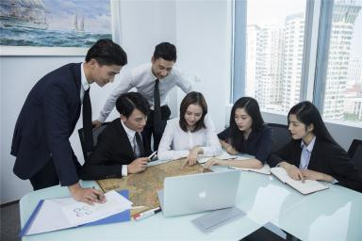
工作成效
GANG WEI JING PIN
工作成效
工作成效
工作成效
工作成效
The user print the presentation and make it into a film to be used in a wider field
The user print the presentation and make it into a film to be used in a wider field
The user print the presentation and make it into a film to be used in a wider field
The user print the presentation and make it into a film to be used in a wider field

Slide 15
0 3
履职能力
GANG WEI JING PIN

Slide 16
履职能力
GANG WEI JING PIN
履职能力
The user print the presentation and make it into a film to be used in a wider field
履职能力
The user print the presentation and make it into a film to be used in a wider field
履职能力
The user print the presentation and make it into a film to be used in a wider field

Slide 17
履职能力
GANG WEI JING PIN
履职能力
The user can demonstrate on a projector or computer, or print the presentation and make it into a film to be used in a wider field
The user can demonstrate on a projector or computer, or print the presentation and make it into a film to be used in a wider field
履职能力
履职能力
The user can demonstrate on a projector or computer, or print the presentation and make it into a film to be used in a wider field
The user can demonstrate on a projector or computer, or print the presentation and make it into a film to be used in a wider field
履职能力

Slide 18
履职能力
GANG WEI JING PIN
履职能力
The user print the presentation and make it into a film to be used in a wider field
履职能力
The user print the presentation and make it into a film to be used in a wider field
履职能力
履职能力
The user print the presentation and make it into a film to be used in a wider field
The user print the presentation and make it into a film to be used in a wider field

Slide 19
履职能力
GANG WEI JING PIN
工作成效
工作成效
70
90
The user print the presentation and make it into a film to be used in a wider field
The user print the presentation and make it into a film to be used in a wider field
工作成效
50
30
工作成效
The user print the presentation and make it into a film to be used in a wider field
The user print the presentation and make it into a film to be used in a wider field

Slide 20
0 4
未来规划
GANG WEI JING PIN

Slide 21
未来规划
GANG WEI JING PIN
工作成效
工作成效
The user print the presentation and make it into a film to be used in a wider field
The user print the presentation and make it into a film to be used in a wider field

Slide 22
未来规划
GANG WEI JING PIN
未来规划
未来规划
The user print the presentation and make it into a film to be used in a wider field
The user print the presentation and make it into a film to be used in a wider field
未来规划
未来规划
The user print the presentation and make it into a film to be used in a wider field
The user print the presentation and make it into a film to be used in a wider field
未来规划
未来规划
The user print the presentation and make it into a film to be used in a wider field
The user print the presentation and make it into a film to be used in a wider field

Slide 23
未来规划
GANG WEI JING PIN
未来规划
The user print the presentation and make it into a film to be used in a wider field
未来规划
The user print the presentation and make it into a film to be used in a wider field
未来规划
The user print the presentation and make it into a film to be used in a wider field

Slide 24
未来规划
GANG WEI JING PIN
Regular | Professional | Promotion | SoHo | Advance
First Service | First Service | First Service | First Service | First Service
- | Second Service | Second Service | Second Service | Second Service
- | - | Third Service | Third Service | Third Service
- | - | - | Fourth Service | Fourth Service
- | - | - | Fifth Service | Fifth Service
- | - | - | - | Sixth Service
- | - | - | - | Seventh Service
$15 | $29 | $39 | $49 | $199

Slide 25
2 0 3 0
感谢您的观看
GANG WEI JING PIN JIAN LI MU BAN
竞聘人：PPT818 时间：2030.12.12

