Slide 1
How was your school trip?
Section B 第2课时
WWW.PPT818.COM

Slide 2
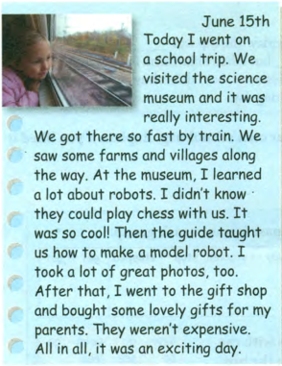
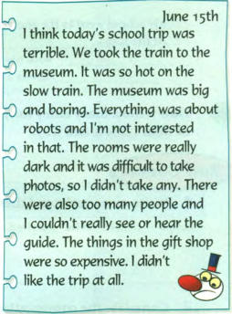

Slide 3
June 15th
Today I went on a school trip. We visited the science museum and it was really interesting.
We got there so fast by train. We saw some
farms and villages along the way. At the museum, I learned a lot about robots. I didn’t know they could play chess with us. It was so cool! Then the guide taught us how to make a model robot. I took a lot of great photos, too. After that, I went to the gift shop and bought some lovely gifts for my parents. They weren’t expensive. All in all, it was an exciting day.
1. learn about：“了解，知道，
获悉”，指学习关于某一方面的知识。
2. teach sb. sth. 教某人某事
teach sb. to do sth. 教某人做某事
Our English teacher teaches us to learn English.
3.“疑问词+不定式动词” 结构，
做宾语成分。
I don’t know what to do next.

Slide 4
June 15th
I think today’s school trip was terrible. We took the train to the museum. It was so hot on the slow train. The museum was big and boring. Everything was about robots and I’m not interested in that. The rooms were really dark and it was difficult to take photos, so l didn’t take any. There were also too many people and I couldn’t really see or hear the guide. The things in the gift shop were so expensive. I didn’t like the trip at all.
1. be interested in ( doing ) sth.
对（做）某事感兴趣
He is interested in playing football.
2. It is + adj. (for sb.) to do sth.
(对某人来说)做… 怎么样
It is easy for me to go to school by bike.
3.take photos拍摄、摄影
表示拍摄某人或物时，要在短语后面接介词“of“引入所拍摄的对象。
Let me take a picture of that house.

Slide 5
根据汉语提示补全句子
1. We saw some farms and villages______ ____ _____ .（沿着路）
2. I didn’t know they ______ _____ _____with us. （会下棋）
3. I went to the gift shop and _______ ____ _____ _____ ___my parents.
（给…买一些可爱的礼物）
4. I think ______ _____ _____was terrible.（今天的 学校郊游）
along the way
could play chess
bought some lovely gifts for
today’s school trip

Slide 6
单项选择
1. _____ the museum, I learned a lot _________ robots.
A. At, for B. At, about C. On, for D. On, about
2. My father ___________ English last year.
A. teaches us B. teaches our C. taught us D. taught our
3. Last year, he didn’t know how ___________ a model robot.
A. made B. make C. makes D. to make
B
C
D

Slide 7
短语
learn about
be interested in
take photos
teach sb. to do sth.
句型和语法
It is + adj. (for sb.) to do sth.
疑问词+不定式动词” 结构

