Slide 1
Unit6 Would you like to take a trip?
人教精通版四年级下册
WWW.PPT818.COM

Slide 2
Review
Let’s sing

Slide 3
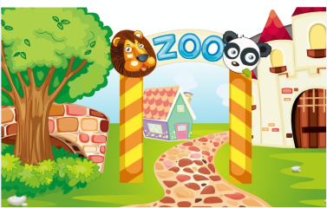
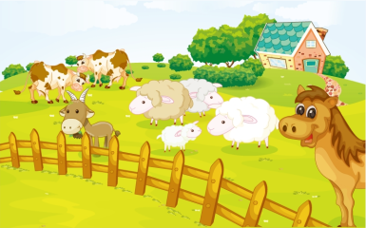
Review
Would you like to take a trip?
Where shall we go?
We want to go to …
zoo
farm

Slide 4
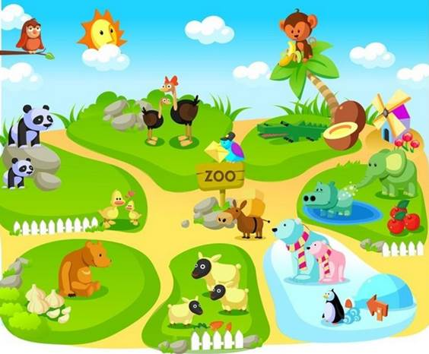
Lead-in
Look and say
What animals can you see in the zoo?

Slide 5
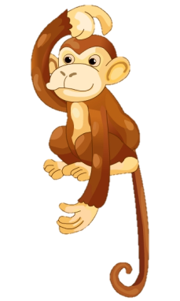
Presentation
What’s this in English?
panda
monkey
It’s a _____.
It’s a ______.

Slide 6
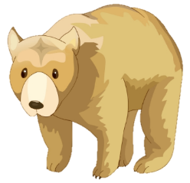
Presentation
What’s this in English?
bear
tiger
It’s a _____.
It’s a ______.

Slide 7
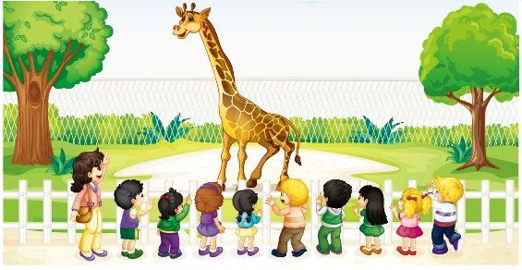
Presentation
Look and say
It’s a sunny day. The teacher and her class are in the zoo. What are they looking at?

Slide 8
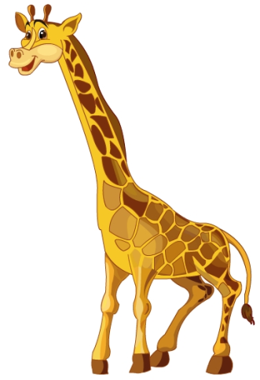
Presentation
What’s this in English?
It’s a giraffe.

Slide 9
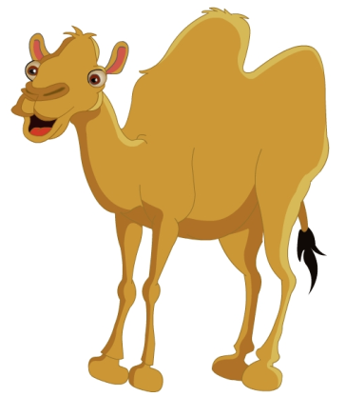
Presentation
What’s this in English?
It’s a camel.

Slide 10
Presentation
Let’s learn
1
Come along, boys and girls!
2
5
Wow! What’s this in English?
Yes, it has a long neck.
Hooray!
Hooray!
Hooray!
Hooray!
Look! The giraffe is so tall!
Hooray!
It’s a giraffe.
Hooray!
3
4

Slide 11
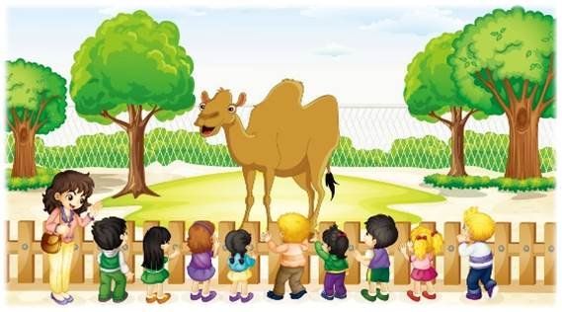
Presentation
Let’s learn
6
Look! Miss Liu. What’s this in English?
7
8
It’s a camel.
Oh, the camel is so big!

Slide 12
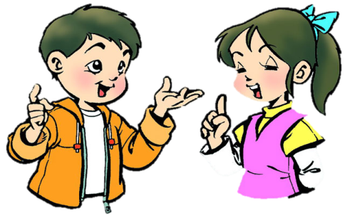
Practice
Role-play
分角色朗读对话，注意模仿语音语调。
小组合作，试着表演出来吧。

Slide 13
Practice
Read it by groups for one minute .
小组读对话一分钟。
一分钟倒计时
60
Learning tip :
50
10
10
四人一组，比赛读句子，看谁能在一分钟内读完，并且读得准确、流利！
20
20
40
30
30
开始

Slide 14
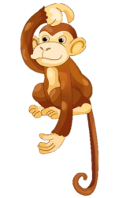
Practice
Game
What’s missing?

Slide 15
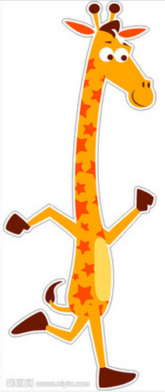
Practice
Look and write
Look at the _______.
It is _________.
It has __________.
It can __________.
giraffe
so tall
long neck
dance

Slide 16
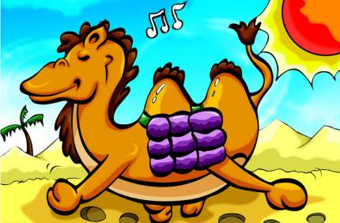
Practice
Look and write
Look at the ______.
It is _________.
It has __________.
It can __________.
camel
so big
small ears
sing

Slide 17
Practice
Let’s chant

Slide 18
Summary
本课学到的重点单词：
panda
bear
monkey
tiger
camel
giraffe

Slide 19
Summary
本课学到的重点句型：
—What’s this in English?
—It’s a/an …

Slide 20
Homework
1. 跟读课文Just talk部分的录音，注意语音、语调。
2. 在四线三格中正确书写本课的新单词，不少于5遍，并听写1遍。
3. 预习Lesson 33。
Close

