Slide 1
Module 10
WY 六年级下册
Unit 2 What are you going to study?
WWW.PPT818.COM

Slide 2
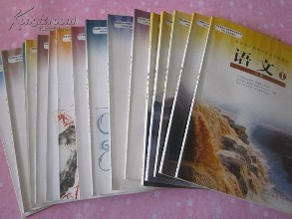
What subjects will you learn in middle school?

Slide 3
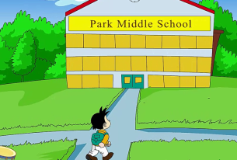
1. Listen and chant.
I’m going to study History,
Science and Chemistry,
Maths and Geography,
and learn with my new friends happily!

Slide 4
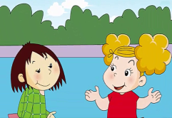
2. Listen and read.
Amy: Are you going to middle school in September，Lingling?
Lingling: Yes, I am. I’m going to Park Middle School. What about you?
Amy: I’m going to Lake Middle School.
Lingling: What are you going to study?
Amy: I’m going to study History, Science, Geography and French.
Lingling: I’m going to study Physics, Chemistry and Chinese. I’m also going to study History and Geography. But I’m not going to study French.

Slide 5
知识点 1
Are you going to middle school in September,
Lingling?你九月份将要去中学了吗，玲玲？
这是询问某人是否将要做某事的问句。
用法：
Be 动词+ 主语+ going to + 其他？
句型结构：
答语：
Yes，主语+ am/is/are. 或：No，主语+ am/is/are not.
例句：
—Are they going to Hainan this week? 这周他们将要去海吗？
—No，they aren’t. 不，他们不去。

Slide 6
知识点 2
What are you going to study?
你将要学习什么？
这是询问对方将要学习什么课程的句型。
用法：
What + be 动词+ 主语+ going to study ？
句型结构：
主语+ be 动词+ going to study + 课程名称.
答语：
—What is she going to study? 她将要学习什么？
—She is going to study French. 她将要学习法语。
例句：

Slide 7
3. Now answer the questions.
1. Is Lingling going to middle school in September?
__________________________________________
2. Which school is Amy going to?
__________________________________________
3. What is Lingling going to study?
__________________________________________
__________________________________________
4. Which middle school do you like? Why?
__________________________________________
Yes，she is.
She's going to Lake Middle School.
She's going to study Physics, Chemistry, Chinese，History and Geography.
I like Lake Middle School. Because I like Science. (答案不唯一)

Slide 8
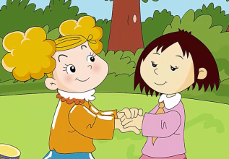
4. Listen and read. Then say the poem.
School is nearly finished.
It’s time to start anew.
Now I can speak English.
I can speak to you.
It’s time to say goodbye now.
School is going to end.
But we can write in English and we will always
be friends.

Slide 9
5. Follow and say.
What are you going to study in middle school?
I’m going to study English.
He’s going to study English and I’m going to study Chemistry.
He’s going to study English, she’s going to study Chemistry and I’m going to study History.

Slide 10
趣味活动：未来畅想。
你未来的生活将是怎样的？快拿起画笔画一画，然后用“be going to + 动词原形”来描述一下并在小组内展示一下吧！

Slide 11
6. Write and talk.
Write about your middle school and talk about it.
Which middle school are you going to？ Where is it?
How will you go to school?
When will you go to school every day?
When will you go home?
What subjects will you study there?
My middle school
I’m going to ... _____________________________________
__________________________________________________

Slide 12
一、单项选择。
It’ s so hot. What about ______ ?
A. go swim
B. go swimming
C. going swimming
C
点拨：
what about后接动词的­ing形式。

Slide 13
二、根据图片提示完成句子。
1. —What is your favourite subject, Daming?
— ____________ is my favourite subject.
2. —Are you going to study History?
— ________________________ .
Physics
No, I’m not.

Slide 14
三、情景选择。
你想知道玲玲将要学什么科目，应这样问：( )
A. What are you going to study?
B. What are you going to write?
A

Slide 15
四、写出句子的汉语意思。
I like playing football. What about you?
__________________________________
我喜欢踢足球，你呢？

Slide 16
本节课我们学习了以下知识，请同学们一定加强巩固，以便能和同学们进行灵活交流哦！
重点词汇：chemistry, physics
重点句式：Are you going to middle school in September，Lingling?
What are you going to study?

Slide 17
1 熟记本节课所学的句型、短语和单词，必须会听、说、读、写。
2 将Listen and read的内容朗读流利。
3 完成配套的课后作业。

