Slide 1
Unit 8 At the fruit shop
第二课时
WWW.PPT818.COM

Slide 2
From Here to There
上一页
下一页
退出

Slide 3
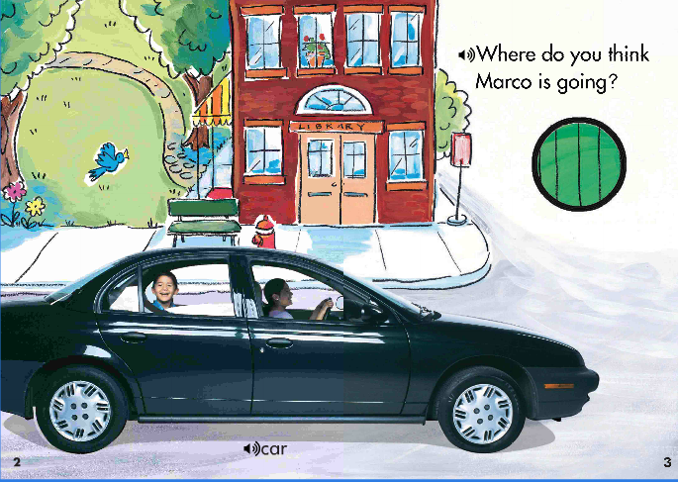
From Here to There
上一页
下一页
退出

Slide 4
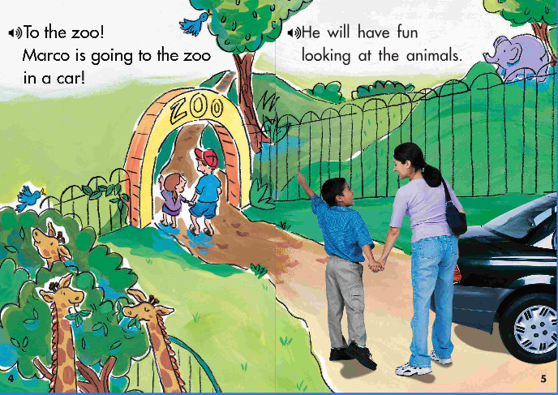
From Here to There
上一页
下一页
退出

Slide 5
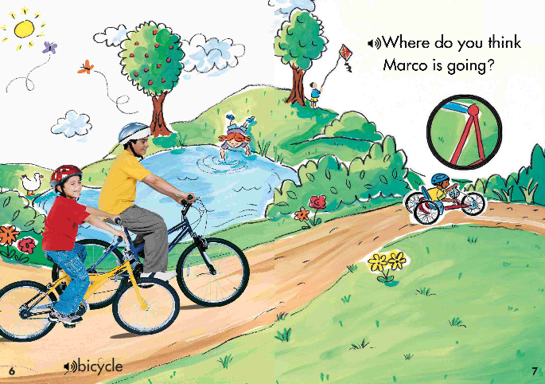
From Here to There
上一页
下一页
退出

Slide 6
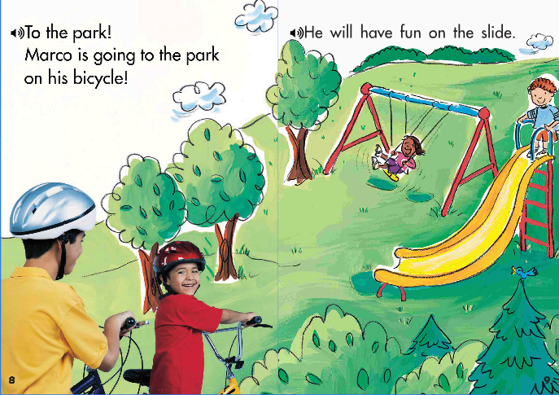
From Here to There
上一页
下一页
退出

Slide 7
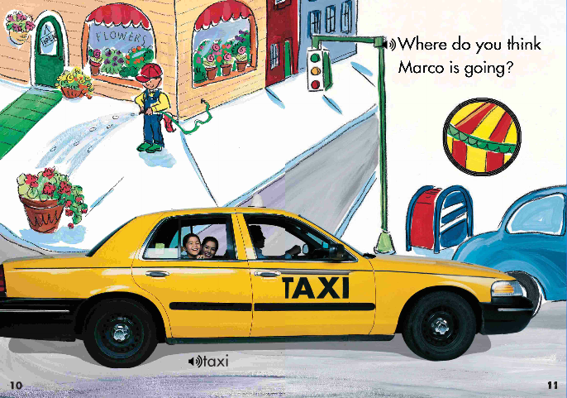
From Here to There
上一页
下一页
退出

Slide 8
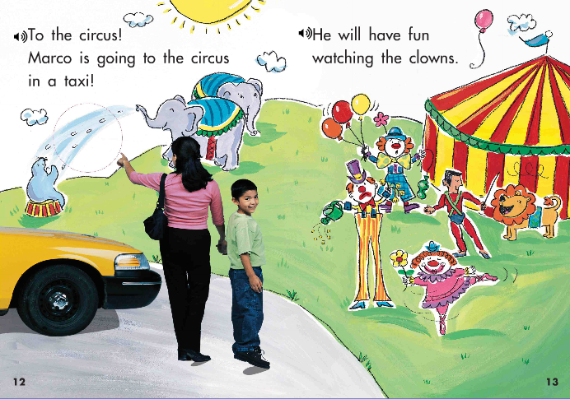
From Here to There
上一页
下一页
退出

Slide 9
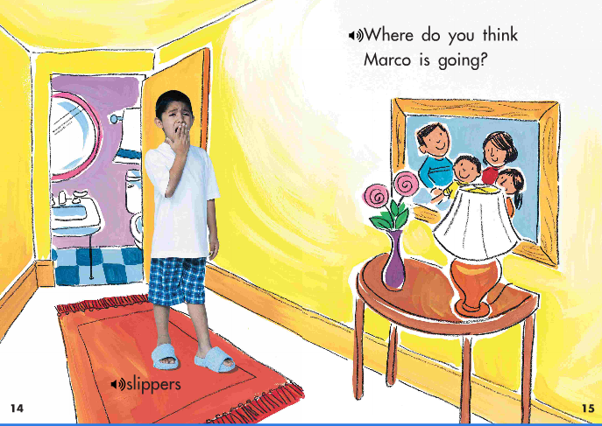
From Here to There
上一页
下一页
退出

Slide 10
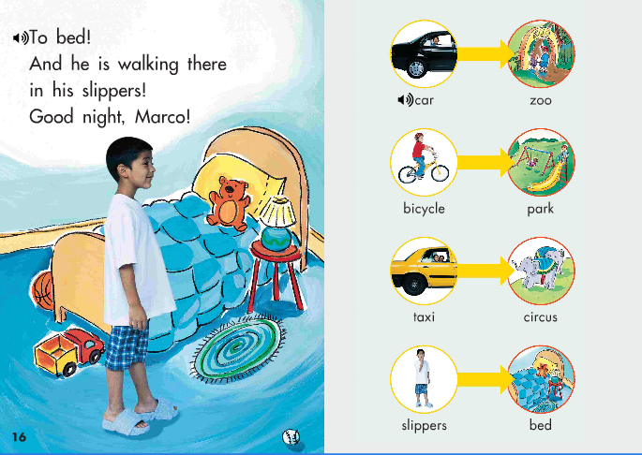
From Here to There
上一页
下一页
退出

Slide 11
Ask and answer
juicy
yummy
I like . They are .
I don’t like . They are .
sweet
sour
上一页
下一页
退出

Slide 12
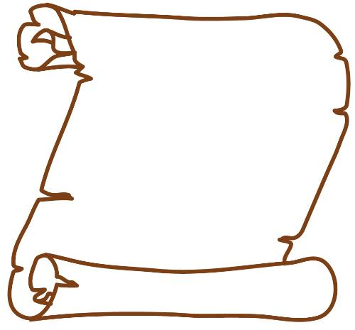
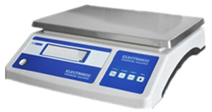
Ask and answer
The fruit I like
1 kg
apples 1kg
上一页
下一页
退出

Slide 13
Marco is shopping in Shenzhen
Can I help you ?
Here you are !
5 yuan. please.
5 yuan.
1 kg
Thank you. How much?
Yes, please. I like apples. How much is it?
May I have 2 apples, please.
上一页
下一页
退出

Slide 14
Marco is shopping in Shenzhen
Can I ？
Yes, please. I like . is it ?
5 yuan .
May I , please.
.
1 kg
Thank you ! ？
(￥5.00)
5 yuan, please.
上一页
下一页
退出

Slide 15
Marco is shopping in Shenzhen
Can I ？
Yes, please. I like . is it ?
4 yuan .
May I , please.
.
1 kg
Thank you ! ？
(￥4.00)
4 yuan, please.
上一页
下一页
退出

Slide 16
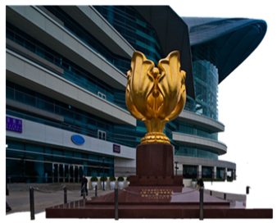
Marco is shopping in Hongkong
HK $5,please.
Here you are!
Can I help you ?
Thank you. How much is it?
May I have water, Please?
上一页
下一页
退出

Slide 17
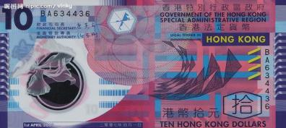
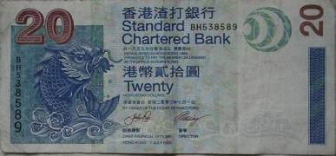
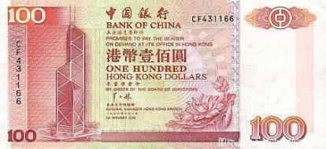
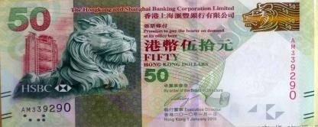
Money in Hongkong
HK$10
HK $
HK$20
HK$50
HK$100
上一页
下一页
退出

Slide 18
Marco is shopping in U.S
Can I help you ?
$2.
Here you are!
May I have cola, Please?
Thank you. How much is it?
上一页
下一页
退出

Slide 19
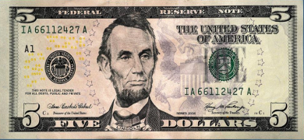
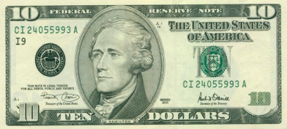
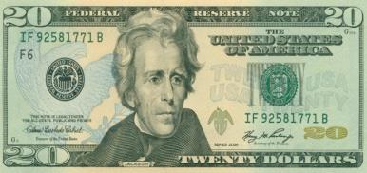
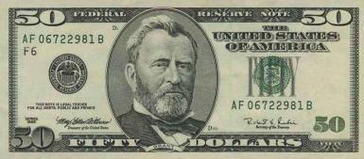
Money in U.S
$5
$10
$20
$50
上一页
下一页
退出

Slide 20
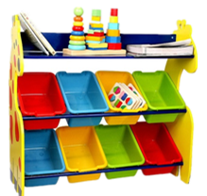
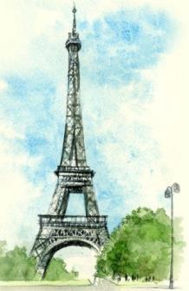
Marco is shopping in France
？
May I have a toy car , please ?
.
？
.
€ 7
上一页
下一页
退出

Slide 21
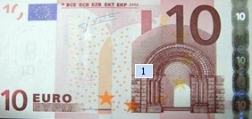
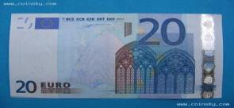
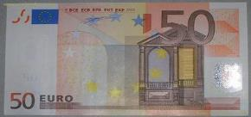
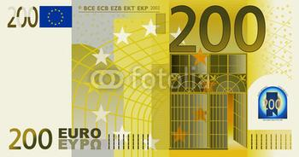
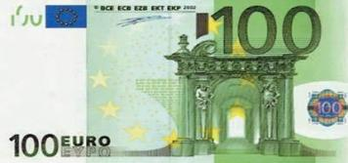
Money in France
€ 20
€ 50
€ 10
€ 100
€ 200
上一页
下一页
退出

Slide 22
Marco is shopping in Shenzhen
Can I help you ?
They are 10 Yuan.
Thank you.
It is 5 Yuan.
2 kg
1 kg
May I have 4 apples please? How much are they?
Here you are.
Apples ,please. How much is it?
上一页
下一页
退出

Slide 23
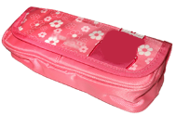
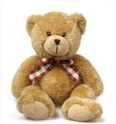
Ask and answer
¥ 12.00
¥ 8.00
¥ 20.00
¥ 10.00
¥ 6.00
¥ 50.00
How much is it?
____ yuan.
上一页
下一页
退出

Slide 24
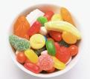
Ask and answer
¥ 4.00
¥ 10.00
¥ 12.00
¥ 30.00
¥ 5.00
¥ 15.00
How much are they ?
____ yuan.
上一页
下一页
退出

Slide 25
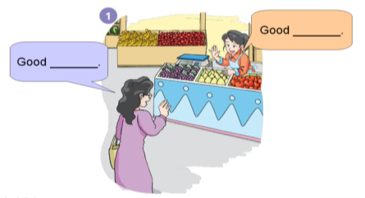
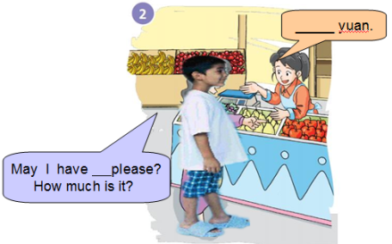
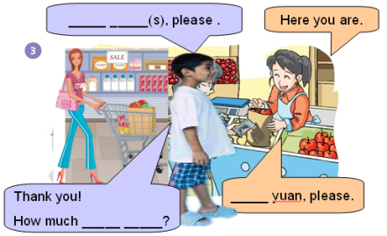
Make a new dialogue
上一页
下一页
退出

Slide 26
Homework
Make a shopping list and write down the shopping with your friends or parents.
Listen and read Page 38.
上一页
退出

