Slide 1
Section Ⅰ Listening and Speaking
WWW.PPT818.COM

Slide 2
主题语境——人与社会之体育运动
【语境概说】 本单元的主题语境为人与社会中的体育运动，该主题语境主要包括体育活动、体坛人物、大型体育赛事、体育与健康和体育精神等。本单元主要涉及体坛人物、体育与健康和体育精神。该主题与学生生活密切相关，在此主题意义引领下，有助于整合体育方面的学习内容，促进学生语言能力、文化意识、思维品质和学习能力的融合发展。

Slide 3
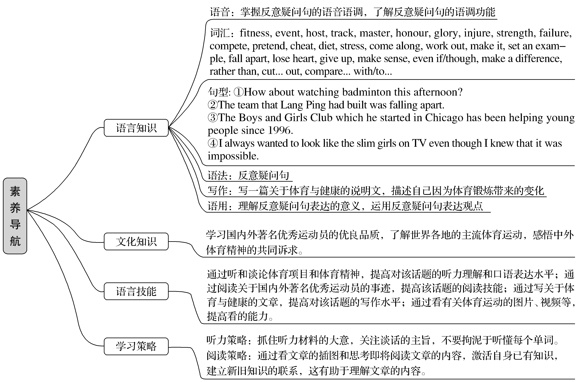

Slide 4
Life lies in movement.生命在于运动。
Reading is to the mind while exercise to the body.读书健脑，运动强身。
Sports not only can change a person’s physical fitness，more can change a person’s character.
体育运动不仅能改变人的体质，更能改变人的品格。

Slide 5
1.Translate the following words and phrases.
拳击
滑雪
①boxing n. ____________ ②ski v. ____________
③badminton n. ____________ ④marathon n. ____________
⑤fitness n. ____________ ⑥poster n. ____________
⑦track n. ____________ ⑧host v. ____________
⑨sweat n. ____________ ⑩an e-sports event ____________
⑪instead of ____________ ⑫come along ____________
⑬work out ____________ ⑭make it ____________
羽毛球
马拉松
健康
海报
跑道；足迹
主办
汗水
电子竞技运动
代替
跟随；到达
锻炼；解决
获得成功

Slide 6
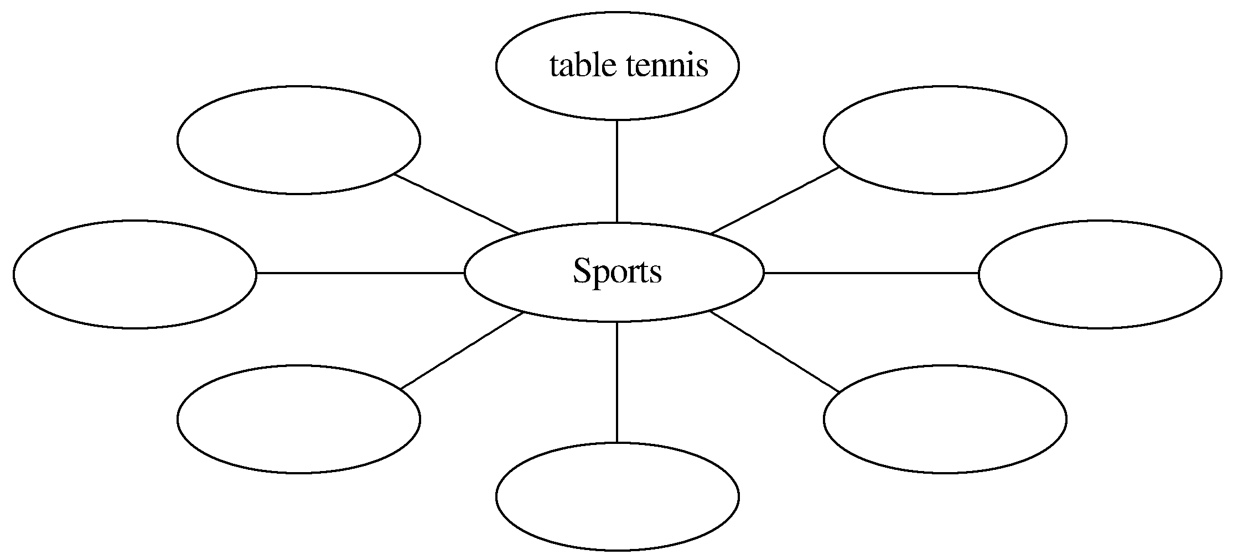
2.Brainstorming：What kind of sports do you like to play?
soccer/football，basketball，badminton，swimming，running，boxing，marathon etc.
________________________________________________________________________
________________________________________________________________________

Slide 7
3.Look at the pictures on Page 36 and tell your classmates what they are doing?
________________________________________________________________________
4.Finish Ex.1 on Page 36.
5.Try to translate the sentence in various ways.
观看足球比赛好吗？
①_____________________________________________________________________
②_____________________________________________________________________
③_____________________________________________________________________
④_____________________________________________________________________
⑤_____________________________________________________________________
⑥_____________________________________________________________________
They are playing soccer/badminton/boxing/running a marathon.
Would you like to watch the soccer match?
How about watching the soccer match?
Why not/don’t you watch the soccer match?
Do you want to watch the soccer match?
Would you please watch the soccer match?
Shall we watch the soccer match?

Slide 8
语言知识积累
表示建议的常用表达
1.Would you like to do...?
2.How about doing...?
3.Why not do/don’t you do...?
4.Do you want to do...?
5.Would you please do...?
6.Shall we do...?

Slide 9
文化知识习得
1.为什么足球在美国叫soccer?
soccer这个词并不是美国人自己发明的，而是20世纪从英国传到美国去的。而在当时，美国人也有了自己的football运动(其实就是现代美国的橄榄球)，于是为了区别，美国人将足球称为soccer。
2.马拉松比赛有哪些？
马拉松(Marathon)长跑是国际上非常普及的长跑比赛项目，全程距离26英里385码，折合为42.195公里。分全程马拉松(Full Marathon)、半程马拉松(Half Marathon)和四分之一马拉松(Quarter Marathon)三种。

Slide 10
1.Finish Ex.2 & Ex.3 on Page 36.
2.Finish Ex.4 on Page 37.
1.Speaking—Finish Ex.5 on Page 37 by following the example.
A：Did you hear that there’s the Youth Ski Race in Zhangjiakou in December？Would you like to come along?
B：Really? I’d love to!
A：Why don’t you join us this Sunday morning?
B：Oh，sorry.I can’t./Of course，I’d like to.

Slide 11
2.Pronunciation
(1)The intonation of tag questions is rising.
①You’re going for a walk with me，↗ aren’t you?
你是要和我一起去散步吗？
②She is coming tomorrow，↗ isn’t she？她是不是明天来？
③You weren’t here on Monday，↗ were you？周一你没在这里，是吧？
④Mary will marry next week，↗ won’t she？玛丽是下个月要结婚吗？
(2)The intonation of tag questions is falling.
①It’s hot today，↘ isn’t it？今天好热，不是吗？
②The film is so boring，↘isn’t it？这部电影很无聊，不是吗？
③You don’t like the clothes，↘ do you？你不喜欢这件衣服，是吗？
④You will go shopping，↘ won’t you？你要去购物，不是吗？

Slide 12
学习策略形成
1.学会用不同句式表达建议
2.学会用发音强弱突出表达的内容。
反意疑问句的语调
1.升调：反意疑问句的疑问形式部分通常用升调，表示说话者并不十分确定陈述句部分所表达的信息，或者表示说话者并不强迫对方同意自己的观点，用反意疑问句只是为了简单的询问。
2.降调：在反意疑问句中，如果说话者特别肯定对方可能给予的答案，或者是特意向对方示意说话者与听者的意见是一致的，这时疑问部分用降调。

Slide 13
1.work out锻炼；计算出；解决； 弄清；制定出
Come and work out at a gym！(教材P₃₇)来健身房锻炼吧！
[合作探究] 体会work out的用法和意义
① While the boys are golfing，I work out in the gym.
小伙子们打高尔夫球的时候，我在健身房____________。
②They will meet later today to work out a plan.
他们定于今天晚些时候进行会谈，____________一个方案。
③It took me some time to work out what was causing this.
我花了一些时间才____________此事的起因。
锻炼
制定
弄清

Slide 14
[自主发现]
④意为“锻炼”时，work out 为____________(及物/不及物)动词短语；
⑤意为“计算出；解决；制定出”时为____________(及物/不及物)动词短语。
[词块积累]
work out in the gym在健身房锻炼
work out a plan 制定一项计划
work out a problem 解出一个问题
不及物
及物

Slide 15
[巩固内化] 补全句子
①I believe that you can _______________________________________.
我相信你自己能做出这道题的。
②I often ___________________________________.
我经常锻炼身体以保持健康。
work out this problem by yourself
work out to keep fit

Slide 16
2.make it 获得成功；准时到达；及时赶上
You can make it.(教材P₃₇)你能获得成功。
[合作探究] 体会make it的用法和意义
①We just made it to the sports meeting.我们刚刚____________了运动会。
②I hope you will make it someday；I’m sure you will become a successful football player.我希望你有一天能____________。我相信你能成为一名出色的足球运动员。
及时赶上
成功

Slide 17
[思考] 借助词典，想一想惯用词it的习语还有哪些？
①______________________________________________________________________
②______________________________________________________________________
③______________________________________________________________________
④______________________________________________________________________
⑤______________________________________________________________________
forget it 不用提；不用谢
I got it.我明白了。
take it easy别着急
believe it or not信不信由你
take it for granted认为……理所当然

Slide 18
[巩固内化] 同义句转换
①Believe in yourself.You can be successful!
→Believe in yourself.You can ____________！
②I’m sorry，I won’t be able to get to the party in time.
→I’m sorry，I won’t be able to ____________ the party.
make it
make it to

