Slide 1
Unit 1 Dream homes
Reading
WWW.PPT818.COM

Slide 2
Period 2 Reading
课前自主预习
单 词 闯 关 | 1. 英里 /maɪl/ ________ 2．花园，果园 /ˈɡɑːdn/ ________ 3．合用；分享 /ʃeə(r)/ ________ 4. 卧室 /ˈbedruːm；ˈbedrʊm/ ________ 5．自己的 /əʊn/ ________ 6．海滩 /biːtʃ/ ________
mile
garden
share
bedroom
own
beach

Slide 3
Period 2 Reading
短 语 互 译 | 1. 在……的中心 ____________ 2．躺在床上听音乐 ________________ 3．向外看 ____________ 4．和某人聊天 ____________
in the centre of
listen to music in bed
look out
chat with sb.

Slide 4
Period 2 Reading
短 语 互 译 | 5. enjoy a cup of tea ____________ 6．have fun ____________ 7．share sth. with sb. _______________ 8．on the seventh floor____________
喝杯茶
玩得高兴
与某人合用/分享某物
在八楼

Slide 5
Period 2 Reading
句 型 在 线 | 1. I live in a town ______ ________ ______ _______. 我住在离伦敦15英里的镇上。 2．I always ________ ________ ________ my dog there. 我总是和我的狗在那里玩得很高兴。 3．I ________ a bedroom ________ my sister. 我和妹妹同住一间卧室。
15 miles from London
have fun with
share
with

Slide 6
Period 2 Reading
句 型 在 线 | 4．I ________ ________ ________ bedroom and bathroom, and I like the balcony _______. 我有我自己的卧室和浴室，我最喜欢阳台。 5．I love to sit there and ________ _____ ______ the beach and the sea. 我喜欢坐在那里，向外眺望海滩和大海。
have my own
best
look out at

Slide 7
Period 2 Reading
课 文 初 探 | 根据课文内容，判断正(T)误(F)。 ( )1.Neil's flat is on the seventh floor. ( )2.Anna often has fun with her dog in the garden. ( )3.Anna has her own bedroom. ( )4.There are eight rooms in Stephen's house. ( )5.Stephen likes the kitchen best.
F
F
F
T
F

Slide 8
Period 2 Reading
课堂互动探究
词汇点睛
1 enjoy vt.喜欢；享受
[观察] My family and I often sit there and enjoy a cup of tea.
我和我的家人经常坐在那里喝杯茶。
Tom enjoys watching TV.
汤姆喜欢看电视。

Slide 9
Period 2 Reading
[探究] enjoy 作动词，意为“喜欢；享受”，后面通常接名词、代词或动名词作宾语。____________ sth.意为“喜欢做某事”。
enjoy doing
[拓展] enjoy oneself＝have a good time＝have fun，意为“玩得
高兴”。

Slide 10
Period 2 Reading
活学活用
2017·临沂 When President Xi Jinping has spare time, he enjoys ________ and sports.
A．read B．reads
C．to read D．reading
D
【解析】考查非谓语动词。句意：当习近平主席有空闲时间的时候，他喜欢读书和运动。enjoy doing sth.“喜欢做某事”，是固定用法。故选D。

Slide 11
Period 2 Reading
2 listen to music 听音乐
[观察] We often listen to music in bed.
我们经常躺在床上听音乐。

Slide 12
Period 2 Reading
[辨析] listen, hear与sound
词条 | 意义及用法 | 例句
listen | 作不及物动词，后面接宾语时，要加介词to，强调“听”的________。 | Are you listening to me? 你在听我说话吗？
hear | 作及物动词，强调“听”的________。 | Can you hear the noise? 你能听见噪声吗？
sound | 可作名词和动词。作名词时，意为“声响，声音”；作动词时，后面一般接形容词或从句。 | She heard the sound of footsteps outside. 她听见了外面的脚步声。 It sounds good. 那听起来不错。
动作
结果

Slide 13
Period 2 Reading
活学活用
(1)Suddenly, Linda stopped. She ________ carefully, but she didn't ________ anything.
A．listened to; heard
B．listened; heard
C．listened to; hear
D．listened; hear
D

Slide 14
Period 2 Reading
(2)2017·阜康—Do you like the songs by Taylor?
—Yes. Country music ________ nice and is full of feelings.
A．sounds B．listens C．hears D．looks
A
【解析】考查动词的用法辨析。句意：“你喜欢泰勒唱的歌吗？”“是的。乡村音乐听起来很优美，充满了感情。”sound意为“听起来”； listen意为“听”；hear意为“听说”；look意为“看起来”。句子中的主语为“Country music”，只能与sound搭配。故选A。

Slide 15
Period 2 Reading
3 own adj. 自己的
[观察] I have my own bedroom and bathroom, and I like the balcony best. 我有自己的卧室和浴室，我最喜欢阳台。
[探究] own 作形容词，意为“自己的”。________________意为“某人自己的某物”。
My father has his own car. He drives to work every day.
我爸爸有自己的汽车，他每天开车去上班。
one's own sth.

Slide 16
Period 2 Reading
[拓展] (1)own vt. 拥有，占有
I will own a shop like this some day.
总有一天，我将会拥有一间像这样的店。
(2)owner n. 物主，所有人

Slide 17
Period 2 Reading
活学活用
用所给单词的适当形式填空
Who is the ________(own) of that motorcycle?
owner

Slide 18
Period 2 Reading
4 look out 向外看
[观察] I love to sit there and look out at the beach and the sea.
我喜欢坐在那里，向外眺望海滩和大海。
The girl often looks out at the flowers in the garden.
这个女孩经常向外看花园里的花。

Slide 19
Period 2 Reading
[探究] look out ________ 意为“向外眺望……”；look out ________ 意为“从……向外看”。
at
of
[拓展] (1)look out还有“当心，小心”的意思，相当于be careful和take care。

Slide 20
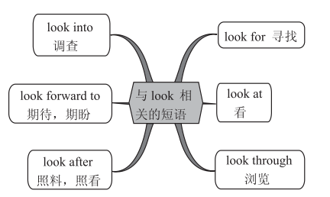
Period 2 Reading
(2)

Slide 21
Period 2 Reading
活学活用
(1)It's good for our eyes ________ the green trees after an hour's reading.
A．to look out of
B．to look out
C．look out at
D．to look out at
D

Slide 22
Period 2 Reading
(2)2018·淮安The girl has to ________ her grandma because her parents are working in another city.
A．look at B．look into
C．look through D．look after
D
【解析】考查动词短语辨析。句意：这个女孩必须照顾她的奶奶，因为她的父母在另一个城市工作。look at意为“看”；look into意为“调查”；look through意为“浏览”；look after意为“照顾”。故选D。

Slide 23
Period 2 Reading
句型透视
1 I always have fun with my dog there.
我总是和我的狗在那里玩得很高兴。
[探究] have fun意为“玩得高兴”，fun作________名词，意为“乐趣，有趣的事”。have fun doing sth. 意为“做某事很开心”。
Students are having fun speaking English now.
现在学生们正在开心地说英语。
不可数
[拓展] funny作形容词，意为“有趣的；好笑的，滑稽的”。

Slide 24
Period 2 Reading
活学活用
________ great fun Alice has ________ kites with her father!
A．What; making B．What a; made
C．How; making D．How; made
A
【解析】考查感叹句和固定搭配的用法。句意：爱丽丝和她爸爸一起制作风筝多么愉快呀！感叹句有两种基本句型：①What(＋a/an)＋形容词＋名词(＋主语＋谓语)！②How＋形容词/副词(＋主语＋谓语)！have fun doing sth.为固定搭配，意为“做某事很开心”，排除B、D；分析句子结构可知选A。

Slide 25
Period 2 Reading
2 I share a bedroom with my sister.
我和妹妹同住一间卧室。
[探究] share sth.with sb.意为“与某人合用/分享某物”。
Tony shares a bicycle with his sister.
托尼和他的姐姐共用一辆自行车。

Slide 26
Period 2 Reading
活学活用
我和玛丽合用一把伞。
I________ an umbrella ________ Mary.
share
with

Slide 27
Period 2 Reading
3 The living room is the best place to chat and watch TV.
客厅是聊天和看电视的最佳地点。
[探究] “the best place to chat and watch TV”意为“聊天和看电视的最佳地点”，其中，不定式“to chat and watch TV”作后置定语，修饰the best place。
I think Suzhou is the best place to visit in spring.
我认为在春天苏州是旅游的最佳地点。

Slide 28
Period 2 Reading
[拓展] 动词不定式除了作定语外，还可作主语、宾语、表语、目的状语等。

Slide 29
Period 2 Reading
活学活用
I'm hungry. Can I have something ________？
A．eat B．eats
C．to eat D．eating
C

Slide 30
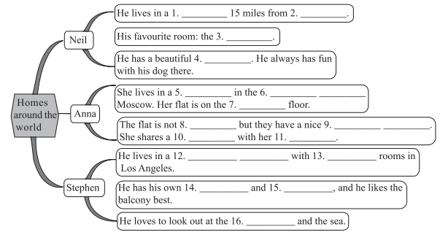
Period 2 Reading
课文回顾
town
London
kitchen
garden
flat
centre of
seventh
big
living room
bedroom
sister
large house
eight
bedroom
bathroom
beach

