Slide 1
Unit 8
Have you read Treasure Island yet?
Section B 1a— 2e
WWW.PPT818.COM

Slide 2
How many kinds of music do you know?
rock
pop
hip-hop
music
latin
…

Slide 3
What’s your favorite band?
Have you seen them in concert yet?
When did you first hear them?
Who is your favorite band member?

Slide 4
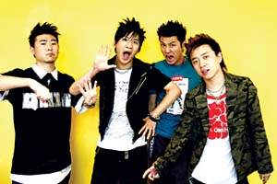
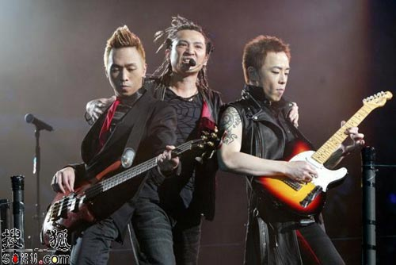
Flowers
Beyond

Slide 5
Listen and take notes
Band name
Country
Number of people in the band
Kind of music
Why Alex and Dave like to listen to this band | Alex:
 | Dave:

Slide 6
Survey
 | What kind of music ? | Why do they listen to it ? | How does it make to feel?
Friend1
Friend2
Parents

Slide 7
Reading

Slide 8
Do you have a favorite singer or band?
Do you have a favorite song?
What facts do you know about your favorite singer, band or song?

Slide 9
Reading strategy
While reading, make notes or underline the main ideas in the text. After reading, write a short summary in your own words. This can help you better understand the text.

Slide 10
Key points
Garth is one of the most successful musicians in American history.
one of the most successful musicians
译成：最成功的音乐家之一
结构：One of + 形容词最高级+ 可数名词复数

Slide 11
Writing
Use the notes you made in 2c to write a short summary of the passage. Write no more than100 words. Then read your summary for the whole class.

Slide 12
What facts can you remember about country music？
What other facts would you like to know about country music?

Slide 13
Homework
调查你的父母最喜欢的音乐、歌手和乐队。

