Slide 1
Unit3 What subject do you like best?
人教精通版四年级下册
WWW.PPT818.COM

Slide 2
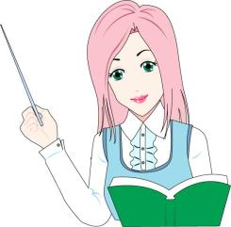
Warm-up
Game
猜猜看
This is a subject. In this class, you can draw pictures and do some painting. What is it?

Slide 3
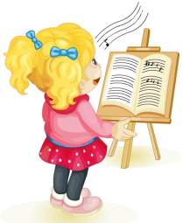
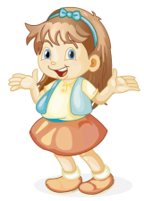
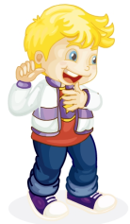
Presentation
What subject is it?
What do you do in the music class?
It’s music. I like music.
We sing and dance.

Slide 4
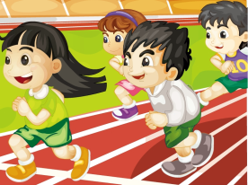
Presentation
Do you like PE?
What do you do in the PE class?
Yes, I do. I like it best.
We run and play on the playground.

Slide 5
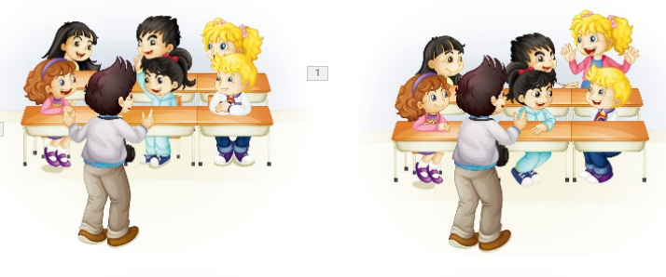
Presentation
Listen and say
What do they do in an English class?
They listen and do.
Speak and sing.
Play and act.

Slide 6
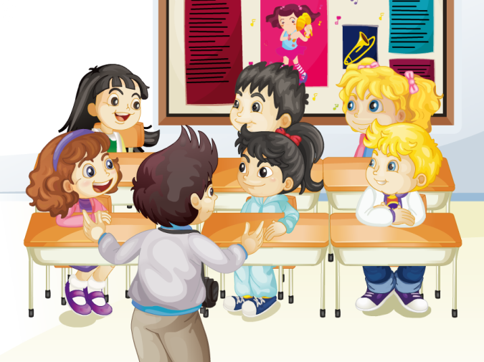
Presentation
Let’s watch

Slide 7
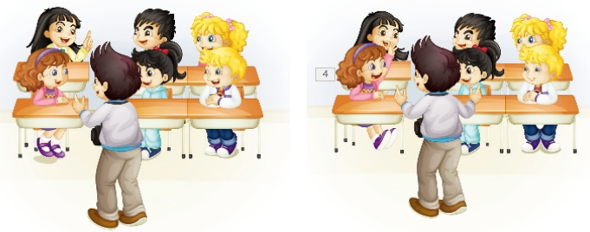
Presentation
Look and read
We listen and do.
We speak and sing.
What do you do in an English class?
We do all kinds of things in English.
We play and act.
That’s great.

Slide 8
Presentation
Listen and read
 | What do you do in an English class?
 | We listen and do.
 | We speak and sing.
 | We play and act.
 | We do all kinds of things in English.
 | That’s great.

Slide 9
Practice
Read it by groups for one minute .
小组读对话一分钟。
一分钟倒计时
60
Learning tip :
50
10
10
四人一组，比赛读句子，看谁能在一分钟内读完，并且读得准确、流利！
20
20
40
30
30
开始

Slide 10
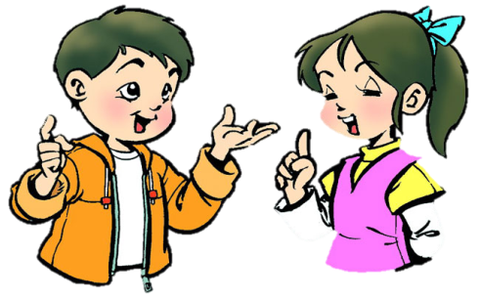
Practice
Role-play
分角色朗读出对话，注意模仿语音语调。
四人一组，试着表演出来吧。

Slide 11
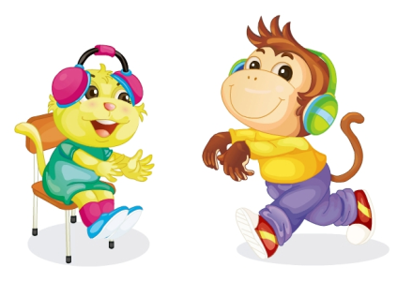
Presentation
Key points
What do you do in the English class?
We listen and do.

Slide 12
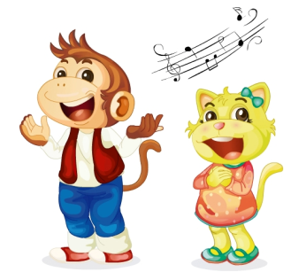
Presentation
Key points
What do you do in the English class?
We speak and sing.

Slide 13
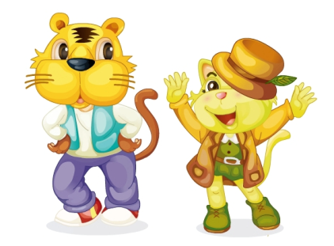
Presentation
Key points
What do you do in the English class?
We play and act.

Slide 14
Practice
Game 1
Magic fingers
listen and do
play and act
speak and sing

Slide 15
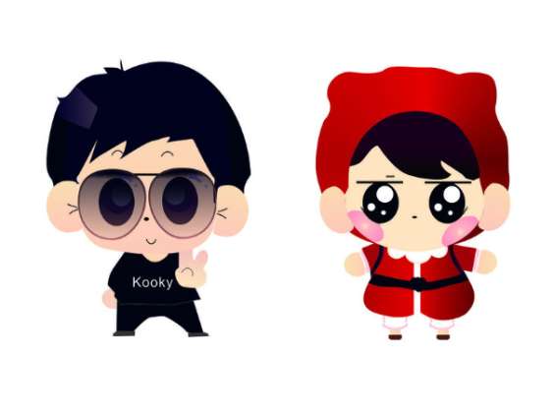
Practice
Game 2
I say you do

Slide 16
Practice
Let’s sing

Slide 17
Summary
1. 本课的重点词汇：
listen and do
speak and sing
play and act
2. 本课的重点句型：
—What do you do in an English
class?
—We listen and do.

Slide 18
Homework
1. 跟读课文Just talk部分的录音，注意语音、语调。
2. 模仿本课对话，编写一段新的对话，不少于4句。
3. 预习Lesson18。
Close

