Slide 1
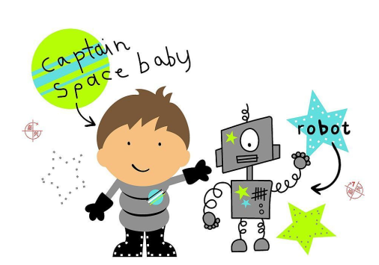
Toys
第二课时
WWW.PPT818.COM

Slide 2
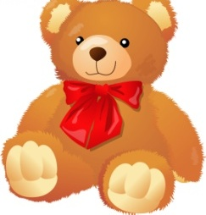
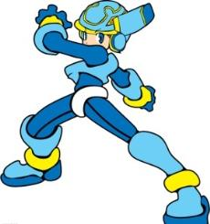
Say and spell
kite
ball
toy bear
robot

Slide 3
Say and read
kite
kites
ball
balls
robot
robots
toy bear
toy bears

Slide 4
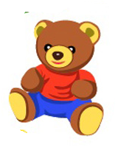
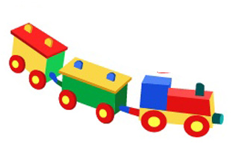
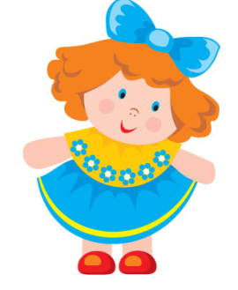
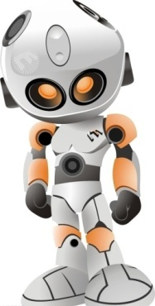
Look and say

Slide 5
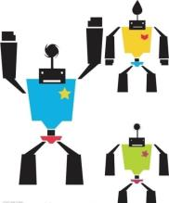
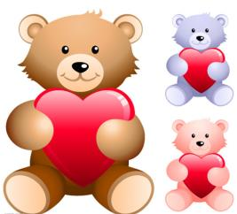
Ask and answer
What do you like? I like…

Slide 6
Choose and talk
I like… They are…

Slide 7
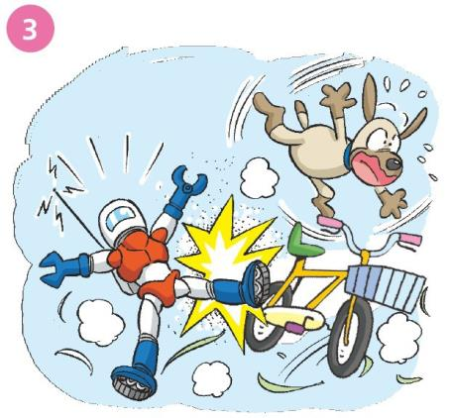
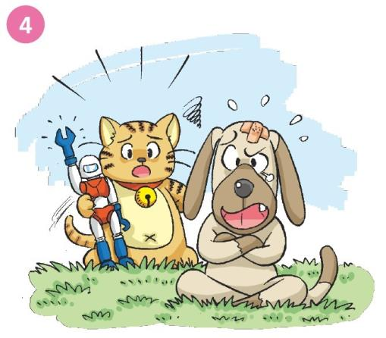
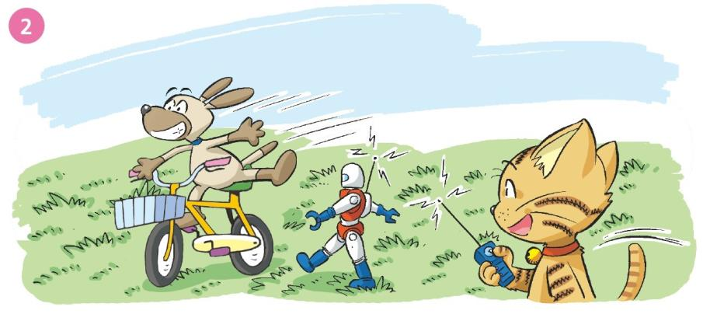
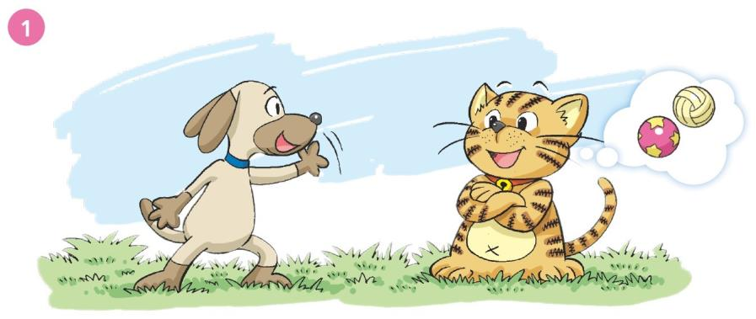

Slide 8
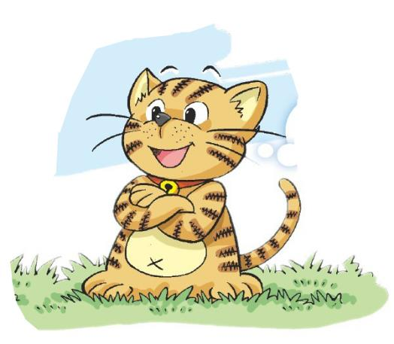
Read and judge
I like dolls.
I like balls.

Slide 9
Read and judge
I like robots.
I like balls.

Slide 10
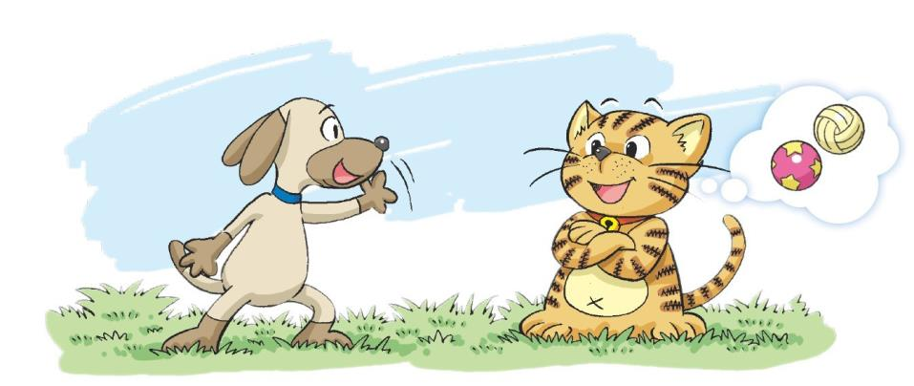
Hi! Let’s play!
OK. I like balls.
Do you like balls?
No, I don’t.
What do you like?

Slide 11
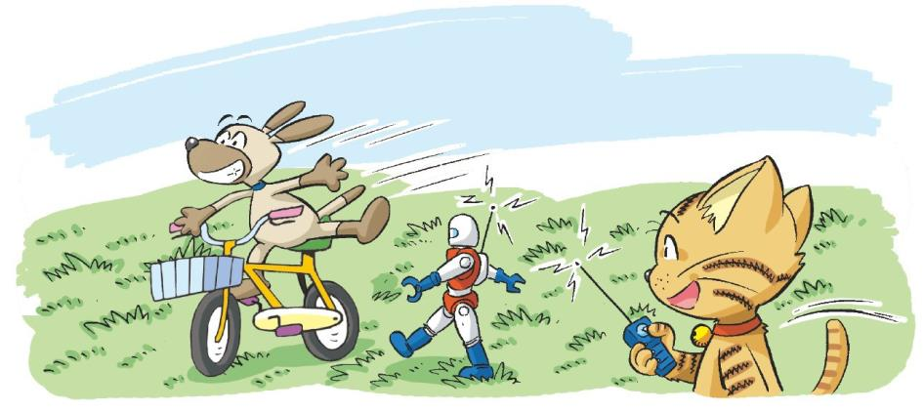
I like bikes.
They’re fun.
I like robots.
They’re super.

Slide 12
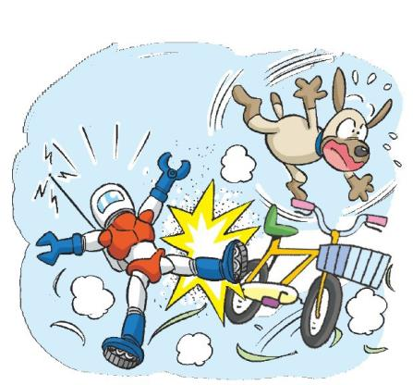
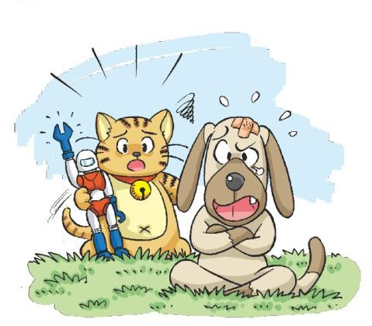
I’m sorry. Are you OK?
Oh dear!
I don’t like robots!

Slide 13
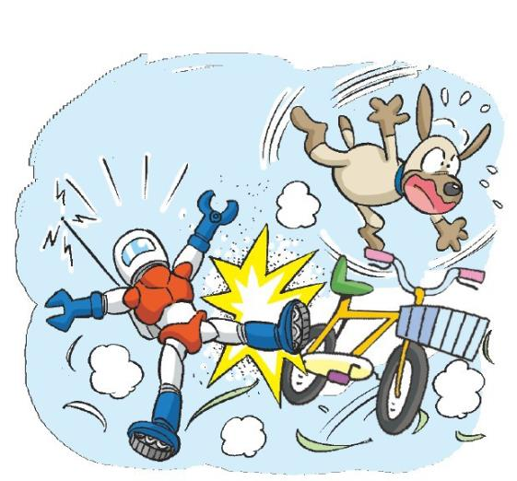
Act it out

Slide 14
Make a dialogue
M: Hi, Bob. Do you like toys?
B: ____________.
M: What do you like?
B: I like ______. They are cool.
They are super. Do you like ______?
M: ____________.
B: _________________?
M: I like _________. They are cute.
They are soft.
Yes, I do.
robots
robots
No, I don’t.
What do you like
toy bears

Slide 15
Make a dialogue
What do you like?
I like …
They are…
They …

Slide 16
Make a dialogue
M: Hi, _______. Do you like toys?
B: ____________.
M: What do you like?
B: I like ______. They _________.
Do you like ______?
M: ____________.
B: _______________?
M: I like ________. They ________.

Slide 17
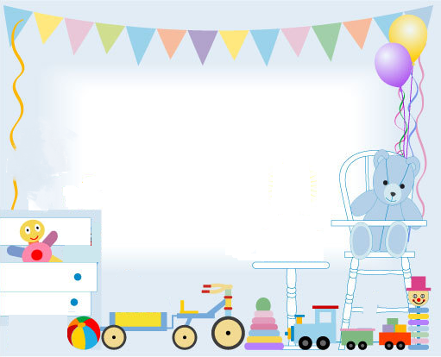
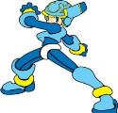
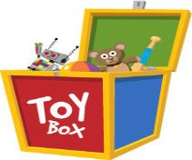
Look and say
Do you like…? What do you….?

Slide 18
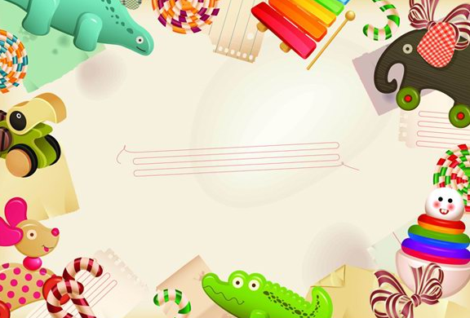
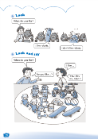
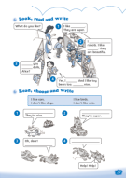
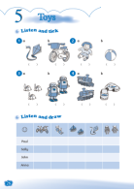
Homework
1 Talk about your toys.
I like … They are …
2 Read Say and act.
3 Complete Workbook pages 26, 28 and 29.

