Slide 1
河北教育出版社 五年级 | 下册
Unit 2 Lesson11
Shopping in Beijing
WWW.PPT818.COM

Slide 2
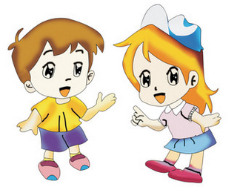
河北教育出版社 五年级 | 下册
Let's review
Role play On the Great Wall!

Slide 3
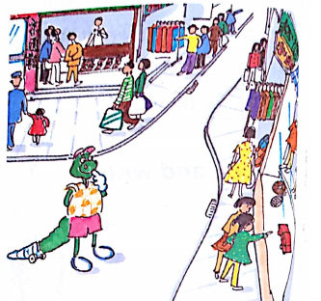
河北教育出版社 五年级 | 下册
Presentation
Danny, Jenny, Li Ming and Mrs. Li are Shopping on Wangfujing Street.
Danny’s tail hurts, but he loves shopping. Jenny buys a scarf for her mother, some tea for her father, a kite for her sister and a cap for her brother.
Danny is so busy.
He looks in fifteen shops.
Mrs. Li, Li Ming and Jenny sit down.

Slide 4
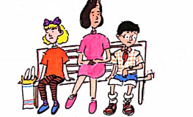
河北教育出版社 五年级 | 下册
What time is it, Li Ming?
It’s 2:30.

Slide 5
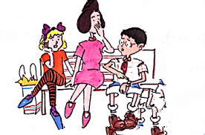
河北教育出版社 五年级 | 下册
What time is it now?
It’s 3:00.

Slide 6
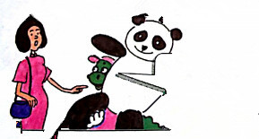
河北教育出版社 五年级 | 下册
Here’s Danny!
What does he have?
It’s a big panda!

Slide 7
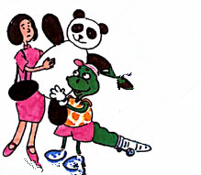
河北教育出版社 五年级 | 下册
But you don’t have a tail, Mrs. Li. You can walk with it!
You are so kind.

Slide 8
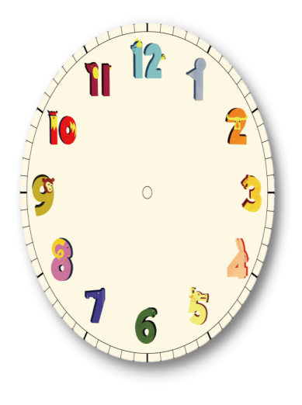
河北教育出版社 五年级 | 下册
Practice
What time is it?

Slide 9
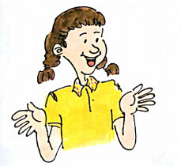
河北教育出版社 五年级 | 下册
Read Part1. Answer the questions.
Does Danny go shopping?
What does Jenny buy?
Is Danny busy?
What does Danny buy?

Slide 10
河北教育出版社 五年级 | 下册
Read and write.
What do you want to buy for your family?
I want to buy
__________________ for my mother.
__________________ for my father.
_______________________________
_______________________________

Slide 11
河北教育出版社 五年级 | 下册
Summary
重点词汇：
for busy
重点句子：
Jenny buys … for …
—What time is it?
—It’s two o’clock.

Slide 12
河北教育出版社 五年级 | 下册
Homework
回家用What time …?向家长询问。

