Slide 1
I have a ball.
第3课时
WWW.PPT818.COM

Slide 2
I have a balloon.
balloon

Slide 3
I have a kite.
kite

Slide 4
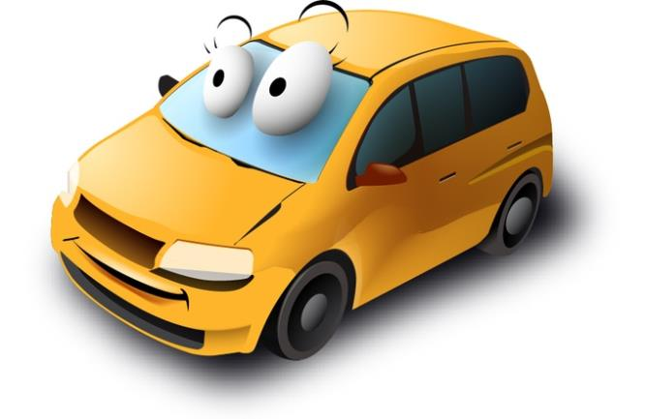
car
I have a new car.

Slide 5
bus
I have a bus.

Slide 6
Car, car. I have a new car.
Really? Really?
Look, look. Look here!
Super! Super!

Slide 7
Lisa, Lisa!
I have a new car.

Slide 8
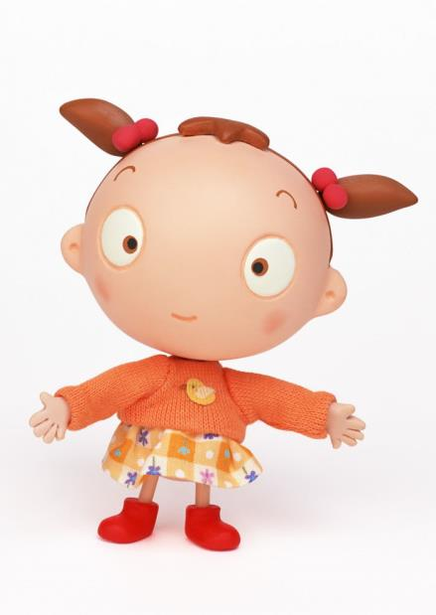
Really?

Slide 9
Yes. Look here!

Slide 10
Wow!
It’s super!

Slide 11
Peter: Lisa, Lisa! I have a new car.
Lisa: Really?
Peter: Yes. Look here!
Lisa: Wow! It’s super!

Slide 12
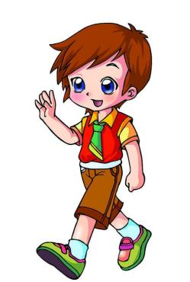
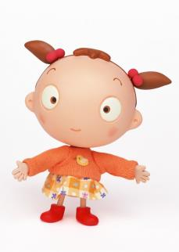
Let's play
Look! I have a car.
Wow! It’s super.
Cool!

Slide 13
Homework
Use I have a…to make sentences.

