Slide 1
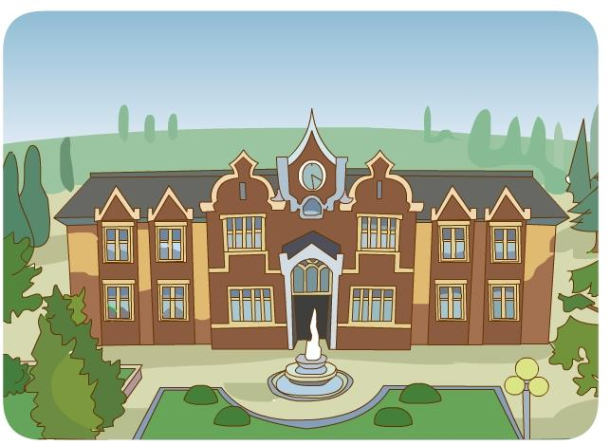
Lesson 2
There is an old building in my school.
WWW.PPT818.COM

Slide 2
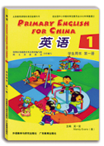
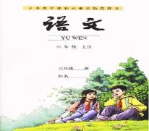
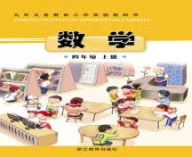
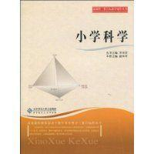
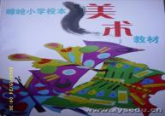
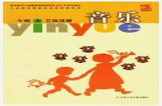
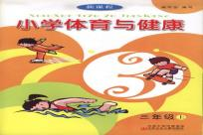
English
Chinese
maths
science
art
music
PE
computer

Slide 3
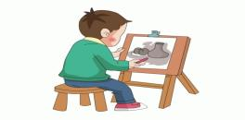
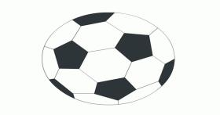
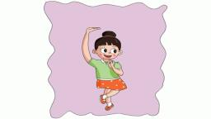
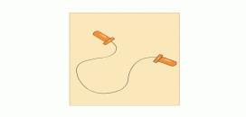
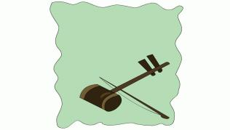
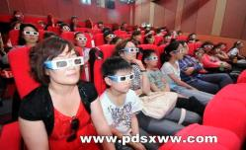
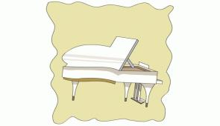
draw pictures
play
football
skip
dance
play
the piano
play
the erhu
watch the films
sing

Slide 4
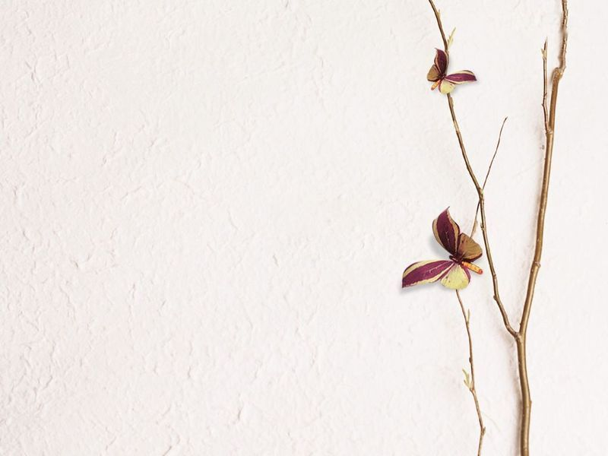
What subjects does Lucy have?
She has science, maths, art, reading and French.

Slide 5
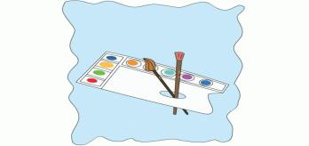
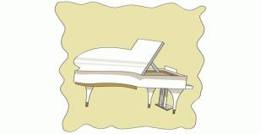
What does she do after school?
She often draws pictures.
Sometimes she plays the piano.
Sometimes she watches films .

Slide 6
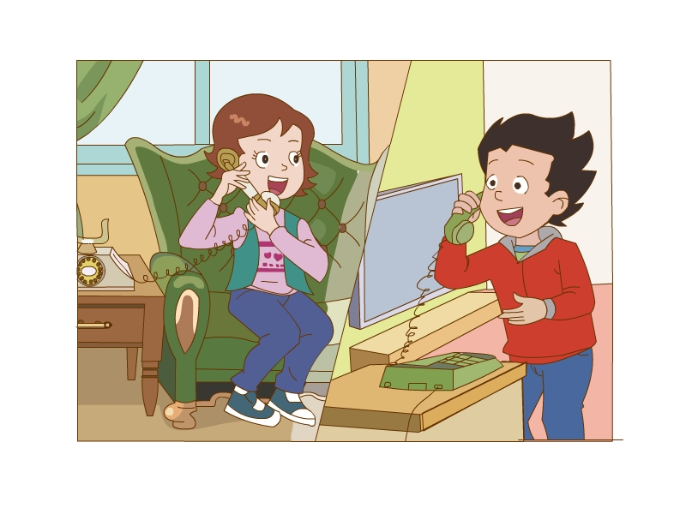
This is Lucy.
This is LiMing .

Slide 7
What’s Lucy’s new school like ?
It’s not big ,but very beautiful.

Slide 8
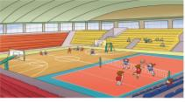
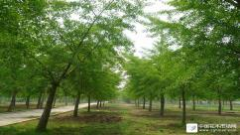
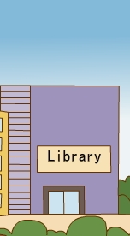
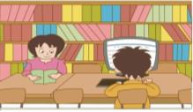
What’s in the school?
There is an old building in my school.
There is a library.
There is a new gym in my school .
There are many books in it .
There are many trees and flowers .

Slide 9
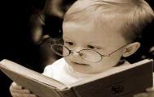
There be--- 的构成
There be + 某物 / 某人 + 某地
表示：某地有某物或某人
There be+ sb+sw
1: There is a girl and two boys in the picture.
2: There are two boys and a girl in the picture.
there 是个近视眼。
就近原则
be动词单复数形式要跟there be之后的第一个主语保持一致，如果第一个主语是单数或不可数名词用is，如果第一个主语是复数用are。

Slide 10
请使用There be--- 描述下图
tree
bird
cat
There is a cat under the tree.
There are three birds in the tree.

Slide 11
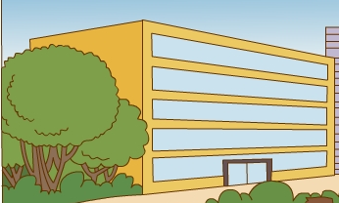
an old
building
a new
building
There is an old building.
buildings
There are two buildings.

Slide 12
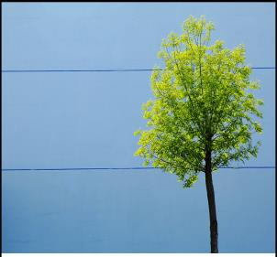
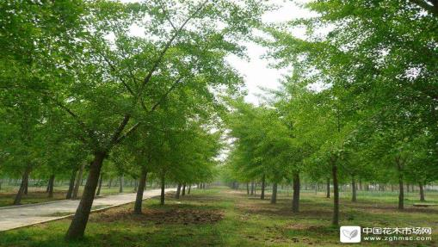
There is .
a
tree
There are .
many trees

Slide 13
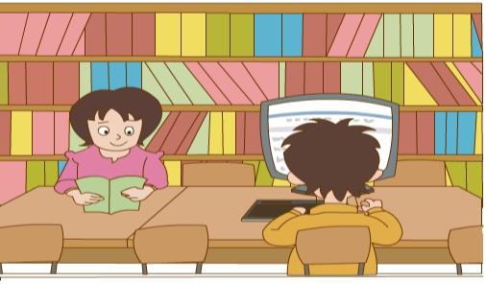
There___a library.
is
are
There ___many books in it.
I like reading there.

Slide 14
is
gym
There ___ a new .
I like doing sports.

Slide 15
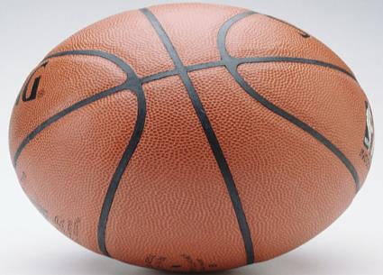
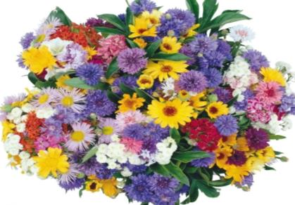
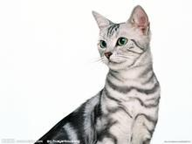

Slide 16
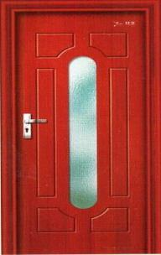
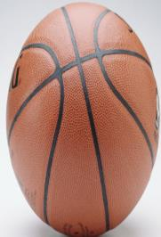
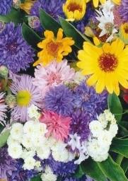
A
D
B
C
There is/are…in it?

