Slide 1
外研（新标准）版-七年级上册
Module 3 Unit 1
There are thirty students in my class.
教学课件
WWW.PPT818.COM

Slide 2
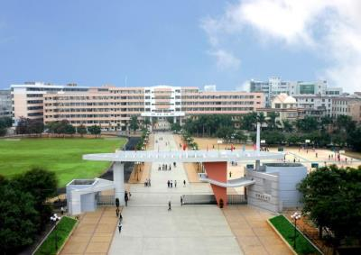
What school are you in?
Warm-up
I am in ____Middle School.

Slide 3
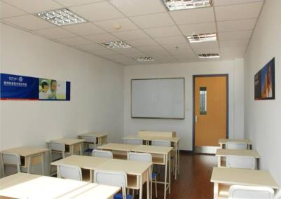
What class are you in?
I’m in Class____.

Slide 4
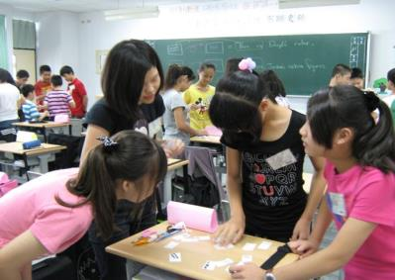
How many students are there in your class?
There are ___students in my class.

Slide 5
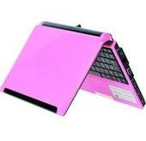
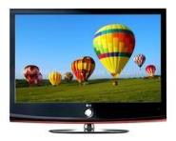
比一比，看谁能快速说出下面的单词。
New words
computer
furniture
picture
television=TV
wall

Slide 6
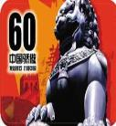
找一找，说出下面图片中的数字。
thirty
forty
fifty
sixty
seventy
eighty
ninety

Slide 7
Language points
1. What’s …like?
这个句型用来询问“……是什么样？”
例如：What’s an elephant like?
大象是什么样子的？

Slide 8
2. at the front of 表示“在……的最前面”。
in the front of 表示“在……的前面”。
（在里面内部的前面）
in front of 表示“在……的前面”。
（在外面的前面）
3. ’s 所有格表示所属关系，意为“……的”。
例如：teacher’s office 老师的办公室
4. a lot of + n. 表示“许多的，大量的”。

Slide 9
Grammar
找出对话3中含有there be结构的陈述句。
例如：
1. There are thirty students in my class.
2. But there is a computer on the teacher’s desk.
3. There’s a map of the world in our classroom.
4. But there aren’t any pictures on our walls.

Slide 10
there be 结构表示在某地有某人或某物。
there be 结构中的be与后面紧跟着的名词
保持单复数的一致。
例如：There is some water in the bottle.
there be 结构的否定句是在be后加not.
其缩写形式为: is not = isn’t
are not = aren’t

Slide 11
Practice
1. 在墙上有一幅地图。
There _____ a map on the wall.
2. 在我们班有40名学生 。
There ____ 40 students in our class.
3. 在我的桌子上有一台电脑。
_______ _____ a computer on my desk.
4. 在你的桌子上有一些书。
_______ ____ some books on your desk.
is
are
There is
There are

Slide 12
请找出对话3中含有there be结构的一般疑问句。
例如：
1. Is there a lot of furture?
2. Are there computers on everyone’s
desk?
3. Are there any pictures on the
classroom walls?
4. And is there a map of the map?
小结：
there be结构的疑问句
是把be放在there前。

Slide 13
Answer race
看图回答问题
Is there a blackboard in the classroom?
Yes, there is.

Slide 14
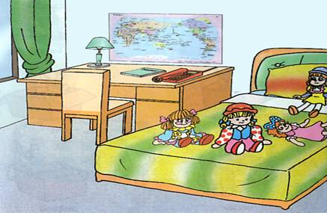
Is there a map of the world on the wall?
Yes, there is.

Slide 15
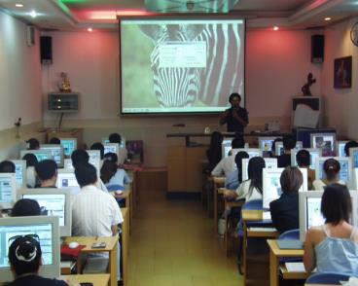
Are there any computers in the classroom?
Yes, there are.

Slide 16
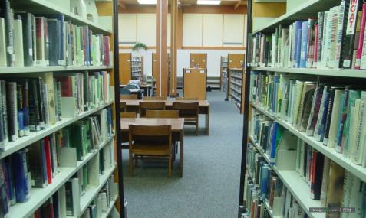
Are there any televisions in the library?
No, there aren’t.

Slide 17
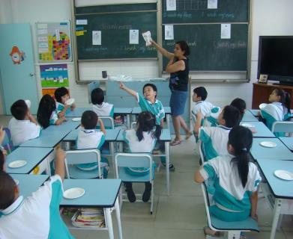
How many students are there in your class?
There are 30 students in my class.

Slide 18
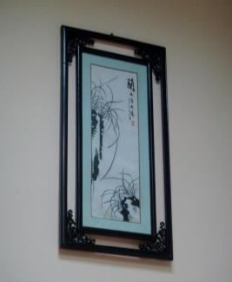
How many pictures are there on the wall?
There is one picture on the wall.

Slide 19
用“how many”提问，调查班级情况:
Work in pairs
How many…? | Numbers
desks
televisions
students
blackboards
pictures
computers
…
30

Slide 20
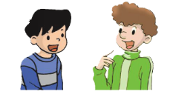
Talk about your ideal classroom.
A: How many…are there in your
classroom?
B: There are …
A: Is there a …
B: Yes, there is./ No, there isn’t.
A: Are there …?
B: Yes, there are./
No, there aren’t.

Slide 21
Pronunciation
Listen and repeat.
some
are classroom
computer teacher
girl thirty

Slide 22
Speaking
Listen and repeat the numbers.
twenty thirty forty fifty sixty seventy eighty ninety

Slide 23
Match the words with the numbers.
21
70
60
46
90
80
50
20
30
40
seventy
thirty
forty-six
fifty
sixty
twenty-one
eighty
ninety
forty
twenty

Slide 24
Summary
小结
there be结构中的be的单复数取决于
后面紧跟的名词。
there be结构的疑问句是把be提前。
some在否定句和疑问句中要变为any。

Slide 25
Practice
A
1. There some water in the bottle.
A. is B. are C. be D. am
2. There aren’t birds in the sky.
some B. a C. an D. any
3. ____ there a pen in the box?
am B. is C. are D. be
D
B

Slide 26
B
4. How many are there in the
classroom?
boy B. boys C. girl D. student
5. There ___ a lot of tall buildings in
the city.
A. is B. am C. are D. be
C

Slide 27
Homework
1. Learn the new words and
expressions in this unit by heart.
2. Finish the activity 7 on page 15.

