Slide 1
What colour is it?
第6课时
WWW.PPT818.COM

Slide 2
Can you remember these words?
white
black

Slide 3
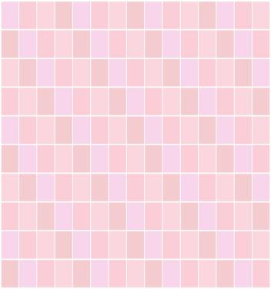
orange
pink

Slide 4
brown
purple

Slide 5
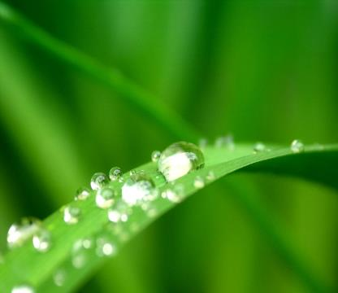
green
yellow

Slide 6
red
blue

Slide 7
Can you translate?
一只新铅笔 多漂亮呀！
它是什么颜色？ 一辆新的公交车
一个大的气球 画一个熊猫
把它涂成白色和黑色 画一个风筝

Slide 8
Fun story
I have a boat. Guess!
What colour is it?
No! It’s yellow.
Blue!
Red!

Slide 9
No! It’s green and purple.
This is my kite. Guess!
What colour is it?
Red and orange.
Black and white.

Slide 10
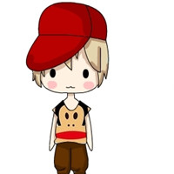
Really?
It’s a pink bag.
Yes, sure!

Slide 11
Yes!
It’s pink.
Wow! Super!

Slide 12
Let’s check and think.
1.认真听第二部分的录音，标出听到的。
2.想一想，然后涂上颜色。

Slide 13
Homework
背会第一部分的Fun story。

Slide 14
Thank You.

