Slide 1
Unit 8 Culture Shapes Us
Good Manners
WWW.PPT818.COM

Slide 2
Look at this proverb:
Manners make the man. 举止造就人。
Do you know its meaning?

Slide 3
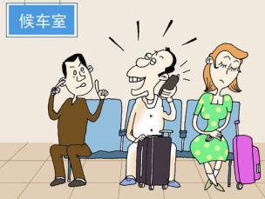
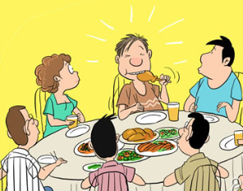
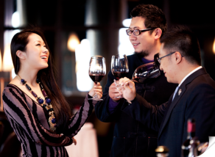
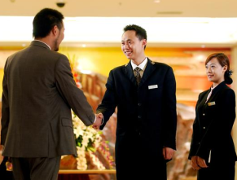
Is it good or bad?

Slide 4
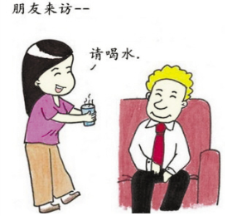
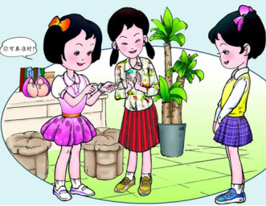
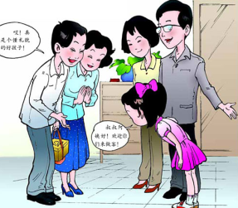
How do you usually treat a guest in your home?
How are you treated when you visit your friend’s house?

Slide 5
New words
tidy v. 使整洁；使整齐；整理
adj. 整洁的；整齐的
Russian adj. 俄罗斯的
n. 俄罗斯人；俄语
noisy adj. 喧闹的；吵闹的

Slide 6
Read the lesson and fill in the table.
Mr.Manner’s tips for Li Ming | Mr. Manner’s tips for Dong Fang
Tidy up your house before your guest arrives.
Open the door for your guest and hang up his coat.
Offer your guest something to drink or eat like tea,fruit and snacks.
Don’t ask your guest to go to the kitchen and serve himself!Serve your guest at the table.
Make him feel at home.Talk to your guest.
Don’t turn on the television.
Bring a small gift,such as sweets or flowers.
Follow the rules of your host’s home.
Do what your host asks you to do.
Don’t be noisy,especially at bedtime.
Offer to help prepare the dinner.
Write a thank-you note after your visit.

Slide 7
Read the text and find out main phrases and main sentences.
Main phrases:
·tidy up
·hang up
Main sentences:
·I invited him for dinner at my home,and he accepted.
·What should I do to make him feel welcome?
·Offer your guest something to drink or eat like tea,fruit and snacks.

Slide 8
·Don’t ask your guest to go to the kitchen and serve himself!
·That’s why you invited him.
·Don’t turn on the television.
·It will be my first time visiting a Russian house.
·Here are some small suggestions for you.
·Bring a small gift,such as sweets or flowers.
·Remember to be yourself and have fun.

Slide 9
☆教材解读☆
1.I invited him for dinner at my home,and he accepted.
◆invite sb. for…意为“邀请某人参加……”,介词for后加名词或代词作宾语。
【拓展】 (1)invite sb. to…意为“邀请某人去某地”,介词to后加表示地点的名词或代词作宾语。
(2) invite sb. to do sth.意为“邀请某人做某事”,其中的不定式作宾语补足语。
◆accept为及物动词,意为“接受,收下”,强调结果,后加名词或代词作宾语。
【辨析】 receive,accept
receive和accept都有“接受”的意思。receive强调客观上的收到,而accept强调主观上的接受。
【注意】 表示“接见,接待”之意时,应用receive,不用accept。

Slide 10
2.What should I do to make him feel welcome?
welcome为形容词,意为“受欢迎的”,be welcome
to do sth.表示乐于让某人做某事,意为“可随意做某事”。
【拓展】 (1)welcome还可作动词,“welcome sb.to+地点”意为“欢迎某人到某处”。
(2)welcome也可用作名词,或用作迎接时的招呼语。
3.Tidy up your house before your guest arrives.
tidy up为动副短语,意为“整洁,整齐”,tidy为动词,意为“使整洁,整理”。
【拓展】 tidy away意为“收拾起来”。

Slide 11
4.Open the door for your guest and hang up his coat.
hang up意为“把……挂起”。
【拓展】 hang up还可表示“挂断电话”。
5.Offer your guest something to drink or eat like tea,fruit and snacks.
◆offer为及物动词,意为“主动提出,自愿给予”,其后可接双宾语或动词不定式,但不可接从句或动名词。常用结构有:offer to do sth.(主动)提出做某事;offer sb.sth.或offer sth.to sb.(主动)为某人提供某物。
【拓展】offer也可用作名词,意为“建议,主动提议”,其后通常接of短语或动词不定式。
◆something to drink意为“喝的东西”。
形容词、不定式短语修饰something,nothing等不定代词时,要放在不定代词的后面。

Slide 12
6.Don’t ask your guest to go to the kitchen and serve himself!
◆ask sb.to do sth.意为“要求某人做某事”,其否定形式是ask sb.not to do sth.意为“要求某人不要做某事”。
◆serve在本句中意为“伺候进餐;为……端上(或摆出)食物(或饮料等)”。
7.That’s why you invited him.
why在本句中引导表语从句。
8.Don’t turn on the television.
turn on意为“打开(煤气、自来水、电灯等)”,为动副短语,其反义词组为turn off,意为“关闭(煤气、自来水、电灯等)”,turn up意为“(把音量等)调高”,turn down意为“(把音量等)调低”。

Slide 13
9.It will be my first time visiting a Russian house.
◆time在本句中意为“次,回”。表达“是某人第一次做某事”,还可以用“It is/was/will be the first time that…”句型。当主句动词为is/will be时,that从句用现在完成时;主句动词为was时,that从句通常用过去完成时,有时也可用一般过去时,that可省略。此结构中主句主语还可用this,this evening,yesterday等;first也可换成其他序数词;time也可换成其他名词。
◆句中的visiting a Russian house是现在分词短语作定语,修饰前面的名词time,visiting前省略了介词of,过去分词短语作定语时也要放在名词后。

Slide 14
10.Here are some small suggestions for you.
suggestion为可数名词,意为“建议”。
【拓展】 suggestion的动词形式为suggest,意为“建议;提出(意见、计划等)”,其后跟名词或代词。若接动词时,要用动名词,不能用动词不定式或不定式的复合结构;也可接that从句,谓语常用虚拟语气(即“should+动词原形”,should可以省略)。

Slide 15
11.Bring a small gift,such as sweets or flowers.
such as用于列举同类人或物中的几个例子;for example一般只举同类人或物中的一个为例,作插入语,用逗号隔开,可位于句首、句中或句末。
12.Remember to be yourself and have fun.
◆remember to do sth.意为“记着做某事(将要做的事)”;remember doing sth.意为“记得做过某事”。
◆yourself用于be,come to等后的意思是“你的正常情况(指健康、情绪等)”。

Slide 16
Imagine you visited a Canadian friend’s house yesterday.Write a short letter to your host.
Task tips:
You can thank him for the kind things he did for you.You can also mention some of the cultural differences you experienced in his home.

Slide 17
Listen and sing along.
So We Can Be Friends
We welcome you to our home.
You are all our guests.
We’d like to offer you some dinner,
Then a bed to rest.
We try to keep our culture.
We don’t find it strange.
I would like to learn about your ways,
So we can be friends.
You may find that our home is different from yours.
Would you like something to eat or drink?
Would you like some more?

Slide 18
Ⅰ.Circle the correct words to complete the sentences.
1.I said sorry for being too(noisy/noise).
2.The book I read was written in (Russian/Russia).
3.Please (tidy up/divide up)your closet.It’s a mess.
4.Big lights(hung/hanged)from the ceiling.
They looked beautiful.

Slide 19
Ⅱ.Choose the correct answers.
5.Don’t spit in public.It rude in many countries.
A.considers B.is considered
C.is considering D.considered
6.—Have you finished washing your clothes?
—Yes.I’m .
A.hanging up them B.hang them up
C.putting up them D.hanging them up
B
D

Slide 20
7.This kind of seafood in the restaurant today.
A.served wide B.can be served wider
C.is served wider D.is widely served
8.Mrs.Green asked her son in the street.
A.not play B.not to play
C.to not play D.doesn’t play
9. your desk before class begins.
A.To tidy B.Tidy for C.Tidy to D.Tidy up
10.We must the light when we leave the room.
A.turn on B.turn down
C.turn off D.turn up
D
B
D
C

Slide 21
Ⅲ.Complete the sentences.
11.你请了谁到家里来参加你的生日聚会?
Who have you your house
your birthday party?
12.这些友好的行为让他感觉像在家一样。
These friendly behaviours make him
.
13.请把你的大衣挂在衣钩上。
Please your coat on the hook.
14.这儿有一些给你的小建议。
Here some small for you.
15.她总是主动帮我做家务。
She always me with the housework.
invited to
for
feel at home
hang up
are tips
offers to help

Slide 22
Homework
1.Finish off the remaining exercises in the activity book.
2.The students are required to read the next text in the student’s book.

