Slide 1
Unit 3
I am more outgoing than
my sister.
Section A 1a-2c
WWW.PPT818.COM

Slide 2
Objectives
To learn to talk about personal traits
To learn to use comparatives to compare people
To learn new words: outgoing,
hard-working, competition, fantastic…

Slide 3
Words review
outgoing
better
loudly
quietly
hard-working
adj. 爱交际的；友好的；
外向的
adj.&adv. (good和well的比较级) 较好的(地)；更好的(地)
adv. 喧闹地；大声地；响亮地
adv. 轻声地；轻柔地；安静地
adj. 工作努力的；辛勤的

Slide 4
Words review
competition
fantastic
which
clearly
win
though
n. 比赛；竞赛；竞争
adj. 极好的；了不起的
pron.&adj. 哪一个；哪一些
adv. 清楚地；清晰地；明白地
v. 获胜；赢；赢得
adv. 不过；可是；然而
conj. 虽然；尽管；不过

Slide 5
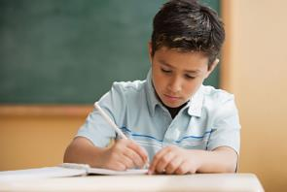
New words
1. outgoing adj. 友好的；外向的
一般修饰人，指人的性格。在句子中可做定语或表语。
e.g. Mary is an outgoing girl.
玛丽是一位外向的女孩。
My brother is not very
outgoing.
我弟弟不善与人交往。

Slide 6
2. better adj. / adv. （good和well的比较级） 较好的（地）；更好的（地）。
e.g.
The red bike is good.
The red bike is better than the blue one.
红色的自行车比蓝色的好。
Mike can play the guitar well.
Mike can play the guitar better than Bob.
迈克弹吉它比鲍勃弹得好。

Slide 7
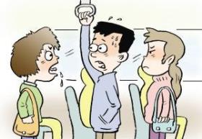
3. loudly adv. 喧闹地；大声地；响亮地
quietly adv. 轻声地； 轻柔地；安静地
e.g.
Don’t talk so loudly.
不要这么大声说话。
All the students are sitting quietly in the library.
所有的学生都安静地坐在图书馆里。

Slide 8
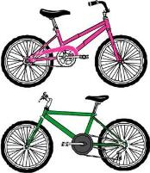
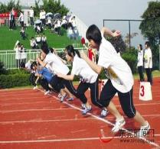
4. which pron. & adj. 哪一个；哪一些
指上文或下文提到的几个名词中的一个或一些。
e.g.
Which is your bike, Mary?
哪一辆是你的自行车，玛丽？
Which girl runs faster?
哪一名女孩跑得更快一些？

Slide 9
5. competition n. 比赛；竞赛；竞争
e.g. The singing competition was very interesting yesterday.
昨天的歌唱比赛很有趣。
6. fantastic adj. 极好的；了不起的
e.g. Look! Our English newspaper is really fantastic.
看！我们的英语报真是太棒了。

Slide 10
7. clearly adv. 清楚地；清晰地；明白地
e.g. Can you see the words clearly?
你能清楚地看到那些字吗？
8. win v. 获胜；赢得
e.g. It’s easy for us to win the game.
我们赢得这场比赛很容易。

Slide 11
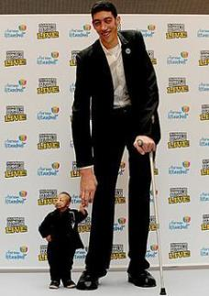
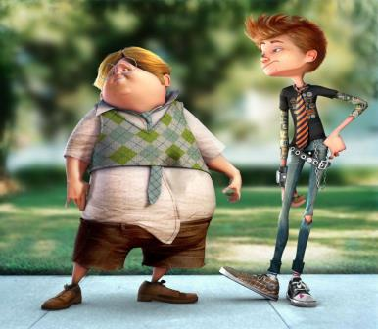
Write the opposite words according to the pictures.
1a
1. _____ → ____
short
tall
2. _____ → _____
heavy
thin

Slide 12
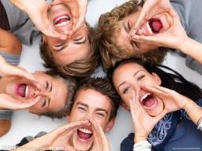
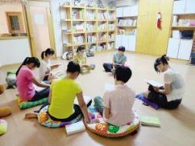
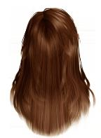
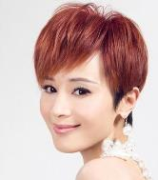
3. ______ → ______
loudly
quietly
4. _________ → _________
long hair
short hair

Slide 13
1a Match each word with its opposite.
tall loudly
thin short hair
long hair heavy
quietly short

Slide 14
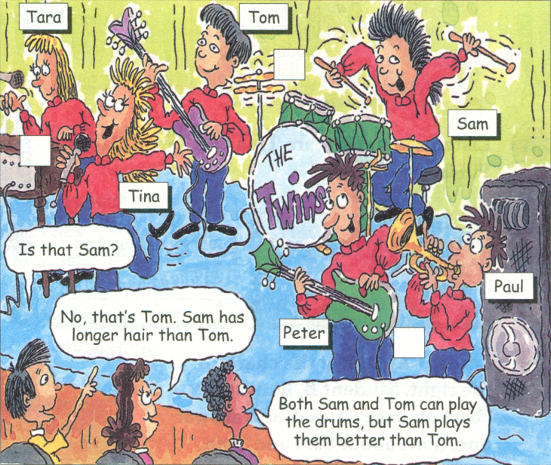
1b Listen and number the pairs of twins
in the picture [1-3]
1
2
3

Slide 15
Talk about the differences.
Who is tall, Tina or Tara?
Who is heavy, Peter or Paul?
Who has long hair, Tom or Sam?
Who is quietly, Tom or Sam?
Who is loudly, Tina or Tara?
Who is short and thin, Peter or Paul?
Tina
Peter
Sam
Tom
Tina
Paul

Slide 16
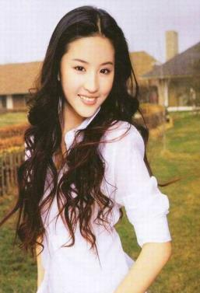
48kg
45kg
Lin Xinru is thin.
Liu Yifei is thinner.
Liu Yifei is thinner than Lin Xinru.

Slide 17
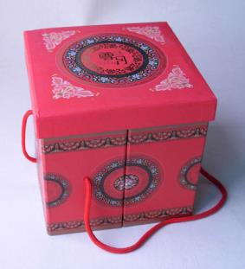
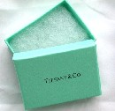
The red box is big.
The green box is small.
The red box is bigger than the
green box.

Slide 18
The purple ruler is long.
The blue ruler is short.
The purple ruler is longer than the blue ruler.

Slide 19
John Mike
outgoing
more outgoing
Mike is more outgoing than John.

Slide 20
Grammar
形容词或副词的比较级形式：
原形
比较级
tall taller
short shorter
nice nicer
thin thinner
funny funnier
outgoing more outgoing

Slide 21
原形
比较级
tall taller
short shorter
(一般在词尾 + er )
nice nicer
(以不发音的字母 e 结尾的 + r )
thin thinner
big bigger
(重读闭音节词词尾只有一个辅音字母时，先双写辅音字母再 + er)

Slide 22
funny funnier
(以辅音字母 + y 结尾的单 词，变 y 为 i + er )
outgoing more outgoing
hard-working more hard-working
(多音节词和部分双音节词前加more)

Slide 23
1c Practice the conversation in the picture
above. Then make conversations about
the other twins.
A: That’s Tara, isn’t it?
B: No, it isn’t. It’s Tina. Tina is taller
than Tara. And she also sings more loudly
than Tara.

Slide 24
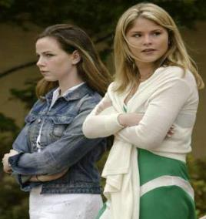
Let’s practice!
No, it isn’t. It’s Tina.
Tara’s shorter than
Tina.
Is that Tara?
Tina
Tara

Slide 25
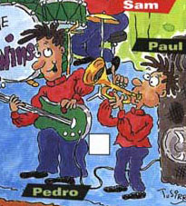
No, it isn’t. It’s Paul.
Paul is thinner than
Peter. Peter’s taller
than Paul.
Is that
Peter?
Peter

Slide 26
2a Listen. Are the words in the box used
with –( i)er or more? Complete the chart.
funny (run) fast
friendly (jump) high
outgoing (work) hard
hard- working (get up) early
smart
lazy

Slide 27
-er \ -ier | more
friendly | Outgoing
funny
smart
lazy
(run) fast
(jump) high
(work) hard
(get up) early
hard- working

Slide 28
Listen and fill in the blanks:
more outgoing
friendlier
1.I’m ____________ than Tara. I’m ___________and _________too.
2. She can ________and ____________than me.
3.Who’s _________________ at school?
4.Tina thinks she ____________than me, but I ____as ____as Tina,
But she’s ________than me.
5.I think I’m _______than Tara. She always _____________than me.
funnier
run faster
jump higher
more hard-working
works harder
work hard
smarter
lazier
gets up earlier

Slide 29
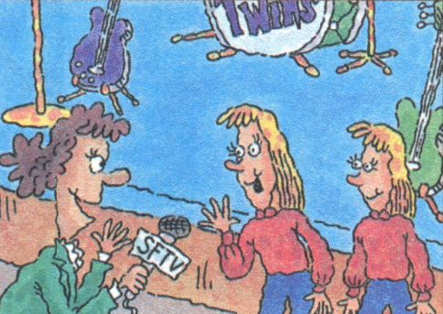
2b Listen again. How are Tina and Tara
different? Fill in the boxes.
Tina … | Tara …
more outgoing. | works as hard as Tina.
friendlier,
funnier,
run faster,
jump higher,
smarter, lazier
gets up earlier

Slide 30
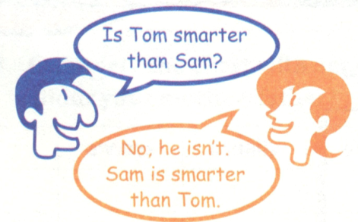
2c Student A, look at the chart on the right. Student B, look at the chart on page 81. Ask and answer questions.
Note:
***Means Sam is taller than Tom.
 | Sam | Tom
smart
tall | *** | *
run fast
get up early | *** | ***
thin
funny | *** | *
hard-working | *** | *
friendly

Slide 31
Who’s smarter?
Who is taller?
Who runs faster?
Who gets up early?
Who is thinner?
Who is hard-working?
Who is friendlier?

Slide 32
Guessing who she/he is?
Try to write at least 3 sentences in your paper to describe one of your classmates. And let us guess who is she/he.
Remember do not mention his/her name.
Example:
My best friend has long hair. She is taller than me. She wears glasses. She is a very hardworking girl.

Slide 33
Revision
形容词或副词比较级的构成：
1. 一般在词尾 + er
2. 以不发音的字母 e 结尾的 + r
3. 重读闭音节词词尾只有一个辅音字母时，先双写辅音字母再 + er
4. 以辅音字母 + y 结尾的单词，变 y 为 i + er
5. 多音节词和部分双音节词前加 more

Slide 34
练 习
一、按要求写出下列各词的正确形式
1 easy(比较级)：___________
2 different(名词)：_________
3 serious(比较级):_____________
4 friendly(比较级):_________
easier
difference
more serious
friendlier

Slide 35
6 funny(比较级)_________
7 outgoing(比较级)_______
8 quiet(反义词)_________
9 tall(反义词)____________
10 beautiful(比较级)______________
funnier
more outgoing
loud
short
more beautiful

Slide 36
二、句型转换。
This picture looks beautiful, but that one
looks more beautiful.(同义句)
That picture looks ______ _________ _______ this one.
2. She has longer hair than Emma.(同义句)
Her hair is ______ _______ _______.
3.Helen studies hardest（最努力） in her class.(同义句)
Helen studies ________ than ______ _______ student in her class.
more beautiful than
longer than Emma's
harder any other

Slide 37
4. My father is two years older than my mother.
(同义句)
My mother is _____ _______ ______ than
my father.
6. Dave is heavy, but he can run very fast. (上同)
________ Dave is heavy, he can run very fast.
two years younger
Though

Slide 38
三.选择
1.If you want to be thinner and healthier, you’d better eat ____food and take ____ exercise.
more, fewer B. more, less
C. fewer, more D. less, more

Slide 39
2.He’s ____ than his brother.
strong B. stronger
C. the stronger D. the strongest

Slide 40
3.Which do you like ____, tea or coffee?
good B. better
C. best D. the better

Slide 41
4. Mum, this T-shirt is much too small for me. Would you buy me a ____one?
good B. better
C. large D. larger

Slide 42
Thank You!

