Slide 1
Module 9 People and places
Unit 3 Language in use
WWW.PPT818.COM

Slide 2
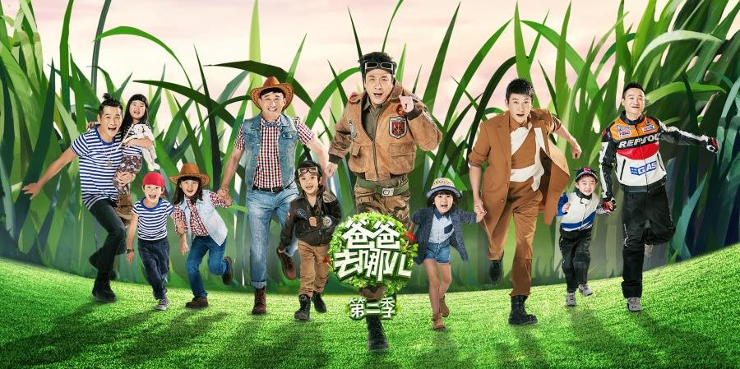
Where are we going, dad?

Slide 3
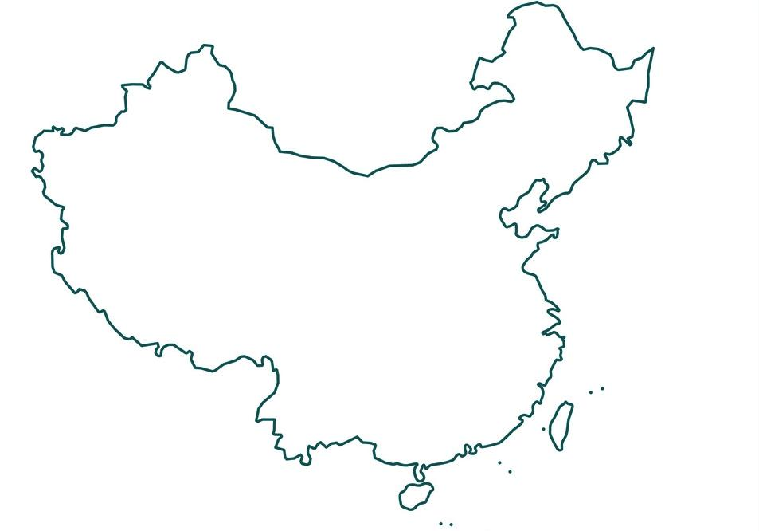
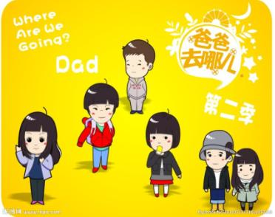
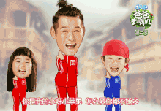
What are they doing?
Present continuous
现在进行时
They are traveling.
Gansu
Inner Mongolia
Sichuan
Chongqing
Zhejiang
Hunan
Taiwan

Slide 4
What are we going to do?
Today we are going to summarize the Present continuous tense. You will have four tasks（任务） to do this class. Try to get as many points as you can in every task.
Task I
Task II
Task IV
Task III

Slide 5
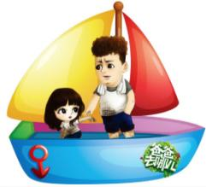
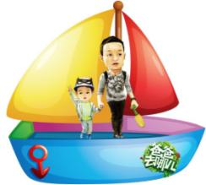
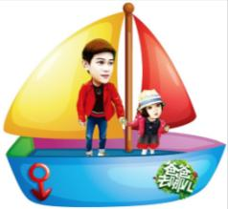
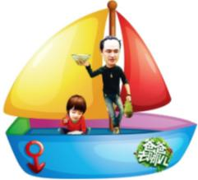
What are we going to do?
And you will stand for（代表） the five families, whenever you get one point, you can move forward(向前) one step.

Slide 6
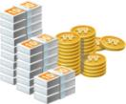
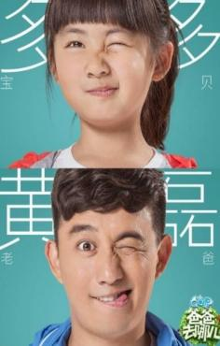
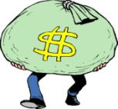
Task I
Change the words into V-ing form. If you are right, you may get:
+1
+2

Slide 7
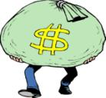
calling
drive
call
driving
running
run
studying
study
make
playing
making
play
shop
begin
lie
shopping
beginning
lying
die
take
get
dying
taking
getting

Slide 8
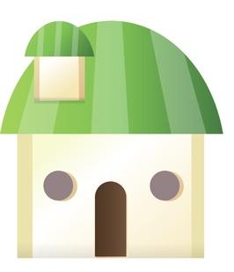
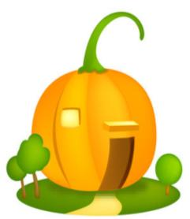
Summary
Can you help them go home?
shop-shopping
play-playing
make-making
lie-lying
begin-beginning
drive-driving
run-running
die-dying
study-studying
take-taking
call-calling
get-getting
直接加-ing
去e加-ing
双写辅音字母加-ing
特殊变化

Slide 9
Task II

Slide 10
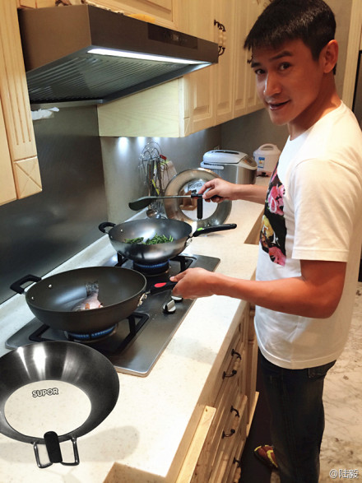
I am .
cooking

Slide 11
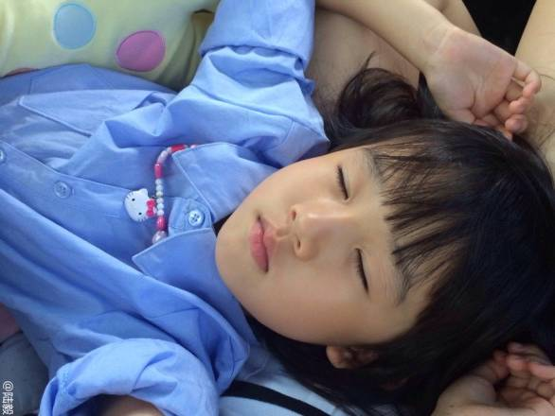
sleeping
Beier is .

Slide 12
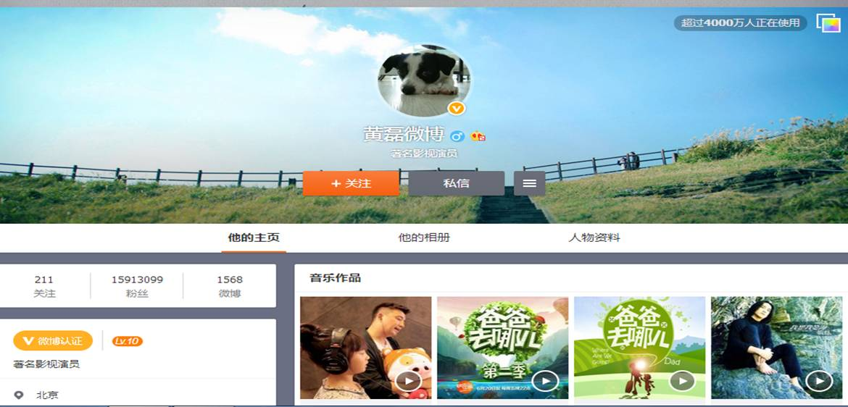

Slide 13
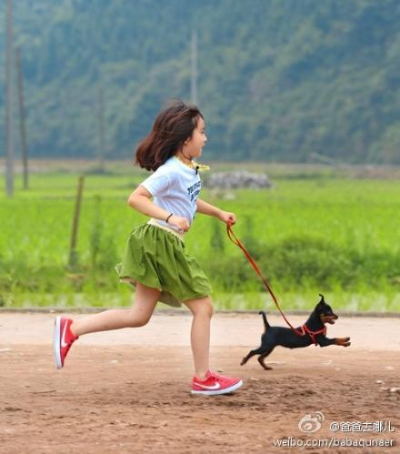
is running
Duoduo .

Slide 14
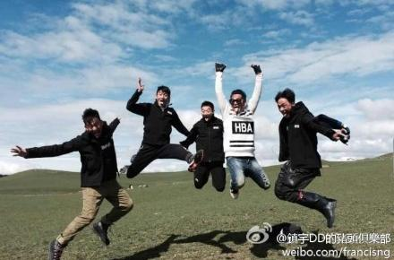
We are .
jumping

Slide 15
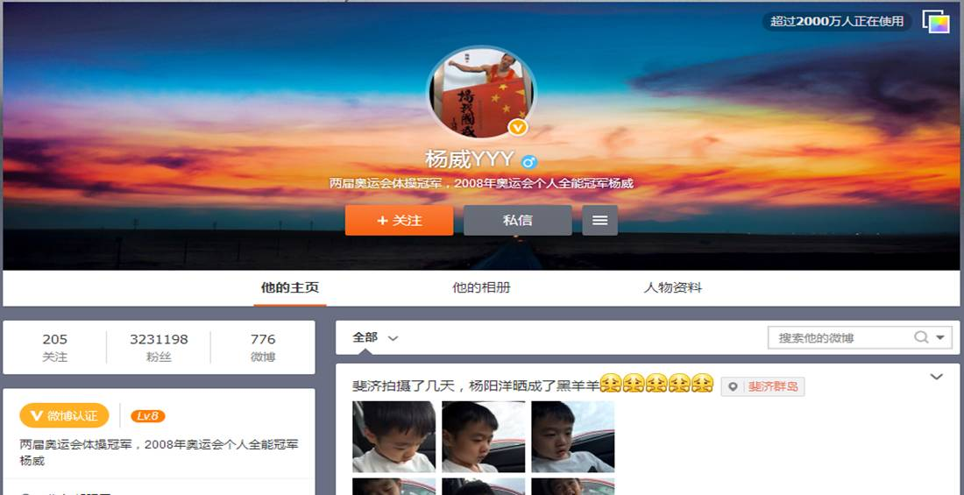

Slide 16
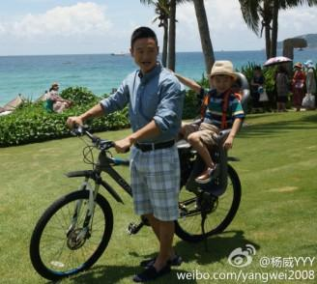
are riding a bike
We .

Slide 17
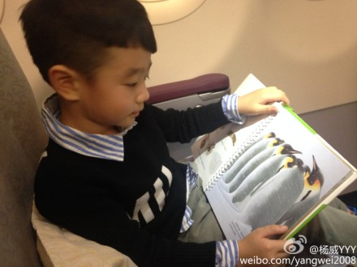
Yang Yangyang .
is reading a book

Slide 19
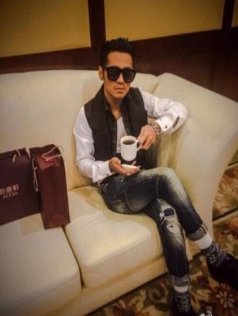
I am not singing. I .
am drinking

Slide 20
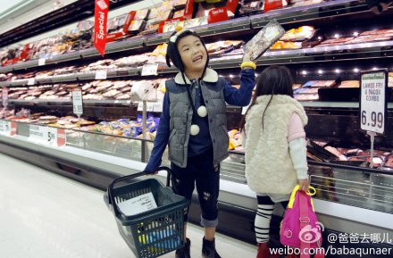
Joe games. He .
is not playing
is shopping

Slide 22
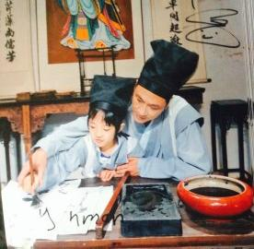
We pictures.
We .
are not drawing
are writing

Slide 23
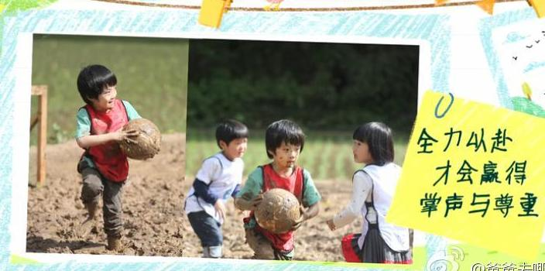
They basketball.
They football.
are not playing
are playing

Slide 24
Summary
I am cooking.
Beier is sleeping.
Duoduo is eating.
We are riding a bike.
They are smiling.
I am not singing.
Joe is not playing games.
We are not drawing pictures.
They are not playing basketball.
sb.+be(am,is,are) + V-ing
sb.+be(am,is,are) + not+V-ing

Slide 25
A guessing game
Guess what they are doing.
He / She is...
They are...

Slide 26
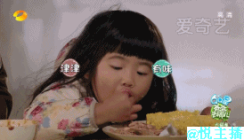
Grace is eating.
？

Slide 27
Duoduo is making bed.
?

Slide 28
Grace is crying.
？

Slide 29
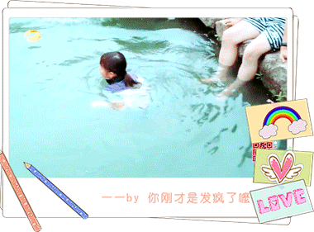
Duoduo is swimming.
？

Slide 30
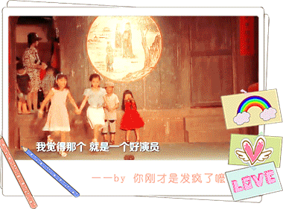
They are dancing.
？

Slide 31
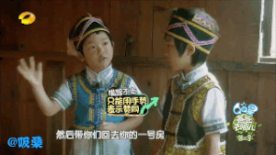
They are talking.
?

Slide 32
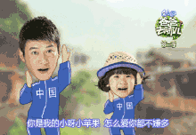
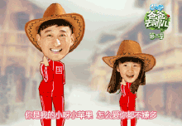
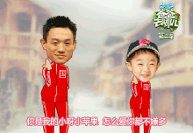
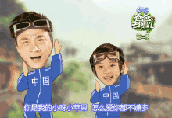
Task III Exercise
2
2
3
4
2

Slide 33
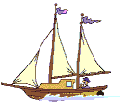
I. Choose the correct answer.
1. -What are you doing? -I_____.
A. eat B. can eat
C. eating D. am eating
2.It’s eight o’clock. Jim’s parents __TV.
A. is watching B. are watching
C. watch D. to watch

Slide 34
3.My mother is __a cake __my birthday.
A. making, to B. making, for
C. doing, to D. doing, for
4.-__you __the window? -Yes, I am.
A. Do, clean B. Is, cleaning
C. Are, cleaning D. Do, cleaning

Slide 35
II. Complete the sentences.
1. 他们正在吃午饭。
They are ____________ now.
2. 三班的学生正在做作业。
The students of Class Three _________ their homework.
having lunch
are doing

Slide 36
3. 孩子们正在起床。
Children _________________ now.
4. 现在是8:20。 他们正在上语文课。
____ 8:20 now. They __________ a Chinese class.
5. 他们正在公园里拍照。
They are ____________ in the park.
are getting up
It’s are having
taking photos

Slide 37
III.Complete the conversation.
Tony: Hi, Dad!
Dad: Hi, Tony. What are you doing now? Tony: We (1) ___________ ( visit ) the Forbidden City. Lingling and Betty
(2) __________ ( write ) postcards.
Dad: What is Daming doing?
Tony: He (3) _________ ( take ) photos. There are lots of people here.
are visiting
are writing
is taking

Slide 38
They (4) ____________ ( enjoy) the sun. Some people (5) ____________ ( look ) at the buildings and some (6) ____________ ( look ) at maps.
Dad: Are you having a good time?
Tony: Yes, we (7) _____________ ( have ) a great time, Dad! See you next Monday.
are enjoying
are looking
are looking
are having

Slide 39
Task IV
Describe what they are doing.
Watch the picture carefully.
Make sure your sentences are correct.
Pay attention to your spelling and handwriting.
Writing

Slide 40
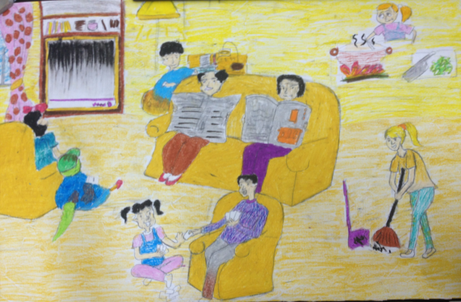
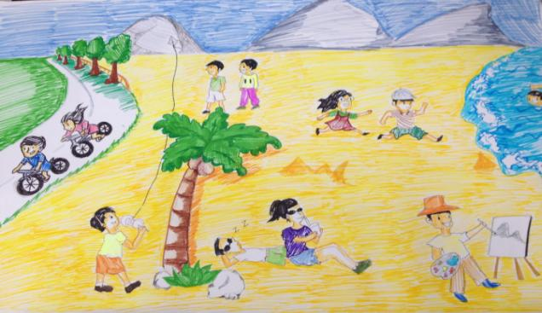
Joe
Lucy
Lingling
Betty
grandparents
Daming
Gary
Grace
Tom and David
Sam
Daming
Grace
Mary
Tony
Joe
Anny
Feyman
Gary

Slide 41
Homework
1. Review the usage of Present continuous.
2. Perfect your writing.

