Slide 1
Module3 My school
Unit1 There are thirty students in my class
WWW.PPT818.COM

Slide 2
音 素 找 到 家
Pre-listening
basketball Thursday father
number winter farm
today her girl son
nurse but about China
[a:] are class
/ʌ/ some
[ɜ:] thirty
/ə/ computer teacher
s

Slide 3
Find the numbers in the picture
Pre-listening
thirty
forty
fifty
sixty
eighty
ninety
seventy

Slide 4
几 十 几
Pre-listening
21
twenty-one
33
thirty-three
46
forty-six
68
sixty-eight
92
ninety-two

Slide 5
看 谁 反 应 快
Pre-listening
20
40
30
80
60
21
64
70
90
91
49
88
72
56
33
50
w

Slide 6
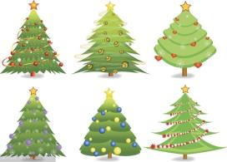
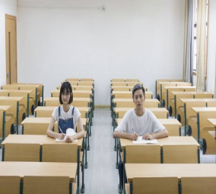
Make a dialogue
Pre-listening
A: How many… are there (in/at/on…)?
B: There is/ are…
B: How many … are there (in/at/on…)?
A: There is/ are…
c

Slide 7
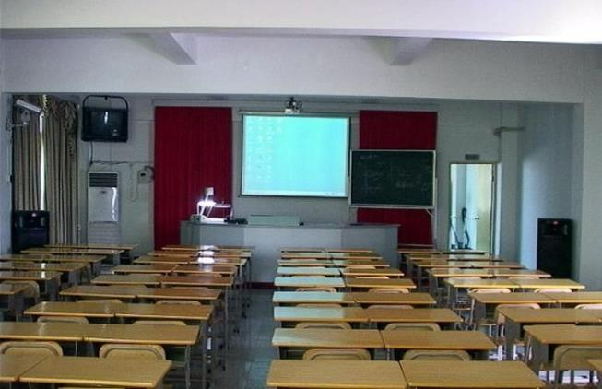
New words
Pre-listening
classroom [ˈklɑ:sru:m]
television
[ˈtelɪvɪʒn]
computer
[kəmˈpju:tə]
blackboard
[ˈblækbɔ:d]
map
[mæp]
desk
[desk]
furniture
[ˈfɜ:nɪtʃə]
teacher’s desk
p

Slide 8
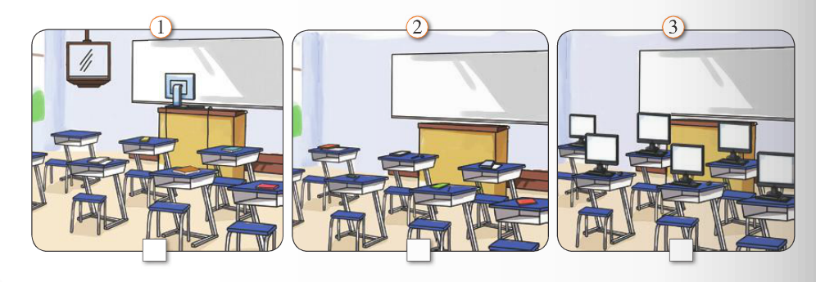
Look at the pictures and talk about them
While-listening
blackboard book classroom computer desk
furniture map picture television wall
√
dl

Slide 9
Listen and answer
While-listening
What is Daming and Linda talking about?
They are talking about their classrooms.
b

Slide 10
Listen and complete the table
While-listening
Class | Number of students | Pictures | Type of map
Linda’s class
Daming’s class
There are pictures at the front of the classroom
30
A map of
England
There aren’t any pictures
A map of
the world
40
r

Slide 11
Read and check（T or F）
While-listening
There are thirty students in Linda’s class.
There are twenty students in Daming’s class.
There is a map of the world in Linda’s classroom.
There are computers on everyone’s desk in Linda’s classroom.
T
forty
F
England
F
There is a computer on the teacher’s desk
F
T

Slide 12
Language points
Post -listening
There be句型---肯定句，否定句
There is a map of England.
There is a computer on the teacher’s desk.
There are 30 students in my class.
There are some students.
There isn’t a computer on everyone’s desk.
There isn’t a map of the world in our classroom.
There aren’t any students in the class.

Slide 13
Language points
Post -listening
There be句型---肯定句，否定句
肯定句
单数:
复数：
There is a/ an + 可数名词单数（ +介宾短语）
There are + some/数量+可数名词复数（ +介宾短语）
否定句
单数:
复数：
There isn’t a/ an + 可数名词单数（ +介宾短语）
There aren’t + any /数量+可数名词复数（ +介宾短语）

Slide 14
Language points
Post -listening
There be句型---疑问句
Is there a lot of furniture? Yes, there is.
Is there a map of the world? No, there isn’t.
Are there computers on everyone’s desk? No, there aren’t.
Are there any pictures on the classroom walls? Yes, there are.
How many students are there in your class?
There are 40 students.

Slide 15
Language points
Post -listening
There be句型---疑问句
一般疑问句
单数:
复数：
Is there a/ an + 可数名词单数（ +介宾短语）?
Yes, there is. No, there isn’t.
Are there + any +可数名词复数（ +介宾短语）
Yes, there are. No, there aren’t.
特殊疑问句
How many + 可数名词复数+ are there（ +介宾短语）?
There is/ are+ 数量…
L

Slide 16
Describe the classroom
Post -listening
big
30 students
a lot of furniture
20 girls
20 boys
a map of the world
Linda’s classroom
aren’t any pictures
40 students
a computer
some pictures
Daming’s classroom
a map of England
p

Slide 17
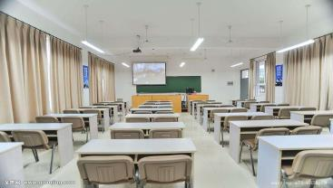
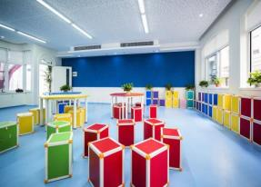
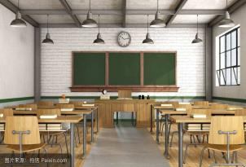
Group work
Post -listening
bright
soft
colourful
clean
tidy
My ideal(理想中) classroom
In my classroom, there is , there are . But there isn’t , there aren’t any ___________________. I like my classroom very much.
v

Slide 18
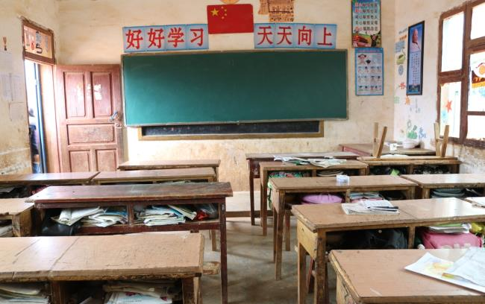
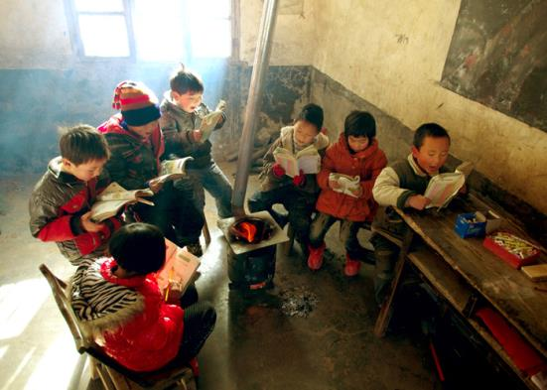
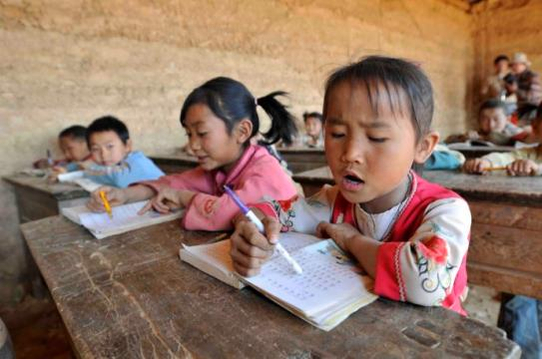
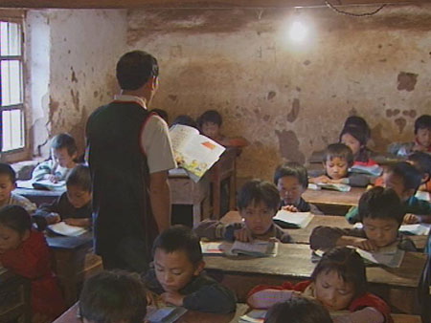
Schools in the village
Post -listening
We are so lucky that we should cherish what we have. Let’s study hard and try to help them.
我们很幸运，请珍惜我们所拥有的一切。
让我们努力学习，尽力去帮助他们吧！

Slide 19
Homework
Post -listening
Please exchange your position with other students to make it better

