Slide 1
九年级英语上 新课标 [冀教]
Unit 5 Look into Science
DNA—The Story of You
WWW.PPT818.COM

Slide 2
This is the shape of DNA.
“DNA” is short for deoxyribonucleic acid.

Slide 3
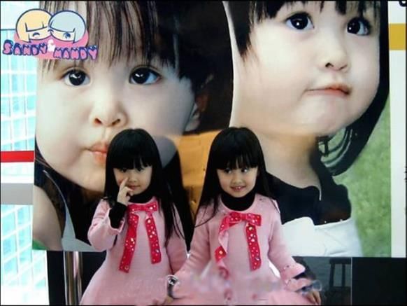
The two girls are twins. Maybe they have the identical DNA.

Slide 4
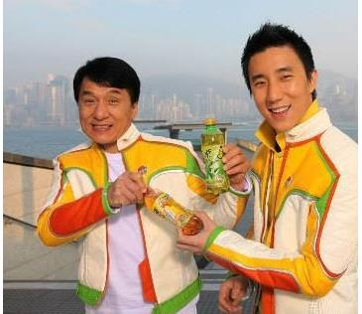
Fang Zuming looks like his father—Cheng Long.

Slide 5
New Words
DNA blueprint
general complex
twin repeat
pattern identify
related grandson
granddaughter instruction

Slide 6
Read the lesson and answer the questions.
(1)What is a blueprint?
(2)Which is more complex,building a living thing or building a house?
(3)Do some twins have the same DNA?
A blueprint is a drawing that shows how to put a house together with many different parts.
Building a living thing is far more complex than building a house.
Yes,they do.

Slide 7
(4)Is it possible to change your DNA?
(5)Whose DNA is related to yours?
Yes,it is.In the future,scientists might be able to change our DNA.
People who are related to me.For example,my parents and grandparents.

Slide 8
Read the text and find out main phrases and sentences.
Main phrases:
·in general
·except for
·be related to
·billions of

Slide 9
Main sentences:
·What can scientists do with DNA?
·But building a living thing is far more complex than building a house.
·Except for some twins,every living thing has its own unique DNA.
·Some health problems can be caused by problems in your DNA.

Slide 10
·In the future,scientists might be able to change your DNA.
·There are copies of your DNA in every part of your body.
·You have your own unique DNA,but it repeats patterns from your parents’ DNA.
·Your DNA has billions of instructions that explain why you are the way you are.
·It’s one of the most amazing things on the earth!

Slide 11
☆教材解读☆
1.What can scientists do with DNA?
do with为固定短语,意为“处理”,强调对象,与疑问词what连用。
【拓展】 deal with也意为“对待,处理”,侧重处理的方式、方法,与疑问词how连用。
2.In general,a blueprint is a drawing that shows how to put a house together with many different parts.
◆in general意为“一般而言,概括说来”,通常置于句首,也可以用generally speaking来表示。
◆different为形容词,意为“不同的”,常用于以下结构中:be different from与……不同;be different in…在……上不同。

Slide 12
3.But building a living thing is far more complex than building a house.
◆living为形容词,意为“活着的,活的”,常作定语。
◆far为副词,意为“非常,远远”,用来修饰形容词和副词的比较级,表示程度。
【拓展】 同样用法的词还有even“甚至”;rather“相当”;much“……得多”;a little/bit“有点”;a lot“……得多”等等。

Slide 13
4.Except for some twins,every living thing has its own unique DNA.
◆except for意为“除……之外,要不是由于”,它要求排除的是不同类的。
【辨析】 except for,except,besides,but
(1)except for意为“除了”,表示对主体的肯定和局部的否定,用于不同类的事物间。
(2)except可用作介词,意为“除了……之外”,表示同类事物间的排除关系。
(3)besides可用作介词,意为“除……之外”,表示同类事物间的叠加关系。
(4)but可用作介词,意为“除……之外”,常与no,all,every,each,none,nobody等词连用,有时可与except互换。

Slide 14
◆every为形容词,意为“每一的,每一个的”,其后接单数名词;“every+单数名词”作主语时,谓语动词用单数;every强调整体概念,不能直接与of连用,指三者及三者以上中的每一个。
【拓展】 each可作形容词,意为“每个的”,也可用作代词,意为“每个”,each作形容词时只能作定语,其后接单数名词;“each+单数名词”或each作主语时,谓语动词用单数;
each强调个体,可与of连用,指两者及两者以上中的每一个。
【注意】 “every/each+单数名词+and+every/each+单数名词”结构作主语时,谓语动词用单数形式。
◆own作形容词,意为“自己的”,位于物主代词或名词所有格之后,还可作动词,意为“拥有”,其后宾语多表示房屋、土地或财产等,其名词形式为owner,意为“物主”。

Slide 15
5.Some health problems can be caused by problems in your DNA.
◆health为不可数名词,意为“健康”,常构成短语in good/bad health,意为“健康/不健康”。
【拓展】 (1)healthy为形容词,意为“健康的”;unhealthy意为“不健康的”,keep/stay healthy意为“保持健康”。
(2)healthily为副词,意为“健康地”,eat healthily意为“吃得健康”。
◆cause为及物动词,意为“引起,导致,发生”,后面可接双宾语,也可接动词不定式作宾语补足语。
【拓展】 cause作名词,意为“原因,起因”。指导致某种结果、造成一种事实的原因,通常与of连用。

Slide 16
6.In the future,scientists might be able to change your DNA.
be able to意为“能,会”,表示通过努力而获得的能力,强调结果,可用于各种时态,其后接动词原形。
7.You have your own unique DNA,but it repeats patterns from your parents’ DNA.
◆repeat为及物动词,意为“重复,重述”,后接名词或代词作宾语。
◆parents’意为“父母亲的”,是复数名词的所有格形式。

Slide 17
8.From your DNA,scientists can identify not only you,but also people who are related to you.
◆identify为及物动词,意为“确认,识别,鉴别”,后接名词或代词作宾语。
◆be related to意为“和……有联系,和……有关,与……有亲戚关系”。related为形容词,意为“有关的,相关的”。relate为动词,意为“把……联系起来”,常与to或with搭配。

Slide 18
9.Your DNA has billions of instructions that explain why you are the way you are.
本句句末的you are是the way的定语从句。the way的定语从句的引导词可用in which,或用that,也可以不用引导词。way在本句中意为“情况,状态”。
10.It’s one of the most amazing things on the earth!
one of the most amazing things意为“最令人惊奇的事情之一”,为“one of the+形容词的最高级+复数名词”结构。其中定冠词the也可使用形容词性的物主代词来代替。

Slide 19
Is it a good idea to change the DNA of the food we eat?Some people say doing this makes our food better. Others think it’s too dangerous. Search the Internet for information and write down your ideas.
·Do you think it’s a good idea to change the DNA of the food we eat?Why or why not?
·What are some of the positives of genetically modified food?
·What are some of the negatives of genetically modified food?

Slide 20
Practice
Ⅰ.Fill in the blanks with the phrases in the box.
in general,except for,not only…but also,
related to,even if,the same…as…
1.Your homework is quite good a few spelling mistakes.
2. the young the old like pop music.
3.Kate’s hair is colour her sister’s.
4. ,women live longer than men.
5. many difficulties remain,we can overcome them.
6.Is wealth happiness?
except for
Not only but also
the same as
In general
Even if
related to

Slide 21
Ⅱ.Complete the passage with the sentences in the box.
Changing DNA
Do you know DNA can be changed?Have you ever seen a pig with a dog’s body?Of course not!Pigs and dogs can’t have babies together. But now, scientists can do it.Scientists can take DNA from one kind of animal and put it into another kind of animal. They can design new plants by combining the DNA of other plants. ________ Some scientists are worried.They say we need to know more about DNA before we start changing it. But what if the plants are bad for humans,too?
A.Their DNA can’t combine.
B.We can make plants that are bad for pests.
C.They can even combine the DNA of a plant and an animal.
A
C
B

Slide 22
Ⅲ.同义句转换
1.Both you and Linda give us a big surprise.
you Linda_____ us a big surprise.
2.It takes me half an hour to clean up my room.
I half an hour up my room.
3.My book isn’t the same as his.
My book is his.
4.What do you do with this problem?
do you with this problem?
5.He can speak Chinese.
He is speak Chinese.
6.I don’t know how I could build a house.
I don’t know how a house.
Not only but also
gives
spend cleaning
different from
How deal
able to
to build

Slide 23
Homework
1.Finish off the exercises in the activity book.
2.Preview Lesson 30.

