Slide 1
Unit 3 Could you please clean your room?
Section A 1a—2d
WWW.PPT818.COM

Slide 2
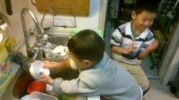
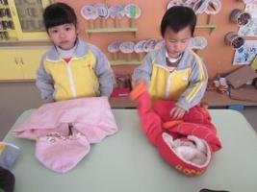
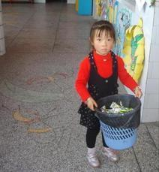
Look and say
do the dishes
fold your clothes
take out the rubbish

Slide 3
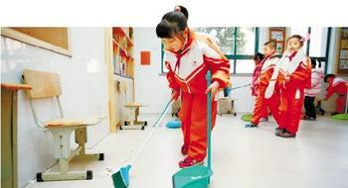
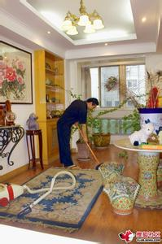
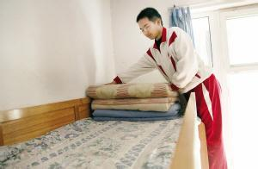
Look and say
sweep the floor
clean the living room
make your bed

Slide 4
What other chores do you know?
wash the car
wash the clothes
cook / make dinner
go shopping
baby sit brother / sister
…

Slide 5
1b Listen and check
Chores | Peter’s mother | Peter
do the dishes
sweep the floor
take out the rubbish
make the bed
fold the clothes
clean the living room

Slide 6
Make conversations
A: Could you please sweep the floor?
B: Yes, sure. Can you do the dishes?
A: Well, could you please do them? I’m
going to clean the living room.
B: No problem.

Slide 7
2a Listen and check
Peter wants to… | Peter’s father says… | His father’s reasons
go out for dinner | √ yes ___ no | I have to do some work.
go to the movies | ___ yes ___ no | You have to clean your room.
stay out late | ___ yes ___ no | I need to eat breakfast.
get a ride | ___ yes ___ no | You have a basketball game.

Slide 8
2c Make different conversations
A: Could I use your computer?
B: Sorry. I’m going to work on it now.
A: Well, could I watch TV?
B: Yes, you can, but first you have to clean
your room.

Slide 9
2d Role-play the conversation:
Q: What chores will Tony have to do?
He will have to take out the rubbish, fold the clothes and do the dishes.

Slide 10
Homework
Please choose one of them as your homework.
A. Remember the new words and
expressions of this lesson. Prepare for
the dictation.
B. Make a new conversation according to
the conversation in Section A 2d.

Slide 11
Thank you for your attention

