Slide 1
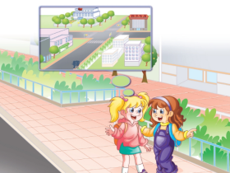
人教精通版六年级下册
Unit2 There is a park near my home.
WWW.PPT818.COM

Slide 2


>>Review
Let’s chant

Slide 3
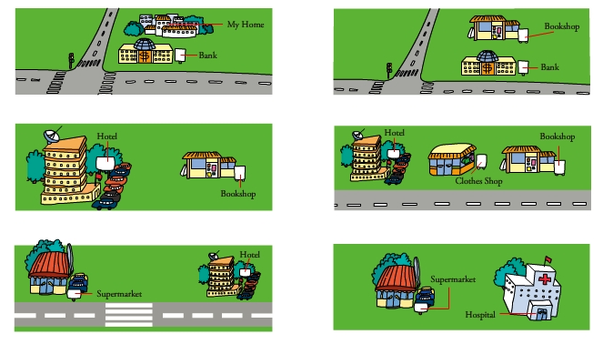
>>Review
Look and say
There is/are …

Slide 4
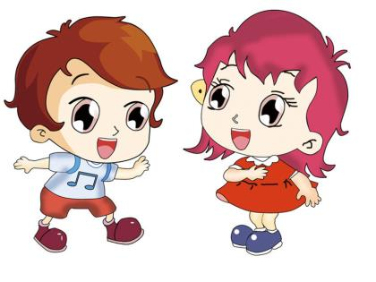

>>Lead-in
Play a game
I say you do
Go back to your seat.
Go to the teacher’s desk.
Show me your right hand.
Show me your left foot.
Turn right.
Turn left.

Slide 5
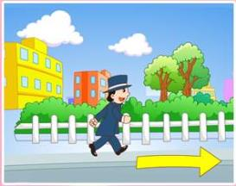
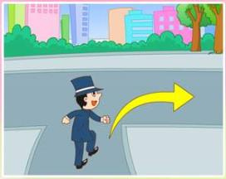
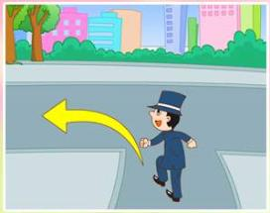

>>Presentation
Look and say
go down this street
turn right
turn left

Slide 6
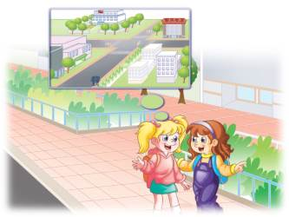
>>Presentation
Look and say
Look at the picture. What’s in it?
There is a community and two girls in it.

Slide 7


>>Presentation
Look and say
Who are the girls?
What are they talking about?

Slide 8
>>Presentation
Look, listen and say
Who is new in the community?
Lisa.
When did Lisa move here?
She moved here last week.
Where is Lisa going?
She is going to the bookshop.

Slide 9
>>Presentation
Look, listen and say
How will Lisa go there?
On foot.
Does Kate know the way?
Yes, she does.

Slide 10
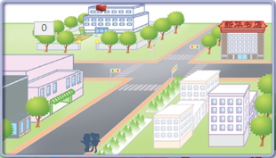
>>Presentation
Look, read and say
Where is the bookshop?
Go down this street and turn right at the traffic lights. Then you can see the bookshop on the left.

Slide 11


>>Presentation
Look, think and say
How long does it take to go there on foot?
Only a few minutes.
Only a few minutes.
How long does it take to go there by bike/
bus/car?

Slide 12
>>Practice
Listen and read
Lisa: Good morning, Kate.
Kate: Good morning, Lisa. Nice to see you here.
Lisa: I moved to this community last week.
Kate: Really? I live in this community! Where are
you going?
Lisa: I want to go to the bookshop. But where is it?

Slide 13
>>Practice
Listen and read
Kate: Go down this street and turn right at the traffic lights. Then you can see the bookshop on the left.
Lisa: How long does it take to go there on foot?
Kate: Only a few minutes.
Lisa: Thank you!
Kate: My pleasure!

Slide 14





>>Practice
Show time
Work in two, choose a way you like to read or act the dialogue.（2人一组, 选择你喜欢的方式去读或者表演对话。）
Act out the dialogue.（表演对话）
Read in roles.（分角色朗读）
Read together.（齐读）

Slide 15
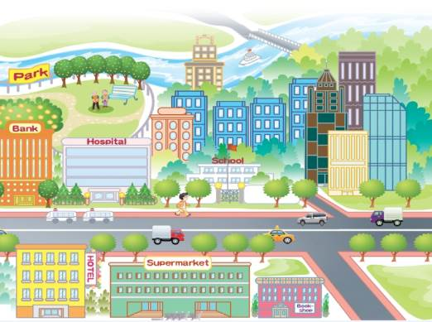
>>Practice
Ask and answer
Where is …?
Go down …
Then you can see…
Songshan
Road
Renmin
Road
Nanyang
Road

Slide 16
>>Summary
本课的重点词汇:
2.本课的重点句型是:
go down this street
turn left
turn right
on foot
minute
Where is it?
Go down … and turn right at ... Then you
can see ...

Slide 17


>>Homework
1.观看课文动画，按照正确的语音、语调朗读课文。
2.观察自己家所在的位置，制作一张方位图，标注上街道名称及周围设施的名称。
3.预习 Lesson10。

