Slide 1
Lesson 43: What Makes You Unique?
WWW.PPT818.COM

Slide 2
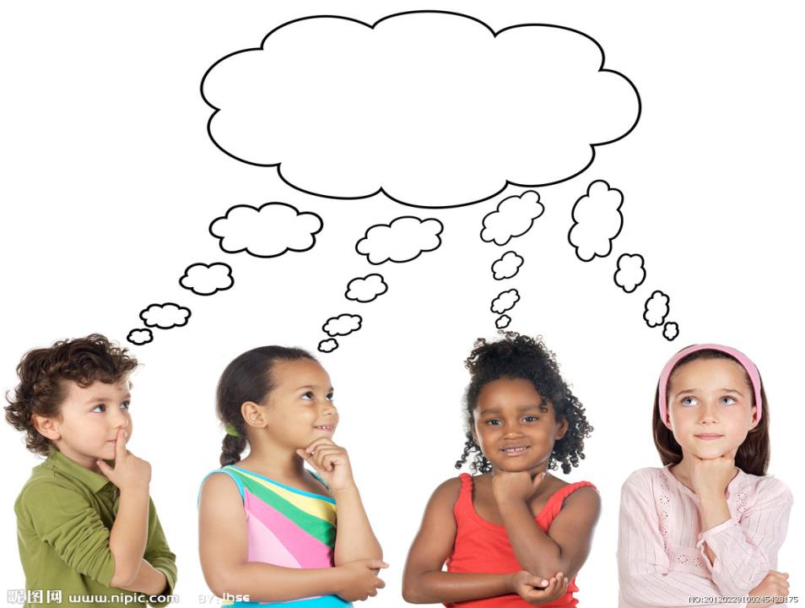
THINK ABOUT IT

Slide 3
Are you proud of yourself?
What are you good at?

Slide 4
Li Ming and Jenny are chatting online.
Li Ming: Hi Jenny! Are you there?
Jenny: Yes, Li Ming. What’s up?
Li Ming: SOS! I need your help with my English
project this week.
Jenny: No problem! Tell me more about it.
Li Ming: We are supposed to describe ourselves
in a report. What should I write about
myself? I find it a little hard.

Slide 5
Jenny: I can’t help you write the report, but I
can help you think about it.
Li Ming: Yes. please. That would be great!
Jenny: First, think about yourself. What do
you like about yourself?
Li Ming: Hmm ... Let me think. I’m a good
student, and I think I’m a good person
I also have many friends.

Slide 6
Jenny: That’s right! You can also write about
your special talents and personal
strengths. What makes you unique?
Li Ming: That seems hard!
Jenny: Not really. Suppose you are talking to a
friend. Tell them about yourself. What
are you good at? What are you proud of?

Slide 7
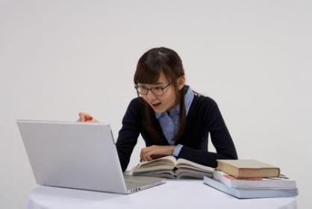
Li Ming: Yes, that makes sense. Thank you so
much for your help.
Jenny: It’s my pleasure.

Slide 8
Read the lesson and write true (T) or false (F).
1. Jenny and Li Ming are talking on the phone. （ ）
2. Jenny can write the report for Li Ming. （ ）
3. Li Ming doesn’t know how to describe himself in the
report at first. （ ）
4. Li Ming is a good student and has many friends. （ ）
F
F
T
T

Slide 9
What’s up? 怎么了？
1.
类似用法还有：
What’s wrong with you?
What’s the matter with you?
What’s the trouble with you?
What’s happened to you ?
……
怎么回事?
有什么事？

Slide 10
SOS! 救命! (求救信号)
2.
to send an SOS 发出紧急呼救信号
SOS 是国际莫尔斯电码救难信号，并非任何
单字的缩写。 鉴于当时海难事件频繁发生，
往往由于不能及时发出求救信号和最快组织
施救，结果造成很大的人员伤亡和财产损
失，国际无线电报公约组织于1908年正式将
它确定为国际通用海难求救信号。

Slide 11
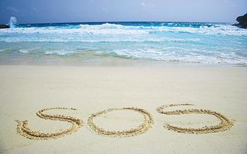
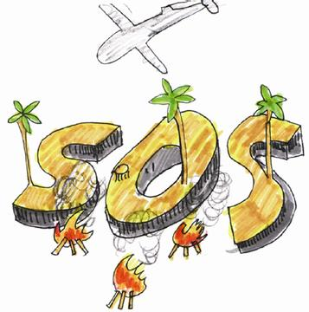
这三个字母组合没有任何实际意义，只是因
为它的电码“…---…”(三个圆点，三个破折号，
然后再加三个圆点）在电报中是发报方最容易
发出，接报方最容易辨识的电码。

Slide 12
3. We are supposed to describe ourselves in a
report.
我们要写一篇报告来描述自己。
“应该，认为必须，被期望” 和should意思相近。
They were supposed to be here an hour ago.
他们应该在一小时以前到达这里。
I am supposed to meet him at the station.
我应该去车站接他。

Slide 13
4.
① 表示“人”， 是个体名词，泛指man,
woman或child中的任何一个
② 其复数形式是persons,但人们习惯用
people代替persons。
person
③ persons作为复数形式用于正式或法
律语言中。“一个人”常译作a person,
而需要说明一个人的性别时，要用a
man 或a woman来表示。

Slide 14
At least one person died and several others
were injured.
至少一人死亡，还有几个人受伤。
Everyone knows he’s the only person who can
do the job.
人人都知道他是唯一能做这项工作的人。

Slide 15
5. You can also write about your special talents
and personal strengths.
你也可以写写你的特殊的天赋和个人强项。
a man of many talents. 多才多艺的男子
a talent show 才艺演出

Slide 16
6. What makes you unique?
什么使得你很独特？
make sb. + adj. 使某人……
7. Suppose you are talking to a friend.
假设你正在和朋友聊天。
表示“假设，假定，认为”
suppose 动词
表示“猜想，推测”
Suppose he isn’t out. What can I do?
假定他没出去，我该怎么办？

Slide 17
I suppose he’ll come back now.
我想他这会儿该回来了。
You can’t suppose whom I met in the street.
你准猜不着我在大街上看见谁啦、

Slide 18
8. What are you proud of?
你以什么而感到骄傲？
be proud of sb./sth.
为（因）……而感到自豪和骄傲
I am proud of myself. 我为自己感到自豪。
She is proud of her new car.
她为自己的新车而感到自豪。

Slide 19
9. Yes, that makes sense. 对，很有道理。
make sense
有意义，有道理
I guess that makes sense.
我想这蛮有道理。
It makes sense to care for your health.
保重身体是明智的。

Slide 20
10. It’s my pleasure. 我的荣幸（乐意效劳）。
可以用于人家请求帮忙时或者你已经帮助别人，别人感谢你时所说的话，表示你很荣幸能帮他这个忙，用于事情发生之后。
It’s my pleasure.
It’s a pleasure.
My pleasure.
With pleasure.
多用于别人请求帮忙时，自己很愿意
去做，用于事情发生之前。

Slide 21
辨析
—Can you give me a glass of water?
你能给我一杯水吗？
—With pleasure. 乐意效劳。
—Thanks for helping me! 谢谢你的帮助！
—My pleasure./It’s my pleasure. 我很荣幸。
在给别人水之前说的
在帮助别人之后说的

Slide 22
Listen to the dialogue and fill in the blanks.
Mike: Hi Helen! Are you there?
Helen: Yes, Mike. What’s up?
Mike: Could you help me with my ___________
this week?
Helen: Sure. Tell me more about it.
project

Slide 23
supposed
Mike: We are ____________to write about Dr.
Hawking. I know he is a famous
_____________. But what should I write
about him? I’m not sure.
Helen: He wrote some interesting books. Maybe
you can talk about one of his books.
Mike: That’s a great idea. Thank you for your
help.
Helen: It’s my _____________.
scientist
pleasure

Slide 24
Make sentences using the given information.
Example: We are supposed to describe ourselves
in a report.
Danny/meet Steven at 8 a.m. in the library (be
supposed to)
__________________________________
__________________________________
Danny is supposed to meet Steven at 8
a.m. in the library.

Slide 25
2. I/do my homework tomorrow evening (be
supposed to)
__________________________________
__________________________________
3. Celina/perform on Christmas Day next week
(be supposed to)
__________________________________
__________________________________
I’m supposed to do my homework
tomorrow evening.
Celina is supposed to perform on
Christmas Day next week.

Slide 26
PROJECT
ALL ABOUT ME
Everyone is special. What makes you special?
Describe yourself and explain why you are unique. Write
a report about yourself and include some drawings or
photographs.
Here are some ideas of things to write about:
What are your personal strengths?
Do you have any talents?
What makes you happy?
What are you proud of?

