Slide 1
Unit1 My Body
陕旅版
三年级下册
Part A Draw yourself
Let’s learn
Part B Play a game
WWW.PPT818.COM

Slide 2
>>Warming-up
Warm-up

Slide 3
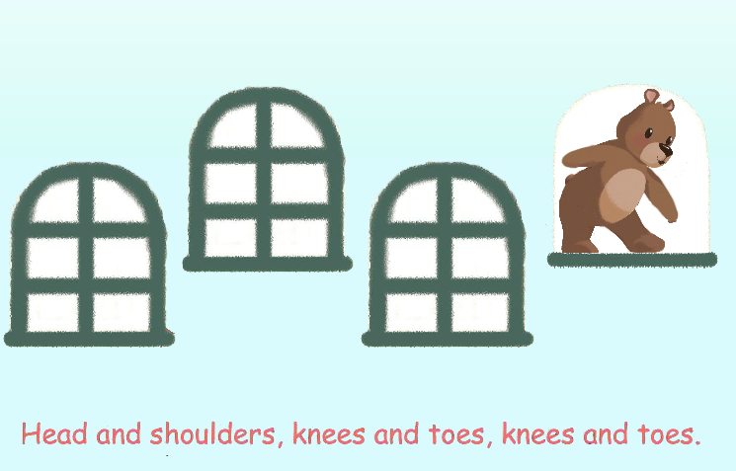
>>Lead-in
Sing a song

Slide 4
>>Presentation
Lead-in
Hello/Hi, boys and girls! Welcome back to school!

Slide 5
>>Presentation
Draw yourself

Slide 6
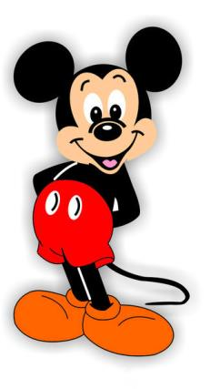
>>Presentation
Let’s learn
Hi, I’m Mickey.
Look at my face.

Slide 7
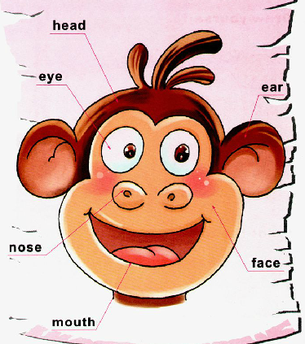
>>Presentation
Let’s learn

Slide 8
>>Presentation
Let’s learn
head
a head
She has a head.

Slide 9
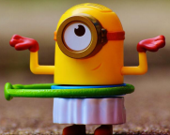
>>Presentation
eye
Let’s learn
What is this?
It is an eye.
an eye
two eyes

Slide 10
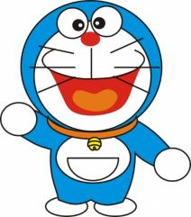
>>Presentation
Let’s learn
mouth
a big/small mouth
I have a big mouth.

Slide 11
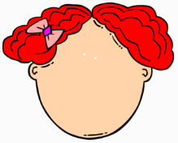
>>Presentation
Let’s learn
face
This is the face.

Slide 12
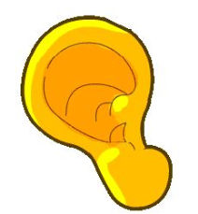
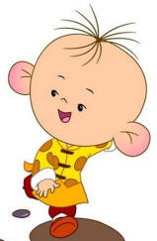
>>Presentation
Let’s learn
ear
an ear
two ears
He has two ears.

Slide 13
>>Practice
Game1
我是小小描述家
This is my …

Slide 14
>>Practice
Game2
句子接龙
Hello, This is ...
Hi, This is ...

Slide 15
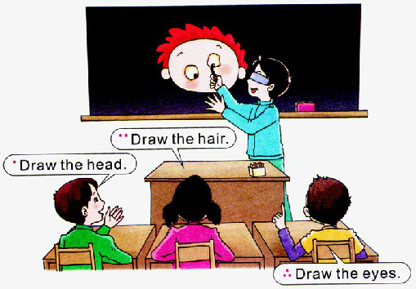
>>Practice
Play a game

Slide 16
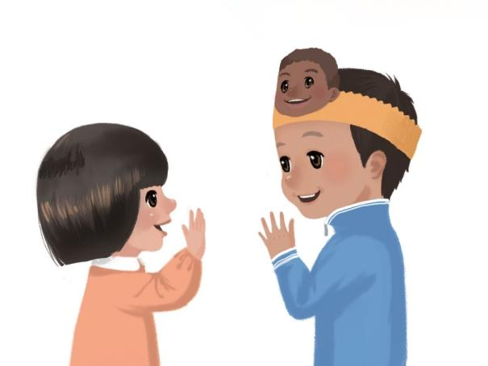
>>Practice
活动
Touch your nose.

Slide 17
>>Consolidation
Body
This is ...

Slide 18
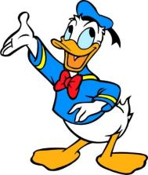
>>Summary
如何表述有关身体部位的词：
head eye nose mouth ear face
怎样向别人介绍自己的身体部分?
This is + 自己的身体部位.
This is my face…

Slide 19
>>Homework
1.听课文录音并跟读，按照正确的语音、语调朗读并表演课文对话。 2.用”This is …”向朋友打招呼并介绍自己的身体部位。
3.预习A Let’s say。
close

