Slide 1
七年级英语（JJ下）教学课件
Unit 6 Seasons
I Can't Wait for Winter!
WWW.PPT818.COM

Slide 2
Learning Targets
1. Be able to use the words and expressions: research, website, hill, ice, snowman, clear, wait for, do some research, world-class restaurant, go back, get… together, make a snowman, put on
2. Learn to talk about the weather in winter and describe the activities of people.
3. Learn some key sentences:
(1)I'm doing some research for my report about my favourite season.

Slide 3
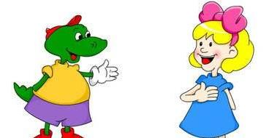
(2)But don't forget your scarves, hats and gloves.
(3)You can even get the family together and make a snowman.
(4)Enjoy a clear, cold night beside a warm fire.
(5)I can't wait for winter.
PPT模板：www.1ppt.com/moban/ PPT素材：www.1ppt.com/sucai/
PPT背景：www.1ppt.com/beijing/ PPT图表：www.1ppt.com/tubiao/
PPT下载：www.1ppt.com/xiazai/ PPT教程： www.1ppt.com/powerpoint/
资料下载：www.1ppt.com/ziliao/ 范文下载：www.1ppt.com/fanwen/
试卷下载：www.1ppt.com/shiti/ 教案下载：www.1ppt.com/jiaoan/
PPT论坛：www.1ppt.cn PPT课件：www.1ppt.com/kejian/
语文课件：www.1ppt.com/kejian/yuwen/ 数学课件：www.1ppt.com/kejian/shuxue/
英语课件：www.1ppt.com/kejian/yingyu/ 美术课件：www.1ppt.com/kejian/meishu/
科学课件：www.1ppt.com/kejian/kexue/ 物理课件：www.1ppt.com/kejian/wuli/
化学课件：www.1ppt.com/kejian/huaxue/ 生物课件：www.1ppt.com/kejian/shengwu/
地理课件：www.1ppt.com/kejian/dili/ 历史课件：www.1ppt.com/kejian/lishi/

Slide 4
Lead In
Do you like winter?
What do you like to do in winter?

Slide 5
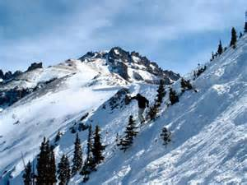
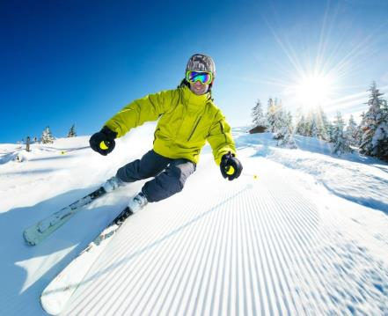
winter
the ski hills
go skiing

Slide 6
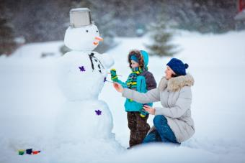
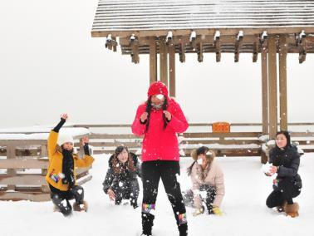
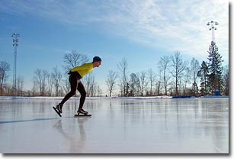
make a snowman
have snowball fights
skate on ice

Slide 7
Words and Expressions
research
website
hill
ice
snowman
clear
n. & v. 调查；研究
n. 网站
n. 山丘；小山
n. 冰
n. 雪人
adj. 晴朗的；明亮的；清澈的

Slide 8
wait for
do some research world-class restaurant go back
get… together
make a snowman
put on
等待
做一些调查/研究
世界级的餐馆
回去
把……聚到一起
堆雪人
穿上

Slide 9
Presentation
Jenny：Hey, Danny！What are you doing?
Danny：I'm doing some research for my report about my favourite season. I'm going to talk about winter. Winter is my favourite season. Look at this website：
Come and enjoy a true Canadian winter out in the mountains. Start your day on the ski hills or go ice skating. But don't forget your scarves, hats and gloves. Why? Winters here are really cold!

Slide 10
Have lunch in our world­class restaurant and then go back outside for a snowball fight. You can even get the family together and make a snowman. In the evening, you can join us inside for dinner. Winter is the best season！Enjoy a clear, cold night beside a warm fire.
Hope to see you there!

Slide 11
Jenny: Wow! That looks really good, Danny. Look at that picture！What a cold, snowy day!
Danny: It's amazing！I can't wait for winter. I'm going to have a great time!
Learning Tip
When it is very cold outside, we get ice and snow.
Ice is very hard and you can skate on it.
Snow is soft and white. You can go skiing or play in the snow.

Slide 12
Let’s Do It!
1. What winter activities does the website mention？
Read the lesson and make a list.Then write a
sentence about each activity on the list.
1．________ __________________________________
2．________→__________________________________
3．______________→_________________________
____________________________________________
4.__________________→__________________________ _______________________________________________
skiing →In winter, I can go skiing on the snow.
skating In winter, you can go skating on the ice.
snowball fight We like to go out for a snowball fight together.
making a snowman We can make a snowman together when it snows.

Slide 13
2. Listen to the passage and put the sentences in
the correct order.
1. Later, we go skating on the ice.
2. My friends and I roll in the snow and have a snowball
fight.
3. I put on my scarf, hat, gloves and jacket.
4. I'm going to play outside with my friends.
5. Now I am ready to go out and play.
6.Then we make a big snowman.
The correct order is :________________
4, 3, 5, 2, 1, 6

Slide 14
3. Li Ming travels to Harbin this winter.Look at the picture in Harbin and fill in the blanks.
snowy scarves hill clear snowman
Hi, I'm Li Ming. I'm in Harbin. The weather here is ______ and cold. The air is ________. People are wearing gloves and ________. They are skiing on the ________. I like skiing. I like snow. Do you see the ________ behind me？He is my new friend!
snowy
clear
scarves
hill
snowman

Slide 15
4. Work in groups. Imagine you are a weather
news team. You are doing a report about
winter weather in your hometown. Present
your report to the class.
Task tips：
What is the temperature？
What clothes do you wear during this season？Why？
What do people do during the winter in your hometown?

Slide 16
Language points
1. I’m doing some research for my report about my favourite season.
research n. & v. 研究；调查。
例：He makes researches on Chinese medicine.
他从事中医研究。
We carried out a research into this problem.
我们对这个问题进行了研究。

Slide 17
【探究总结】research的用法
(1)research可与不定冠词连用，也可以用复数形式，但通常不与many或数字连用。
(2)research后常跟介词on、into或for。
【学以致用】
①这是一份市场调查报告。
Here is _____ _______ _______ report.
②她正在从事癌症研究。
She is doing some _______ _______ cancer.
Xi’an—the Walled City
a market research
research on

Slide 18
2. Start your day on the ski hills or go ice skating.
【辨析】hill与mountain
hill和mountain都有“山”的意思, 但其类型及范围不同:(1)hill是指比较低矮的小山、山丘。(2)mountain是指高山、大山, 通常指比hill大或陡峭的高山。
例：Qomolangma is the highest mountain in the world. 珠穆朗玛峰是世界上最高的山脉。
There are lots of sheep on the hill. 山上有很多绵羊。

Slide 19
【学以致用】
①这座山有3, 500米高。
The ________ is 3, 500 meters high.
②他们正在爬山。
They are climbing the ________.
mountain
hill

Slide 20
3. But don't forget your scarves, hats and gloves.
(1)这是一个否定祈使句。祈使句是用来表达命令、要求、请求或劝告等的句子。它通常有下列几种形式：
①第二人称祈使句。以动词原形开头，其否定形式是在谓语动词前加don't。在祈使句中，有时我们可以加上称呼语，称呼语一般放在句子末尾；有时为了使祈使句表达得客气、 委婉，可以加上please、will you等。
例：Don't be late for school, Tom. 汤姆，上学不要迟到。
Please open the door. 请开门。

Slide 21
②第一人称祈使句。以let为引导词，句式结构为：Let me/us do sth.，其否定形式一般为：Let me/us not do sth.。
例：Let's play basketball.咱们打篮球吧。
Let's not stay too late.我们别待得太晚了。
③第三人称祈使句。句式结构为：Let him/her/them do sth.，其否定形式为Don't let him/her/them do sth.。
例：Let him go away. 让他走开。
Don't let anyone run away.不要让任何人跑掉。

Slide 22
(2)forget是动词，意为“忘记”，其反义词为remember(记住，记得)。常用短语：forget to do sth.忘记去做某事(表示事情并没有做)；forget doing sth.忘了做过某事(表示事情已经做过了，只是忘记了)。注意：remember的用法与forget的用法一致。
例：Sorry，I forgot to turn off the light.
对不起，我忘了关灯。(灯还没有关)
I forgot turning off the light.
我忘了已经关灯了。(灯已经关了)

Slide 23
4. I can't wait for winter.
wait是动词，意为“等待，等候”。
常用短语：wait for sb./sth.等候某人或某物；
wait for sb.to do sth.等待某人做某事；
can't wait for sth.对某事物迫不及待；
can't wait to do sth.迫不及待做某事。
例：Who are you waiting for？你在等谁呢？

Slide 24
Exercises
Ⅰ. 选词并用其适当形式填空。
1. ________ in Heilongjiang are very cold.
2. It’s snowing. Let’s make a ________.
snowman scarf amaze winter clearly
Winters
snowman

Slide 25
3. Little Tom bought two nice ____________ for his
mother.
4. —We can have snowball fights in winter here.
—It’s _________! I can’t wait for winter.
5. What a ________ river!
scarves
amazing
clear

Slide 26
Ⅱ. 补全对话。
从方框中选择最佳选项完成对话，有两项多余。
A. Is it very cold in winter in Australia? B. The Australian seasons are opposite(相反) to the Chinese seasons. C. It’s very cold in Australia. D. How interesting! E. Swimming is very popular in summer. F. In Australia, there is beautiful sunshine every day. G. What’s the weather like in Australia?

Slide 27
A: Hi, Kangkang! What a cold day!
B: Yes. It’s very cold. I know you are from Australia.
1._____
A: In Australia, summer is from December to
February and winter is in June, July and August.
B: Oh! 2._____ When it is spring in China, it’s fall in
Australia, right?
A: Quite right. 3._____ It’s very warm. Sometimes it’s
too hot.

Slide 28
B: 4._____
A: No, it’s quite warm.
B: 5._____
A: Look at the clouds! It’s going to rain. Let’s go
home.
B: All right. Bye-bye!
1. ______ 2. ______ 3. ______ 4. ______ 5. ______
G
B
F
A
D

Slide 29
Ⅲ.翻译下列句子，每空一词。
1. 这是一个世界级的饭店。
This is a ____________ restaurant.
2. 李明正在做一些关于兔子的研究。
Li Ming is _____ some _______ ______ rabbits.
3. 我想堆个雪人。
I want to _____ _____ ________.
4. 这里的水看起来很清澈。
The water here _____ very ______.
world-class
doing research
about
make a snowman
looks clear

Slide 30
Summary
1. Knowed about the weather in winter and
can talk about some activities of people;
2. Learned some useful words and phrases in
this lesson.

Slide 31
Homework
1.Do you like winter? What do you
like doing in winter? Write an
article and share it with your
friends.
2. Finish the exercise of this lesson.

