Slide 1
Unit6
How many classrooms are there in your school?
WWW.PPT818.COM

Slide 2
Let's count from 1 to 25.

Slide 3
Let's Chant
One, two, tie your shoes.
Three, four, close the door.
Five, six, pick up sticks.
Seven, eight, don’t be late.
Nine, ten, start again.

Slide 4
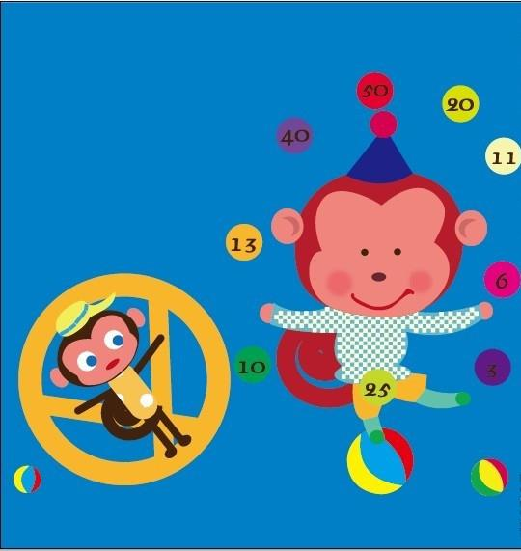
Hello! My name is Lucky.
Welcome to see my show.

Slide 5
Ha, ha ! What numbers
can you see?

Slide 6
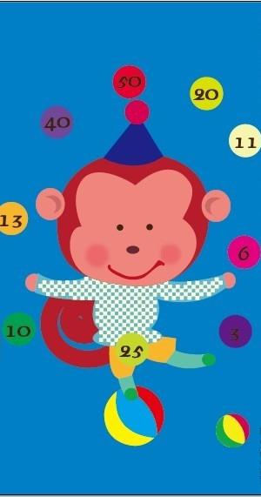
3 three
6 six
7 eleven
20 twenty
50 fifty
40 forty
13 thirteen
10 ten
25 twenty-five

Slide 7
个位 | 十几 | 几十
one | eleven | twenty
two | twelve | twenty-one
three | thirteen | thirty
four | fourteen | forty
five | fifteen | fifty
six | sixteen | sixty
seven | seventeen | seventy
eight | eighteen | eighty
nine | nineteen | ninety
十几十几，-teen,-teen,-teen
几十几十，-ty,-ty,-ty

Slide 8
Put the numbers in order
28,18,47,96,16,69, 36,83,80,53,77,60
16<
18<
28<
36<
47<
53
<60<
69<
77<
80<
83
<96

Slide 9
Brain storming time
Good luck!

Slide 10
Brain storming 1
What is 5 and 10?
What is 3 and 18?
What is 6 and 39?
What is 13 and 16?
What is 37 and 12?
fifteen 15
twenty-one 21
forty-five 45
twenty-nine 29
fifty 50

Slide 11
Brain storming 2
Book P35 Ex3 Ask and say.
A: What’s ___ and____?
B: ___ and____ is_____.

Slide 12
Brain storming 3
小组竞赛
37
16+21= 2. 28+11=
3. 31+12= 4. 10+60=
5. 17+55= 6. 43+38=
7. 40+13= 8. 70+20=
39
43
70
72
81
53
90

Slide 13
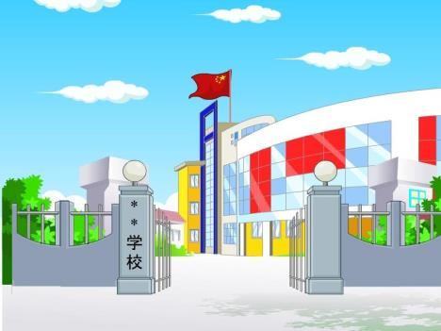
Do you like my show? Welcome to my school.
My school is so big.let's see what's in my school?

Slide 14
48
25
38
How many classrooms are there in your school?
There are …
The school has …
The school is big and beautiful.

Slide 15
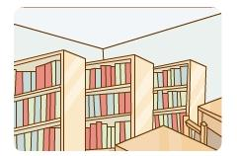
75
25
35
How many books are there in the library?
There are …
The library has …
The library is small.
But we like to read books there.

Slide 16
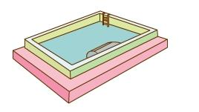
38
28
42
How many children are there in the
swimming pool?
There are …
The swimming pool has …in it.
The swimming pool is clean and beautiful.

Slide 17
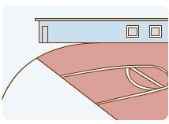
35
25
12
How many boys are there on the playground?
There are …
The playground is new.
We sometimes play games there .

Slide 18
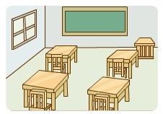
37
43
30
How many desks are there in one classroom?
There are …
The classroom is big .
We have lessons there.

Slide 19
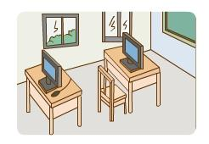
40
48
58
How many computers are there in the
computer room?
There are …
We sometimes …
It is clean and tidy.

Slide 20
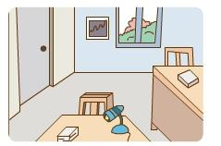
13
25
15
How many teachers are there in the
teachers’ room?
There are …
Teachers work there.
Teachers are very nice.

Slide 21
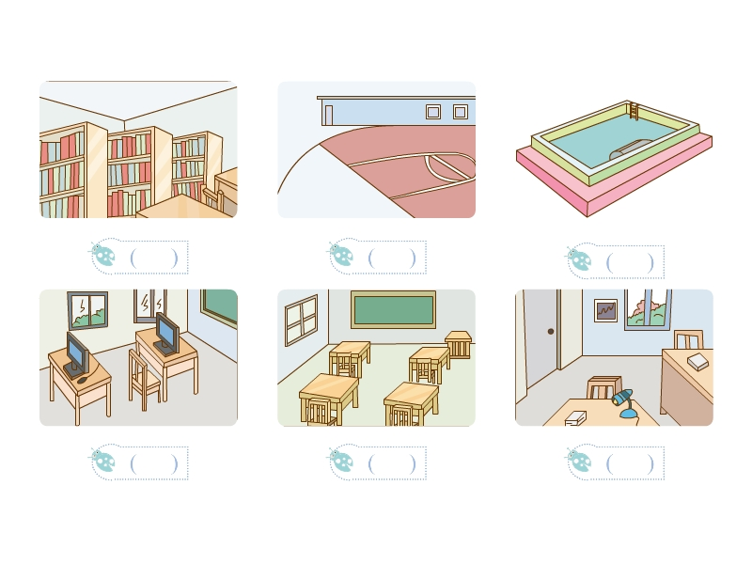
Listen and write
35
25
28
48
30
15

Slide 22
I want to visit(参观） your school.

Slide 23
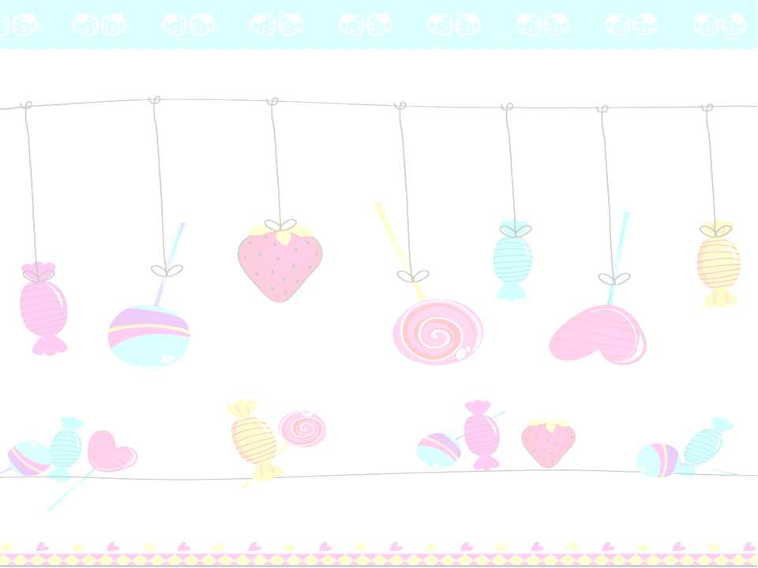
Please introduce（介绍）our school.(南校区)
Welcome to______.
There are ____ buildings in it.
In building 1 there are ____teachers’ room and ____ classrooms.
The classrooms are __________.
In building 2 there is _________________.
They are ______.
Between the two buildings, there is _____.
It is _____.
But I like to _________ there.
our school
two
four
nine
clean and tidy
a library, a music room ...
beautiful
a playground
small
playgames

Slide 24
Dream school
Project
Draw your dream school.
Name different rooms.
Introduce your dream school.

Slide 25
Draw your dream school and talk about
with your partner.
This is my dream school .
It’s….
There is ….
There are…
They are...
I like to...
I like my dream school.

Slide 26
playground
library
swimming pool
computer room
lab(实验室)
book
desk
chair
big
small
clean
beautiful
nice
good
large
tall
tidy…
play games
read books
have lessons
eat meals

Slide 27
Homework
读、拼、记数字单词。
家听8个数字单词和4个形容词。
描述自己的学校。

