Slide 1
Unit 5 Family and Home
Lesson 28 A Family Picnic
WWW.PPT818.COM

Slide 2
Lesson 28 A Family Picnic
课前自主预习
单 词 闯 关 | 1. 野餐['pɪknɪk] ________ 2．携带；搬运['kærɪ] ________ 3．篮；筐['bɑːskɪt] ________ 4. 许多[lɒt] ________ 5．安静的；平静的['kwaɪət] ________ 6．tablecloth['teɪblklɒθ]______________
picnic
carry
basket
lot
quiet
桌布；台布

Slide 3
Lesson 28 A Family Picnic
短 语 互 译 | 1. 小心；注意 ________________ 2．去野餐 ________________ 3. 在湖边 ________________ 4．a basket of…________________
look out
go on a picnic
near the lake
一篮子……

Slide 4
Lesson 28 A Family Picnic
句 型 在 线 | 1. 我妈妈正在做什么？ ________ ________ my mum ________？ 2．她正在做沙拉。 She is ________ ________ ________．
What is
doing
making a salad

Slide 5
Lesson 28 A Family Picnic
句 型 在 线 | 3．有许多水果和蔬菜供我们食用。 There are ________ ________ fruits and vegetables for us. 4. 我爸爸正在做三明治。 My dad is ___________ ___________．
lots of
making sandwiches

Slide 6
Lesson 28 A Family Picnic
句 型 在 线 | 5．鲍勃和琳正在做什么？ What ________ Bob and Lynn ________？ 6．他们正在画画。 ________ are ________．
are
doing
They
painting

Slide 7
Lesson 28 A Family Picnic
课堂互动探究
词汇点睛
1 carry v. 携带；搬运
[观察] Bob is carrying a big basket of food.
鲍勃正提着一大篮子食物。

Slide 8
Lesson 28 A Family Picnic
[辨析] carry, take, bring与get/fetch都有“拿”的意思，其区别如下：
词条 | 用法 | 例句
carry | 意为“携带；搬运”，指搬运较重的东西，不强调动作的方向性。 | Will you please carry the box for me? 请帮我搬那个箱子好吗？
take | 意为“拿走，带走”，强调远离说话人。 | Take the box to your room, please. 请把这个盒子拿到你的房间去。
bring | 意为“拿来，带来”，强调靠近说话人。 | Don't forget to bring your homework to school tomorrow. 明天别忘了把你的作业带到学校来。
get/fetch | 意为“去取”，强调往返。 | Could you fetch me my bag? 你能帮我去取我的包吗？

Slide 9
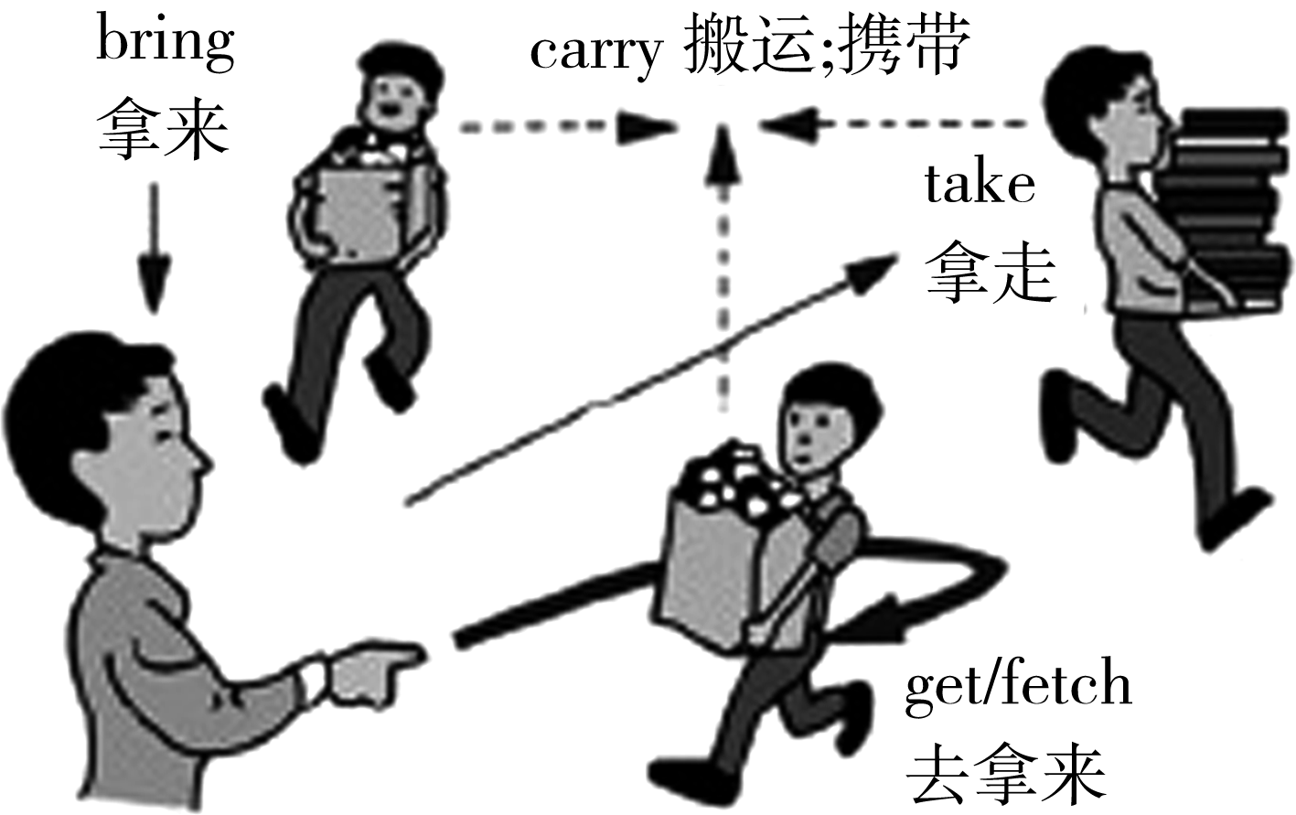
Lesson 28 A Family Picnic
[图解]

Slide 10
Lesson 28 A Family Picnic
活学活用
(1)明天把你的CD带给我好吗？
Can you ________ ________ your CD tomorrow?
(2)你给我提着手提箱好吗？
Could you ________ the suitcase ________ ________？
bring me
carry
for me

Slide 11
Lesson 28 A Family Picnic
2 lots of 许多
[观察] There are lots of fruits and vegetables for us.
有许多水果和蔬菜供我们食用。
[探究] lots of相当于a lot of，表示“许多”，既可修饰可数名词(相当于many)，又可修饰不可数名词(相当于________)。
much

Slide 12
Lesson 28 A Family Picnic
[拓展] a lot为副词短语，意为“非常；十分”，相当于much/very much，修饰形容词、副词和动词，在句中作状语。例如：
Thanks a lot. 非常感谢。

Slide 13
Lesson 28 A Family Picnic
活学活用
(1)篮子里有许多苹果。
There are ________ ________ apples in the basket.
(2)鲍勃对詹妮非常了解。
Bob knows ________ ________ about Jenny.
lots of
a lot

Slide 14
Lesson 28 A Family Picnic
3 look out 小心；注意
[观察] Look out! There is a car coming.
当心！汽车过来了。
Look out! It's dangerous！小心！危险！
[探究] look out 相当于be careful。

Slide 15
Lesson 28 A Family Picnic
[拓展]与look相关的短语：
look for 寻找 look after 照顾
look over 检查 look up 向上看；查阅
look around 向四周看 look at 看

Slide 16
Lesson 28 A Family Picnic
活学活用
(1)________！ Your baby is climbing up the tree.
A．Look out B．Look in
C．Look at D．Look down
(2)Don't worry. I can help you ________ your pet cat when you go on a trip.
A．look up B．look at
C．look after D．look like
A
C

Slide 17
Lesson 28 A Family Picnic
4 quiet adj.安静的；平静的
[观察] They are very quiet. 他们很安静。
Be quiet! The baby is sleeping.
安静！宝宝正在睡觉。
[探究] quiet在句中作表语或定语，即“be quiet”或“quiet＋名词”。其副词形式是quietly。

Slide 18
Lesson 28 A Family Picnic
活学活用
(1)My father is sleeping. ________ ________(安静), please.
(2)Lucy is ________ ________ ________(安静的女孩)．She likes reading.
Be quiet
a quiet girl

Slide 19
Lesson 28 A Family Picnic
句型透视
There are lots of fruits and vegetables for us.
有许多水果和蔬菜供我们食用。
[探究] (1)there be 句型是倒装句，句子的主语是后面的名词。若后面的名词为单数或不可数名词，be动词用is；若后面的名词为复数，be动词用are。当后面接多个名词时，be动词与离其最近的名词在数上保持一致，即遵循“就近一致”原则。例如：

Slide 20
Lesson 28 A Family Picnic
is
There ________ a map on the wall. 墙上有一张地图。
There ________ two pencils on the desk. 书桌上有两支铅笔。
There is a dog and two cats under the tree.
树下有一条狗和两只猫。
There are two oranges and an apple in the basket.
篮子里有两个橘子和一个苹果。
are

Slide 21
Lesson 28 A Family Picnic
(2)there be句型还有其他的时态变化，如一般将来时、一般过去时、现在完成时等。
(3)there be句型表示“存在；有”，而have/has当“有”讲时，表示某人拥有某物。

Slide 22
Lesson 28 A Family Picnic
记忆口诀
there be句型有特点，主语跟在be后面；
单数主语用is，复数用are也不难；
多个主语若并列，be随第一主语变；
否定be后加not，疑问be在there前；
介词短语表地点，“有”是“存在”记心间。

Slide 23
Lesson 28 A Family Picnic
活学活用
There ________ some beef in the fridge. Let's make some beef noodles.
A．am B．is
C．are D．be
B

