Slide 1
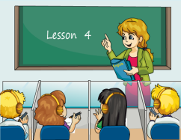
Unit1 Welcome to our school!
人教精通版五年级下册
Lesson 4
WWW.PPT818.COM

Slide 2
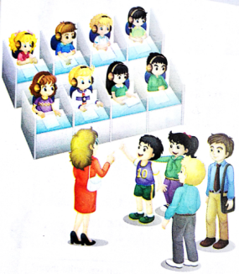
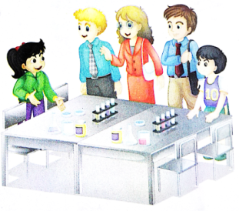
>>Warm-up
Let’s review
This is our … We often ... in it. We have …
lessons in a week.

Slide 3
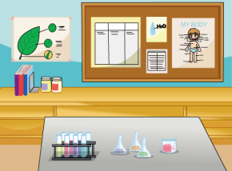
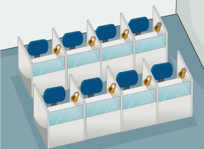
>>Lead-in
Guessing game
What place is it?

Slide 4
>>Presentation
Look and say
We often have English lessons in the language lab.
language lab
English lesson

Slide 5
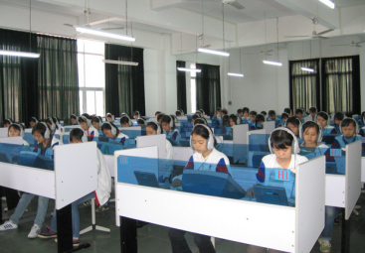
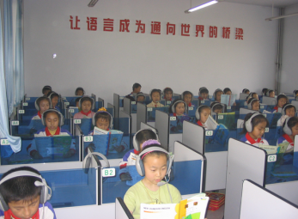
>>Presentation
Look and say
What do you often do in the language lab?
We often …
listen to English
speak English

Slide 6
>>Presentation
Ask and answer
How many English lessons do you have in a week?
We have …

Slide 7
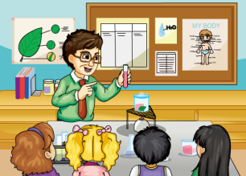
>>Presentation
Look and say
We often have science lessons in the science lab.
science lab
science lesson

Slide 8
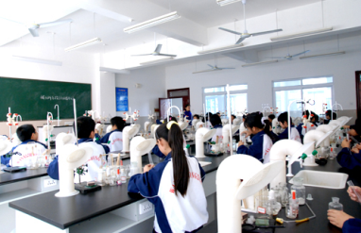
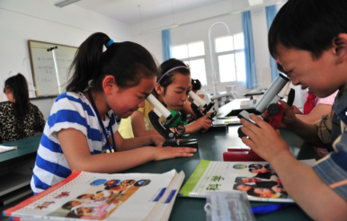
>>Presentation
Look and say
What do you often do in the science lab?
We often …
do experiments
observe things

Slide 9
>>Presentation
Ask and answer
How many science lessons do you have in a week?
We have …

Slide 10
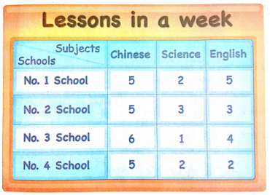
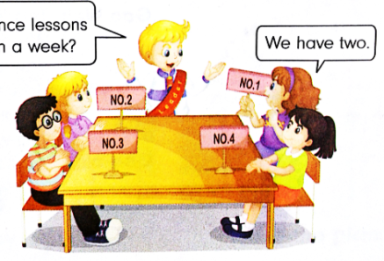
>>Practice
Let’s talk
How many science lessons do you have in a week?
We have two.

Slide 11
>>Practice
活动1
制作四格漫画
language
lab
English
lesson
three
lessons
listen and
speak

Slide 12
>>Practice
活动2
介绍自己的漫画
lab
lesson
three
listen

Slide 13
>>Practice
Let’s chant
（单击图片可播放动画）

Slide 14
>>Summary
How many … lessons do you have in a week?
We have … in the … lab.

Slide 15
>>Homework
1.在四线三格中正确抄写本课新学的单词和短语，至少五遍。 2.登录“优教同步学习网”，预习 Lesson 5。

