Slide 1
Christmas
WWW.PPT818.COM

Slide 2
Santa Claus

Slide 3
Father Christmas

Slide 4
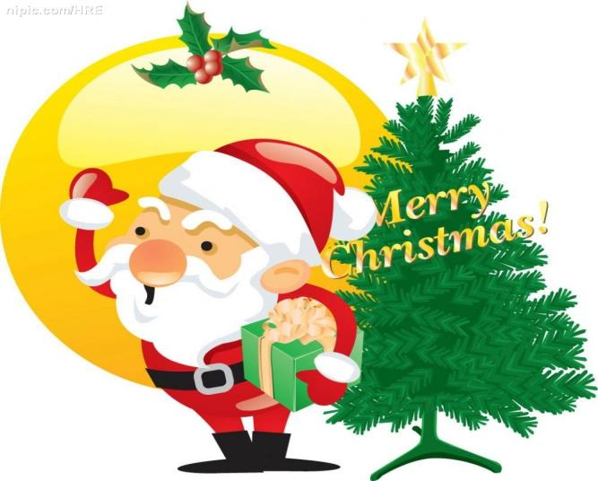
December 25th
It’s Christmas Day.

Slide 5
Christmas tree

Slide 6
stocking

Slide 7
present

Slide 8
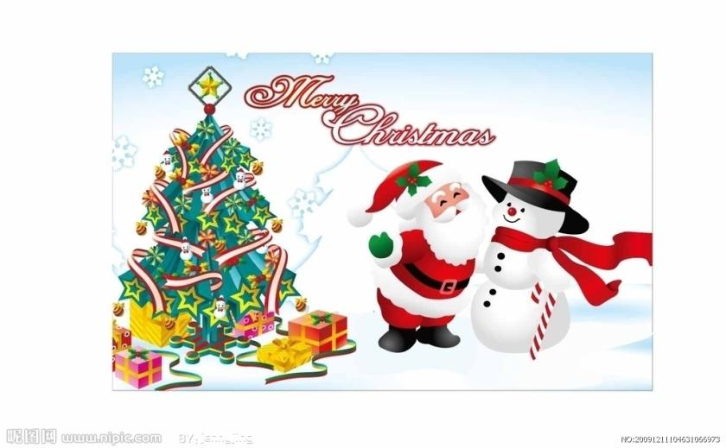
Christmas card

Slide 9
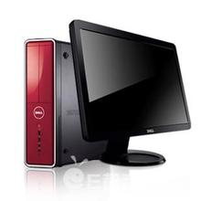
computer

Slide 10
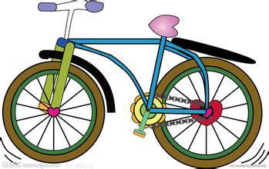
bike

Slide 11
robot

Slide 12
open
打开

Slide 13
Let’s listen and say.

Slide 14
1、Christmas Day falls on 25December.People put up a Christmas tree in their home. They put presents for family and friends under the Christmas tree.
圣诞节在每年的12月25.
人们在家里装饰圣诞树。
他们在圣诞树下为亲人和朋友准备圣诞礼物。

Slide 15
It’s Christmas again! I can’t wait to open my presents.
圣诞节又来了！我迫不及待地想打开我的礼物。
你可以在圣诞节那天打开它。
You can open it on Christmas Day.

Slide 16
2、Santa Claus or Father Christmas will go to each house. He leaves presents for the children in their stockings.
圣诞老人将走遍每家每户。
他给孩子们送礼物，放进他们的长筒袜里。

Slide 17
3、People send Christmas cards to their friends to wish them a “Merry Christmas”.
人们发送圣诞贺卡给朋友们，祝愿他们圣诞快乐。

Slide 18
4、People buy a lot of things for Christmas. In big shopping centers, Father Christmas gives gifts to children.
在圣诞节的时候人们买很多东西。
在大型商场，圣诞老人给孩子们送礼物。

Slide 19
What presents do you want, children?
我想要一辆单车。
孩子们，你们想要什么礼物呢？
I want a bike.
I want a computer.
I want a robot.
我想要一台电脑。
我想要一个机器人。

Slide 20
1.Christmas Eve is _______.
A. the night before December 24
B. the night of December 25
C. the night of December 24
2.Father Christmas often puts the presents______.
A. into children’s hats B. into children’s stockings
C. into children’s shoes
3. Father Christmas comes into the house through the ______.
A. window B. front door C. chimney
4. On the morning of Christmas Day children wake up their parents very early and say “_______”.
A. Good morning! B. Merry Christmas! C. Best wishes to you!
5. On Christmas day, people often ____ to each other.
A. give presents B. ask for money C. ask for presents

Slide 21
we wish you a merry Christmas we wish you a merry Christmas we wish you a merry Christmas and a happy new year we wish you a merry Christmas we wish you a merry Christmas we wish you a merry Christmas and a happy new year good tidings we bring to you and your kin we wish you a merry Christmas and a happy new year

