Slide 1
Unit 3 Robots
Grammar
WWW.PPT818.COM

Slide 2
What’s the news about?

Slide 3
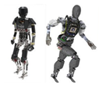
Scientists consider that the robot astronaut is a good help in space.
Scientists consider the robot astronaut a good help in space.
The robot astronaut knew how it could walk properly in space.
The robot astronaut knew how to walk properly in space.
The robot astronaut is so clever that it can work with other astronauts in space.
The robot astronaut is clever enough to work with other astronauts in space.
The news is so fantastic that we can hardly believe it.
The news is too fantastic for us to believe.

Slide 4
Some other robots

Slide 5
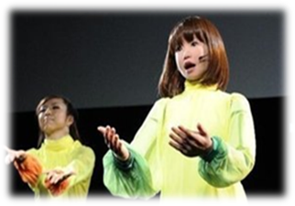
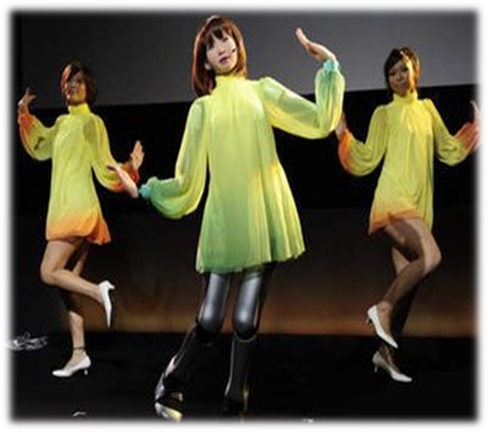
We saw that a robot was singing and dancing on the stage last night.
We saw a robot singing and dancing on the stage last night.

Slide 6
I found that a new robot was in the restaurant near my home yesterday.
I found a new robot in the restaurant near my home yesterday.

Slide 7
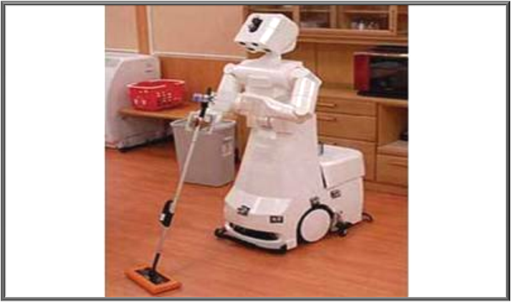
I think that it is exciting to own such a useful robot.
I think it exciting to own such a useful robot.

Slide 8
Have you found any rules?
object clauses
objects + object complements

Slide 9
He saw that two dogs were sitting on the grass.
He saw two dogs sitting on the grass.

Slide 10
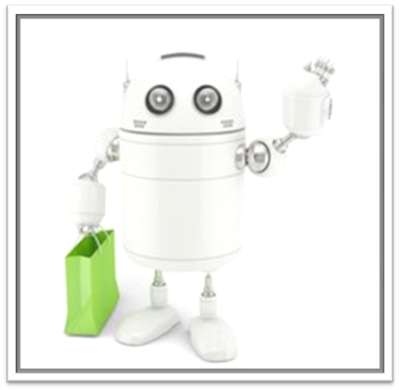
This robot knows when it should go shopping.
This robot knows when to go shopping.

Slide 11
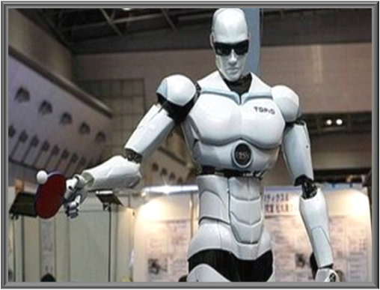
The robot knows how he can play table tennis with people.
The robot knows how to play table tennis with people.

Slide 12
Can you find any rules?
object clauses
question words + object complements

Slide 13
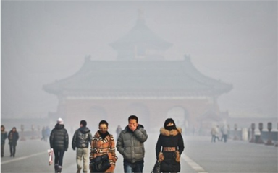
Do you know what you should do with the smog?
Do you know what to do with the smog?

Slide 14
This robot is so clever that it can play chess with human beings.
This robot is clever enough to play chess with human beings.

Slide 15
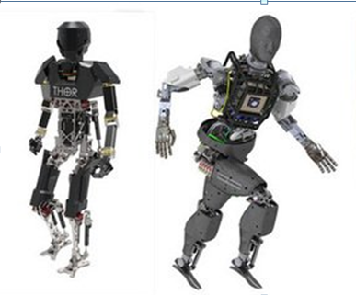
Robots are so heavy that they can’t run fast.
Robots are too heavy to run fast.

Slide 16
My mother plans to buy a robot so that she can have more free time.
My mother plans to buy a robot in order to have more free time.

Slide 17
Have you found any rules?
Use to-infinitives to replace some
adverbial clauses expressing results
or purposes

Slide 18
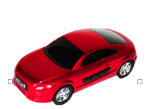
Yao Ming is so tall that he can’t
get into this red car.
Yao Ming is too tall to get into
this red car.
Yao Ming is so rich that he can buy many cars.
Yao Ming is rich enough to buy many cars.
Yao Ming needs to buy a car so that he can drive to work.
Yao Ming needs to buy a car in order to drive to work.

Slide 19
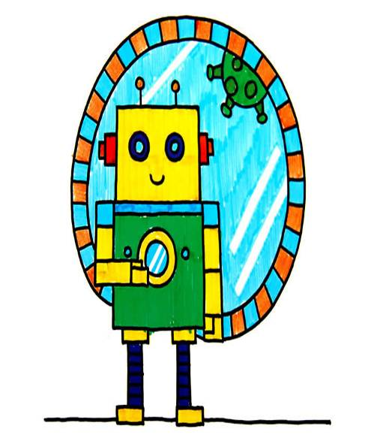
1. Work hard in order to invent more robots for human beings.
2. Work hard so that you will be able to invent more robots for human beings.

Slide 20
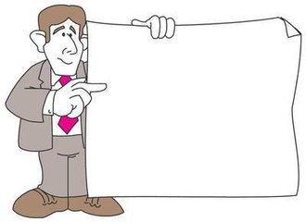
Review what we have
learned in this class.
2. Finish more exercises.

