Slide 1
Unit 5 MUSIC
Section Ⅶ Reading for Writing
WWW.PPT818.COM

Slide 2
有关音乐对生活影响的演讲稿
本单元的读写任务是读一篇关于音乐对生活影响的演讲稿后，写一篇同样话题的演讲稿。
Ⅰ.Pre-writing
(Ⅰ)Learning to write from the model
Good morning, my name is Sarah Williams, It’s an honour to be here and to share with you the story of how music has had an impact on my life.

Slide 3
篇章结构
Paragraph 1：Introduce myself and point out the topic of my speech.

Slide 4
[A]Have you ever faced a time when things looked dark and you had no hope at all? Two years ago, I was told I had a serious disease which was difficult to cure.My body ached all the time and thus I thought I didn’t have much longer to live.I was very afraid and I felt so alone and discouraged.Then one day, I had to go through a two-hour medical treatment.The doctor wanted me to relax, so he had me listen to some music, and one of the songs was “Happy”.The song made me feel so much better that from then on I began to listen to music all the time.[B]John A.Logan said, “Music is the medicine of the mind.”And it’s true.Music helped me recover.

Slide 5
Paragraph 2：My experience with music—Music helped me recover.

Slide 6
[C]Music gave me happiness.When I listened to music, [D]it made my spirits fly like a kite in the wind.[C]Music gave me strength and brought me relief.[E]It was the rock I leant on to become strong and to get through those hard times.Moreover, [C]music gave me hope and a sense of satisfaction.[F]It became my best friend.It spoke words of encouragement to the deepest part of my being.

Slide 7
Paragraph 3：How music made me feel.

Slide 8
Of course，I hope none of you have to go through the same kind of suffering that I did.At the same time, we all go through various periods when we feel sad or alone.During those times, music can help you in the same way that it helped me.I hope all of you will somehow begin to treasure music and make it a part of your life.
Thank you.

Slide 9
Paragraph 4：Sum up and offer a suggestion.

Slide 10
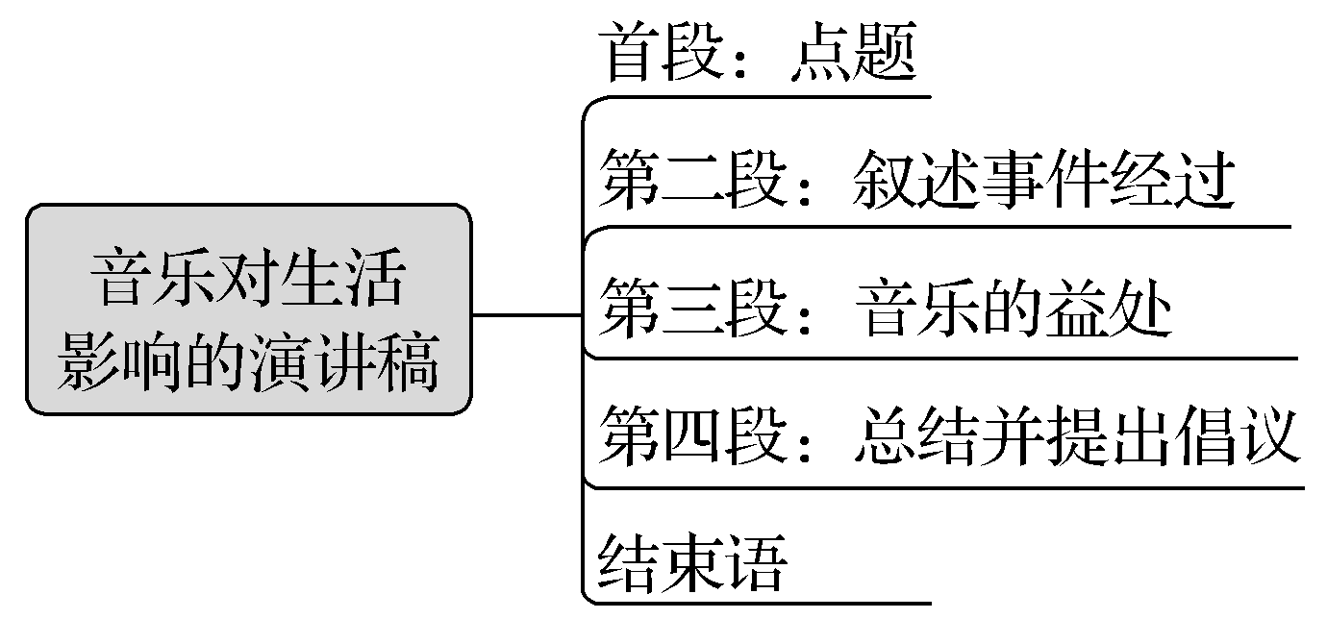
(Ⅱ)Preparation for writing—words and phrases
①________________ 对……有影响
②________________ 一段……的时光
③________________ 没有希望
④________________ 一直
⑤________________ 感到沮丧
have an impact on
a time when
have no hope
all the time
feel discouraged

Slide 11
⑥__________________________ 两个小时的治疗
⑦________________ 给予某人幸福
⑧________________ 听音乐
⑨______________________ 像风筝一样在空中飞舞
⑩____________________ 满足感
⑪________________ 感到伤心
⑫________________ 珍爱音乐
a two-hour medical treatment
give sb happiness
listen to music
fly like a kite in the wind
a sense of satisfaction
feel sad
treasure music

Slide 12
Ⅱ.While-writing
假如你是李华，打算参加学校组织的一场以“音乐”为主题的演讲比赛。请根据下面提示写一篇演讲稿。
1.曾经考前紧张，无法入眠；2.音乐改变状况。
Step 1 List the outline of the passage.
Paragraph 1：__________________________________________________________
Paragraph 2：__________________________________________________________
Paragraph 3：__________________________________________________________
Paragraph 4：__________________________________________________________
Introduce myself；point out the topic of my speech
My experience with music
How music made me feel
Sum up and offer a suggestion

Slide 13
Step 2 List the words, phrases and sentences.
1.Words and phrases
①____________ adj. 紧张的 ②____________ v. 到达；来临
③____________ 过去常常 ④____________ 睡觉
⑤____________ 和往常一样 ⑥______________ 感到气馁
⑦_______________________ 别无选择只有做……
⑧______________ 让我吃惊的是 ⑨____________ n. 焦虑
nervous
approach
used to
fall asleep
as usual
feel discouraged
have no choice but to do...
to my surprise
anxiety

Slide 14
2.Sentences
①很荣幸能在这里与大家分享音乐对我生活的影响。(it’s an honour to do sth)
________________________________________________________________________
________________________________________________________________________
②老师建议我听音乐。(suggest)
________________________________________________________________________
③音乐给我力量，给我安慰。(relief)
________________________________________________________________________
④有机会的时候为什么不试试呢？(why not)
________________________________________________________________________
It’s an honour to be here and to share with you the story of how music has had an impact on my life.
My teacher suggested me listening to music.
Music gives me strength and brings me relief.
Why not have a try whenever you have an opportunity?

Slide 15
Step 3 Draft the article by using the following words and phrases.
in addition，then，as a result，as you know
Hello, my name is Li Hua.It’s an honour to be here and to share with you the story of how music has had an impact on my life.
Are you nervous with the exam approaching? I used to be.I could not fall asleep as usual.As a result, I felt discouraged.Then, my teacher suggested me listening to music.I had no choice but to try.To my surprise, my anxiety died out.
As you know, music gives me strength and brings me relief.In addition, listening to music gives me a sense of satisfaction.
Music can change the life of us.Why not have a try whenever you have an opportunity?
Thank you!

Slide 16
Ⅲ.Post-writing—polishing the passage
Exchange your passage with your partner and pay attention to the following points.
□1.Does the writer explain how music has changed his/her/someone else’s life?
□2.Are some of the rhetorical devices included and used properly?
□3.Does the writer talk about how music makes him/her/someone feel?
□4.Is the first word in each sentence capitalised?
□5.Does the writer use correct punctuation?

Slide 17
常用词汇
1.have the opportunity to do... 有机会做……
2.honor n. 荣幸
3.share with 分享
4.opinion n. 观点
5.topic n. 主题
6.aspect n. 方面
7.concentrate on 集中
8.conclusion n. 结束
9.quote v. 引用

Slide 18
亮点表达
1.开头部分常用语
①My name is...Today I am very glad to have the opportunity to make this presentation.I shall be speaking about...我是……今天很高兴能有机会做这个演讲。我演讲的内容是……
②Good morning, everyone! It is my great honor to share with you my opinions on...
大家上午好！很荣幸能和你们分享一下我关于……的看法。
③It’s my great honor to be here/to have the opportunity to say something about...
很荣幸能在这里/能有机会谈论一下关于……

Slide 19
2.主体部分常用语
①The topic of my speech is...
我演讲的主题是……
②I’ll divide this topic into five main aspects.我将从五个主要方面谈论这个主题。
③I would like to concentrate on the problem of...
我想把重点集中在……问题上。

Slide 20
3.结尾部分常用语
①I hope I have made myself understood.
希望我说的大家都能理解。
②That’s all I want to say about this point.
关于这一点，我就讲这些。
③By way of conclusion, I’d like to quote what Newton once said.
我想借用牛顿曾经说过的话来结束我今天的发言。
④Thank you from the bottom of my heart for giving me this chance to speak to you today.
我从心底感谢你们今天给了我这个演讲的机会。

Slide 21
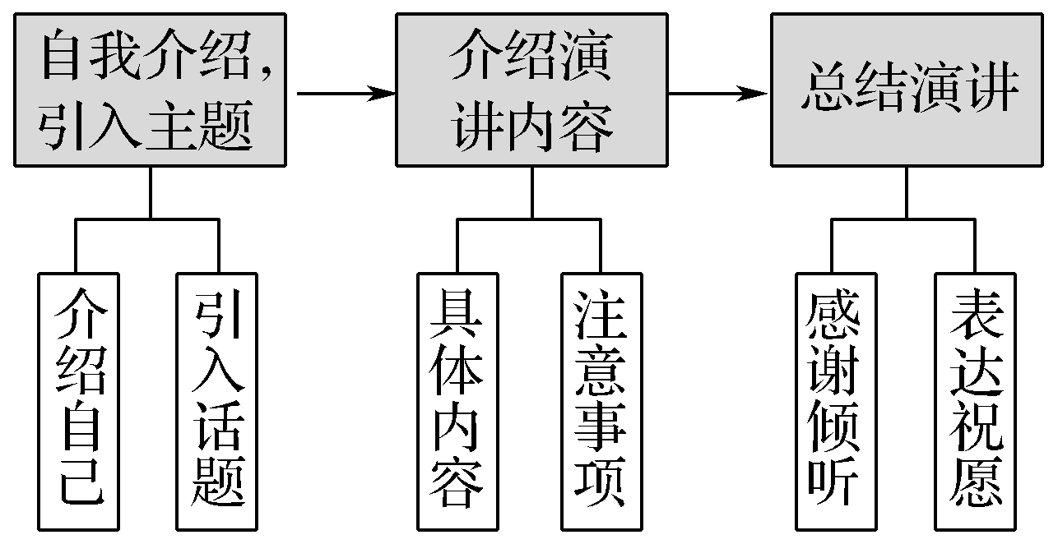
写作技巧
演讲稿包括发言稿、致辞、竞选稿等，是人们在工作和学习生活中经常使用的一种文体，该文体语言通常极富感染力。演讲稿写作首先要明确发言的对象，对不同听众的发言，内容自然就不一样。演讲稿的句子要求短小精悍，铿锵有力。立场要明确，观点要鲜明。赞成什么、反对什么要旗帜鲜明，不能模棱两可。具体写作结构如下：

