Slide 1
陕旅版小学英语三年级下册
Unit7 There Is a TV in the Classroom
第1课时
WWW.PPT818.COM

Slide 2
学习目标
能听说新单词：student, teacher, fan, TV, blackboard, light
简单了解句型：There is …
激发学生探索知识的兴趣，养成积极主动地进行观察动脑的习惯。
1
2
3

Slide 3
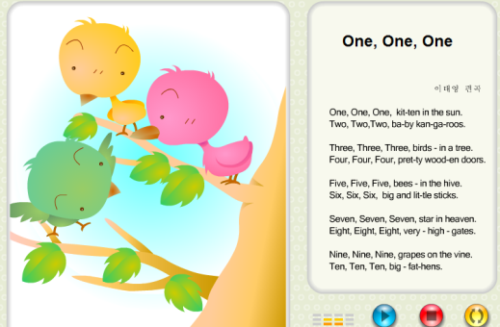
歌曲导入One one one

Slide 4
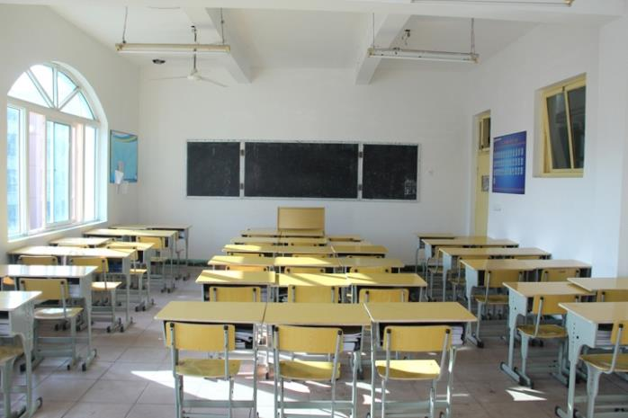
We are in the classroom. There are two windows in our classroom. What else can you see in the classroom?

Slide 5
How nice it is if there is a TV in the classroom!
Today we are going to learn unit 7.
Now lift your heads and you can see some lights. And look at me, there is a blackboard near me.

Slide 6
Part A Let’s learn
student
学生

Slide 7
teacher
老师

Slide 8
blackboard
黑板

Slide 9
TV
电视

Slide 10
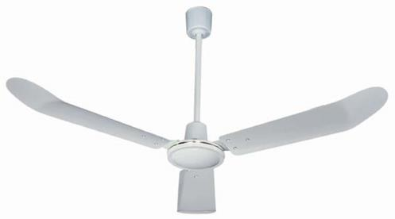
fan
吊扇；风扇

Slide 11
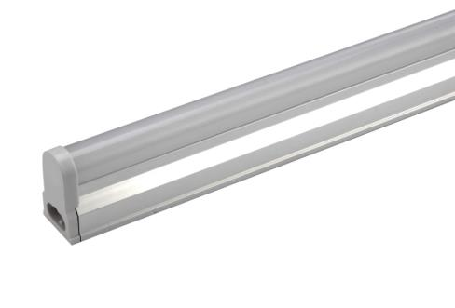
light
灯；日光灯

Slide 12
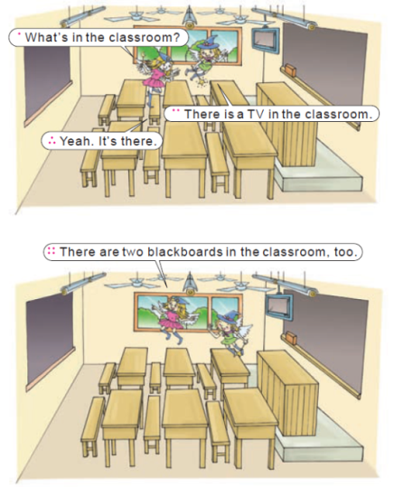
Part A Let’s talk

