Slide 1
Unit 6 In the kitchen
WWW.PPT818.COM

Slide 2
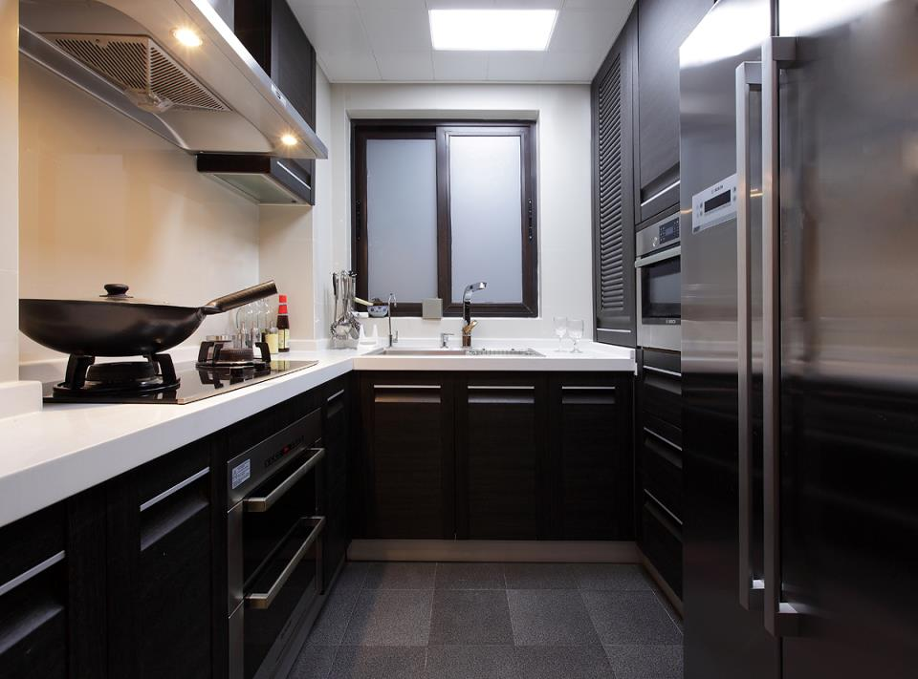

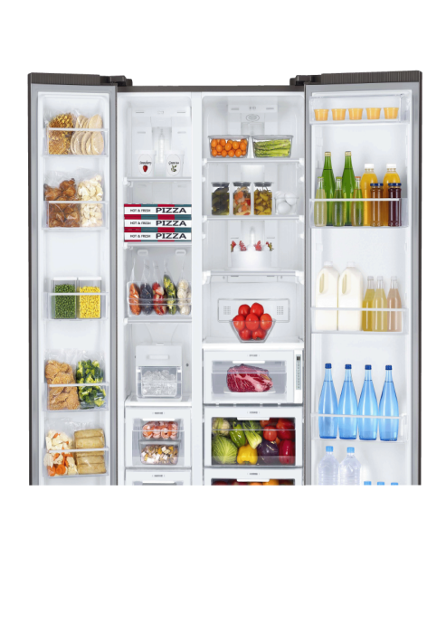
Talking time
fruit
drinks
vegetables
food

Slide 3


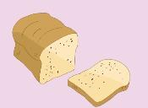
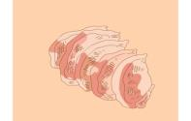
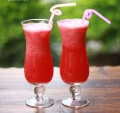
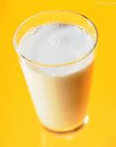
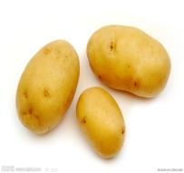
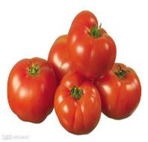
Talking time
A:What's in the fridge?
B:There is/are some...

Slide 4
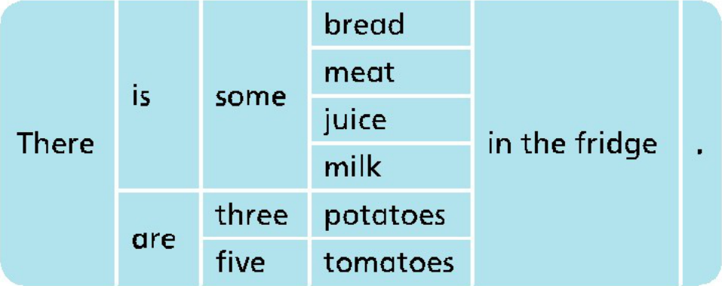
Grammar time
不可数名词
前可用some修饰，
但be动词要用is。
可数名词复数形式
be动词要用are。

Slide 5

Game time
可数名词
不可数名词
Tip:不可数名词指所表示的事物是不能按个数来计算的，
它一般只有单数形式。
water
pear
coffee
egg
peach
tea
study
soup
piano
bus
rice
box
knife
mango
可数名词指所表示的人或事物是可以按个数计算的。
它有单数形式和复数形式。

Slide 6
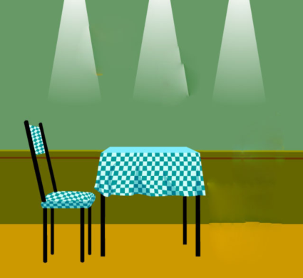

















Game time
大家来找茬！
picture1
picture2
There is/are … on/under the … in picture1.
There is/are … on/under the … in picture2.

Slide 7

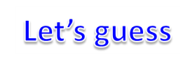
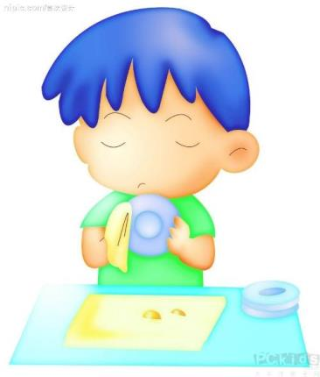
Look, what’s he doing?
Is he …?
Yes, he is./No, he isn’t.

Slide 8
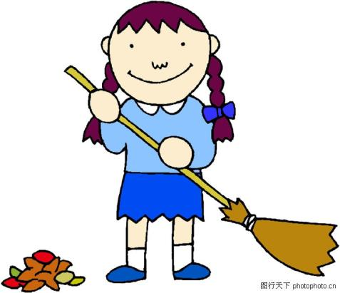
Look, what’s she doing?
Is she …?
Yes, she is.
No, she isn’t.

Slide 9
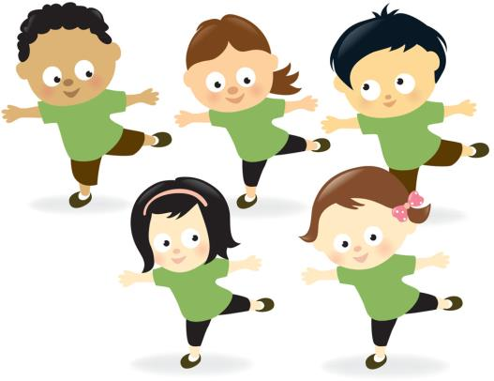
Look, what are they doing?
Are they …?
Yes, they are.
/No, they aren’t.

Slide 10

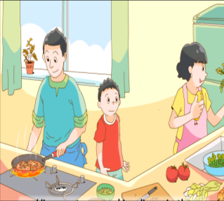
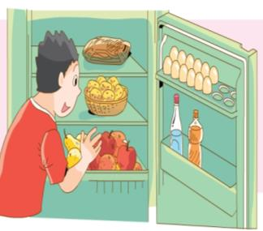
Are they cooking dinner?
Yes, they are.
Is he looking for some tomatoes?
No, he isn’t.
Tip: 朗读一般疑问句时用升调 ，
回答时用降调 。

Slide 11
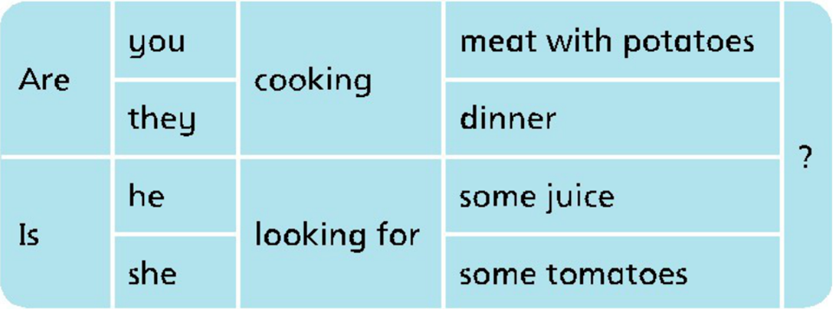
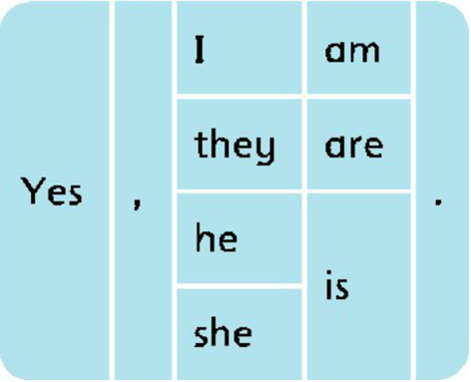
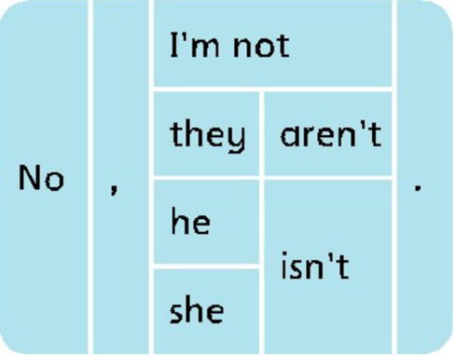
Grammar time
自己观察现在进行时一般疑问句的基本结构
+
=
现在进行时一般疑问
句的基本结构
Be动词
主语
+现在分词(doing) ...?

Slide 12

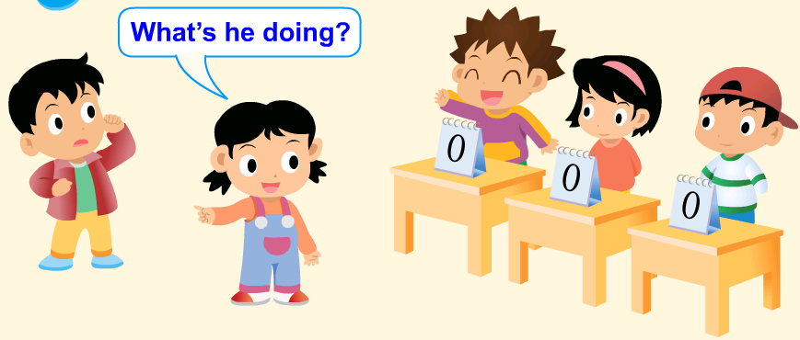
Act and guess
Rule: 全班分成四组，选一人演、一人当裁判，表演的同学要先从裁判手里抽取一张卡片并做相应的动作，四组同学分别按顺序猜，每组只有一次机会，回答错误其余三组同学可以抢答，最后得分最多的组获胜。

Slide 13
Exercise time
一、按要求改写句子
1. I am cooking lunch.(改为一般疑问句）
______ _______ cooking lunch?
Are you
2. Is he eating fruit in the bedroom?(做肯定回答)
_______, he ________.
Yes is
3. There are four potatoes in the fridge.(改为单数句)
There _______ a _________ in the fridge.
is potato
4. There is a tomato on the table.(改为复数句）
There _______ some ___________ on the table.
are tomatoes
Tip: 做练习时请圈出每一句的关键词。

Slide 14
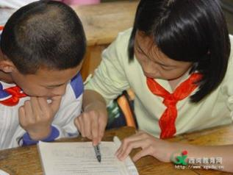
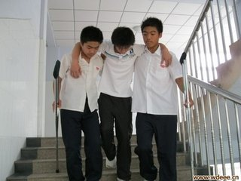
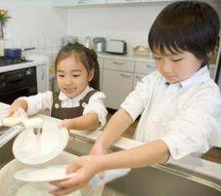
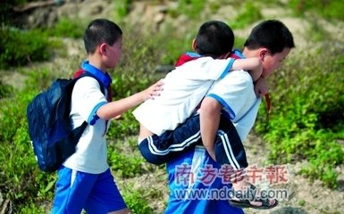
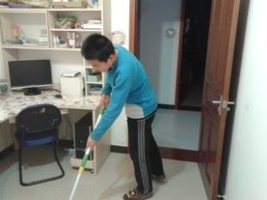
Sharing time
At home, we should help our parents.
At school, we should help each other.

Slide 15

GOODBYE!

