Slide 1
陕旅版英语六年级上册
Unit8 New Year’s Party
第1课时
WWW.PPT818.COM

Slide 2
教学目标：
1. 能听、说、读、写词汇：laugh, cry, tell a joke, act a play, play the guitar, win a gift。
2. 能在日常交流中灵活运用上述词汇。

Slide 3
Let’s sing

Slide 4
Free talk
Do you want to have a New Year’s Party?
What do we need to have a New Year’s Party?

Slide 5
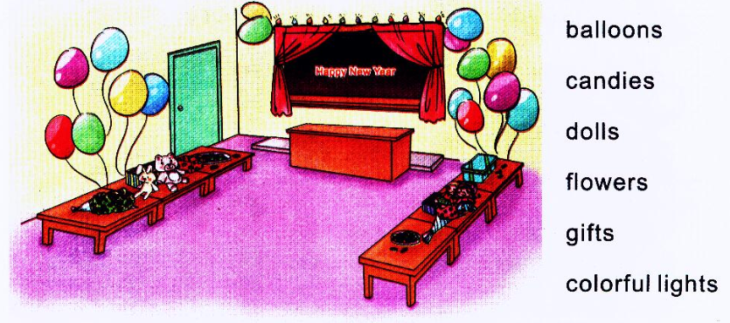
Warming-up: Look and match

Slide 6
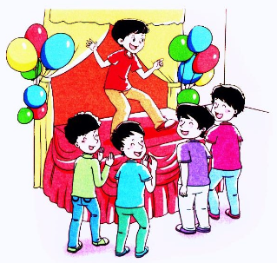
Let’s learn
tell a joke

Slide 7
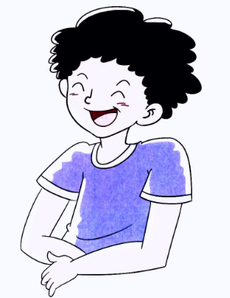
laugh

Slide 8
cry

Slide 10
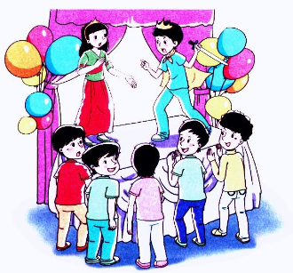
act a play

Slide 11
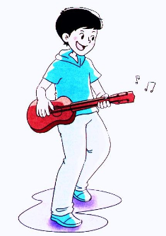
play the guitar

Slide 12
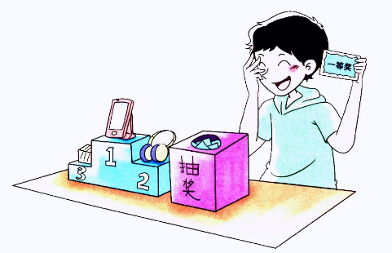
win a gift

Slide 13
Watch the flash and read aloud

Slide 14
全班学生听声传递灰姑娘的头饰，声音停止时则选择任意一张卡片进行拼读练习，由下一位同学说出相应的动词过去式，并同样大声拼读，正确完成拼读的学生可以获得奖励。
Let’s play—击鼓传花

Slide 15
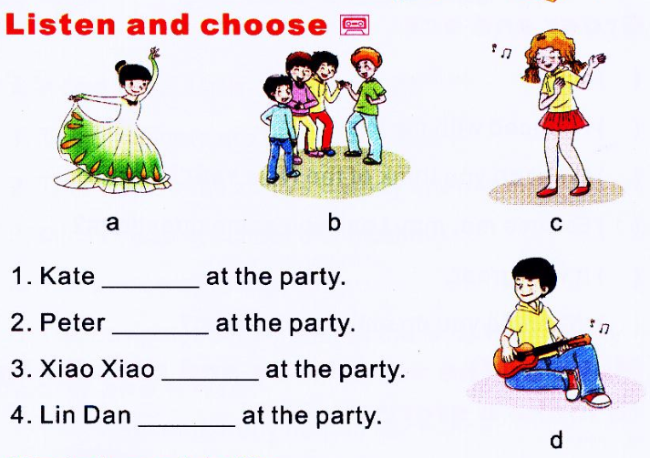
Part C

