Slide 1
What’s in your room?
WWW.PPT818.COM

Slide 2
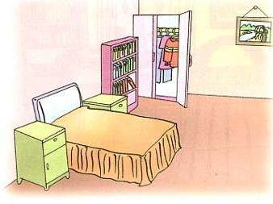

Slide 4
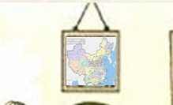
A map is on the wall.

Slide 5
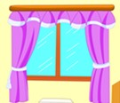

Slide 8
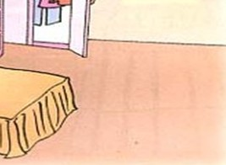

Slide 9
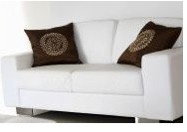

Slide 11
Practice:
请用“There is”或者
“There are”描述房间的物件。

Slide 12
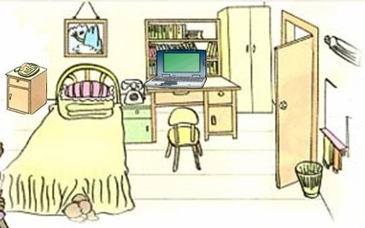

Slide 13
Please look at the picture
and answer my question.
(请看图回答问题。）

Slide 14
我们用“There is” and “There are” 来描述“某地有某物”。
There is a/an 名词单数....
There are 名词复数....

Slide 15
Practise：请根据图片回答问题。
1 What’s on the wall?
2 What’s on the desk?
3 What’s in front of the desk?
4 What’s beside the desk?
5 What’s beside the bed?

Slide 16
Listen to the tape and decide whether the statment
is “T” or “F”.(听录音，判断对错）
F
1 Ms White wants students to draw their classroom.
2 There is a bed next to the window in Jiamin’s room.
3 There is a pisture on the wall.
4 There is a desk and a computer in Jiamin’s room.
5 Janet’s computer is pink.
T
T
F
T

Slide 17
Discuss:
Look at the pictures on P3, use “There be” to combine two phrases in a group of 2.

Slide 18
there be 复习
1( ) There ____ asmall bed in my bedroom.
A are B is C be
2( ) Are there ____ balls?
A some B a C any

Slide 19
3（ ）There _____ a book on the table.
A. is B. are
4（ ） ______ there an apple on your desk?
A. are B. is
5（ ）There _____ a pencil, a book and two pens on the table.
A. is B. are

Slide 20
6（ ）There ___ two apples, one orange and one banana on the table.
A. is B. are
7（ ）Are there ____ pictures on the wall?No,there aren’t ___ .
A .any \ any B some \ any C. some \ some
8（ ）Are there ___ houses near the river?Yes, there are___.
A. some, some B. any, some
C. any, any D. some, any
9（ ）There is ___ book in his hand.
A. no B not

Slide 21
sound family
Letters | Words you know | Try more
sh | she, shop, ship, short, show, English, fish, | cash, sash
a-e | game, face, grape | shape, safe
a | hat, has, man, can, hand, black | sap, bad, sand
ar | car, are | shark, park
ay | may, play | bay, stay

Slide 22
Practice:判断每组单词划线部分的发音是否相同，相同的打勾，不同的打叉。
hat
( )
has
grape
( )
black
shark
( )
are
show
( )
English
bad
( )
game

Slide 23
阅读理解
This is Kate's room.It's not small. we can see
many things in it.A big table is in the room.On
the table,we can see a clock and two books.Under
the table,we can see a black and white cat.We
can see a blue sofa next to the table.Kate's
glasses are on the sofa.Where are Kate's shoes(
鞋)?One is in the cat's mouth.Where is the other
one?I can't see.
1 ( ) The room is small.
2 ( ) A clock is on the table.
3 ( ) The books are on the sofa.
4 ( ) The cat is under the table.
5 ( ) There is a blue sofa in the room.

