Slide 1
Module 8 Story time
Unit 2 Goldilocks hurried out of the house.
WWW.PPT818.COM

Slide 2
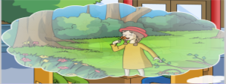
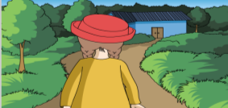
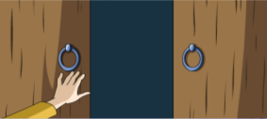
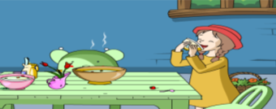
Revision
Look and fill
1
First
2
Next
walk
pick
notice
She _________ in the forest
and _________ some flowers.
walked
noticed
picked
She ___________ a little house.
3
Then
4
Finally
knock
push
enter
finish
She __________ the house and
____________ all the food in the
smallest bowl.
entered
knocked
Goldilocks _________ on the
door and __________ it.
finished
pushed

Slide 3
Revision
Retell
Can you retell this story? Have a try.

Slide 4
Pre-reading
New words and phrases
either adv. 也（不）
piece n. 部件；碎片；一件/ 个/ 张
asleep adj. 睡着的
return v. 返回；归还
cry v. 哭；喊叫
point v. 指向；指
shout v. 高声说；大声喊
jump v. 跳
without prep. 无，没有
part n. 部分；地区；地方
in pieces
破碎
at first
起初；首先
point at
指着……

Slide 5
Pre-reading
1 Work in pairs. Say what happened next in Goldilocks and the Three Bears.
—I think Goldilocks decided to go home.
—Maybe she stayed in the house.
…
Do you want to know what happened next in this story? Let’s guess.

Slide 6
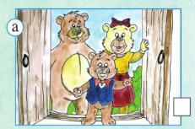
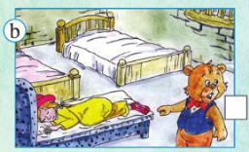
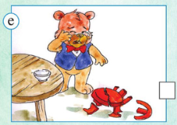
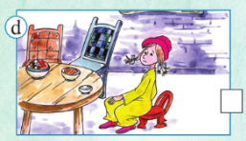
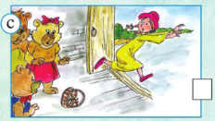
While-reading
2 Read the next part of the story and number the pictures in the correct order.
4
2
3
5
1

Slide 7
While-reading
3 Match the sentences with the pictures in Activity 2.
1) Goldilocks opened her eyes, jumped out of bed and hurried out of the house.
2) She tried the small chair.
3) The Three Bears returned to their house.
4) Baby Bear cried because there was nothing in his bowl and his chair was in pieces.
5) Baby Bear pointed at Goldilocks. She was asleep in his bed.
c
d
a
e
b

Slide 8
While-reading
4 Check (√) the true sentences.
1) Goldilocks liked the big chair.
2) Goldilocks liked the small bed.
3) Baby Bear looked in the bedroom.
4) The Three Bears were happy to see Goldilocks.
5) Goldilocks didn’t like the Three Bears.
√
√
√

Slide 9
Post-reading
5 Complete the passage with the correct form of the words from the box.
asleep either piece point return shout without
Goldilocks tried the three chairs and liked the small chair, but she was very heavy and soon the small chair was in (1) ________. She walked into the bedroom. She tried the middle bed, but it wasn’t comfortable and the big bed wasn’t comfortable (2) ________. Very soon she was (3) ________ in the small bed.
pieces
either
asleep

Slide 10
Post-reading
asleep either piece point return shout without
Then the Three Bears (4) __________ to their house. They walked up to their bedroom. Baby Bear (5) __________ at Goldilocks and (6) ________, “That’s her! She finished my food and… look at my chair!” Goldilocks jumped up and hurried out of the house (7) __________ her basket.
returned
pointed
shouted
without

Slide 11
Post-reading
Fill and retell
Goldilocks
sat down: big chair, 1___________, small chair
walked into: middle bed, big bed, 2________
middle chair
small bed
Three bears
looked at the bowls and the chairs, 3____________
4____________________, Baby Bear pointed at the little girl in his bed and shouted.
Baby Bear cried
looked in their bedroom
Goldilocks
opened her eyes, 5_______________ and hurried out of the house.
jumped out of bed

Slide 12
Post-reading
Language points
1. I think Goldilocks decided to go home.（复合句）
主句
从句
decide v. 决心；决定 + (not) to do sth.
I decided to go shopping this Sunday.
我决定这周日去逛街。

Slide 13
Post-reading
2. Goldilocks wanted to sit down because she was tired.
金凤花姑娘想坐下来，因为她累了。
want to do sth. 想做某事
I want to go for a walk. 我想去散步。
tired adj. 累的，疲惫的（主语是人）
tiring adj. 令人疲惫的（主语为物）
I’m tired. 我累了。
The trip is so tiring. 这段旅程太令人疲惫了。

Slide 14
Post-reading
3. Then she tried the middle chair. It was not comfortable either.
然后她试了试那把中等大小的椅子。那把椅子也不舒服。
(1) try v. 尝试 过去式tried
try可作及物动词，也可作不及物动词。
try to do sth. 努力做某事
try doing sth. 试着做某事
I try to finish my homework before six o’clock.
我尽量六点之前完成作业。

Slide 15
Post-reading
(2) either adv. 也（不）
either | too | also
否定句句末 | 肯定句句末，前面常用逗号隔开 | 肯定句，be动词、助动词、情态动词之后，行为动词之前
I can’t dance, either. 我也不会跳舞。 | I can dance, too. 我也会跳舞。 | I can also dance. 我也会跳舞。 I also like dancing.我也喜欢跳舞。

Slide 16
Post-reading
4. … soon the chair was in pieces.
……不一会椅子就散架了。
in pieces 破碎
a piece of… 一张/片/块…… 后加不可数名词
数量大于1时，piece变为复数，如two pieces of paper 两张纸

Slide 17
Post-reading
5. She didn’t like the middle bed or the big bed.
她不喜欢中等大小的床，也不喜欢大床。
否定句中用or连接并列成分。
I don’t like football or basketball.
我不喜欢足球也不喜欢篮球。
6. Very soon she was asleep in it. 很快她在小床上睡着了。
asleep adj. 睡着的 （只能作表语或宾语补足语）
fall/be asleep表示睡觉这一状态
go to bed和sleep表示睡觉这一动作

Slide 18
Post-reading
7. The Three Bears returned. 三只熊回来了。
不及物动词，返回
return作及物动词时，意为“归还”。
return sb. sth.=return sth. to sb.
归还某物给某人
I returned the book to Lucy.
我把书还给了露西。

Slide 19
Post-reading
8. Then Baby Bear pointed at the little girl…
然后熊宝宝指着小女孩……
point at （近指）指着
point to （远指）指向
He points at the book on this table.
他指着这张桌子上的书。
He points to the hill in the distance.
他指向远方的山。

Slide 20
Post-reading
9. There’s the bad girl. 那个坏女孩在那儿。
倒装句，正常语序为：The bad girl is there!
Here comes the bus. 公共汽车来了。
Here you are. 给你。
Tips: 主语是名词，谓语动词提到主语之前，构成完全倒装；主语是代词时，主谓不倒装。

Slide 21
Post-reading
10. … Goldilocks jumped out of bed and hurried out of the house without her basket.
……金凤花姑娘从床上跳下来，没有拿篮子就跑出了房间。
out of 从……出来
without prep. 无，没有（后加n./V-ing）
反义词 with

Slide 22
Production
6 Look at the sentences. Read and act.
1) First, she tried the big chair.
2) Then she tried the middle chair.
3) Finally, she tried the small chair.

Slide 23
Post-reading
Now write some new sentences using first, next/then and finally.
pick up/very big bowl/didn’t like/too hot
pick up/big bowl/didn’t like/too cold
pick up/small bowl/like/good
First, Goldilocks picked up the very big bowl. But she didn’t like it because it’s too hot.
Then, Goldilocks picked up the big bowl. But she didn’t like it because it’s too cold.
Finally, Goldilocks picked up the small bowl. She liked it because it’s good.

Slide 24
Post-reading
7 Read the story in Activity 2 again. Imagine what will happen next. Write at least three sentences.

Slide 25
Post-reading
Test
一、用词汇适当的形式填空。
1. _______ (one), it is cheap; second, it is very quick.
2. The old man _______ (point) at the stone and told us a story.
3. Tom is too heavy, and the chair under him is in _______ (piece).
4. He was very tired and soon was _______ (sleep).
5. Goldilocks hurried out of the house _______ (without) her basket.
First
pointed
pieces
asleep
without

Slide 26
Post-reading
二、 单项选择。
( )1. It’s not polite to point _______ others with your fingers.
A. at B. to C. out D. in
( )2. I hurried to school without _______ breakfast.
A. had B. having C. have D. has
( )3. “I won’t _______ to this place!” Tom said angrily.
A. return B. return back C. returned D. returned back
( )4. The story is so interesting and I _______ like it.
A. either B. too C. also D. so
( )5. Tony didn’t play football _______ go shopping yesterday. He stayed at home.
A. and B. but C. so D. or
A
B
A
C
D

Slide 27
Summary
1. 词汇：
Words: either, piece, asleep, return, cry,
point, shout, jump, without, part
Phrases: in pieces, at first, point out
2. 句型：
(1) Goldilocks wanted to…
(2) It was not comfortable either.
(3) Very soon she was asleep…
(4) Next, …
(5) Then…
3. 语法
规则动词的过去式、一般过去时的用法

Slide 28
Homework
1. Read a fairy story and retell it to your friend.
2. Review the words and expressions in this unit.

Slide 29
Goodbye!

