Slide 1
Unit 1 I like red
WWW.PPT818.COM

Slide 2
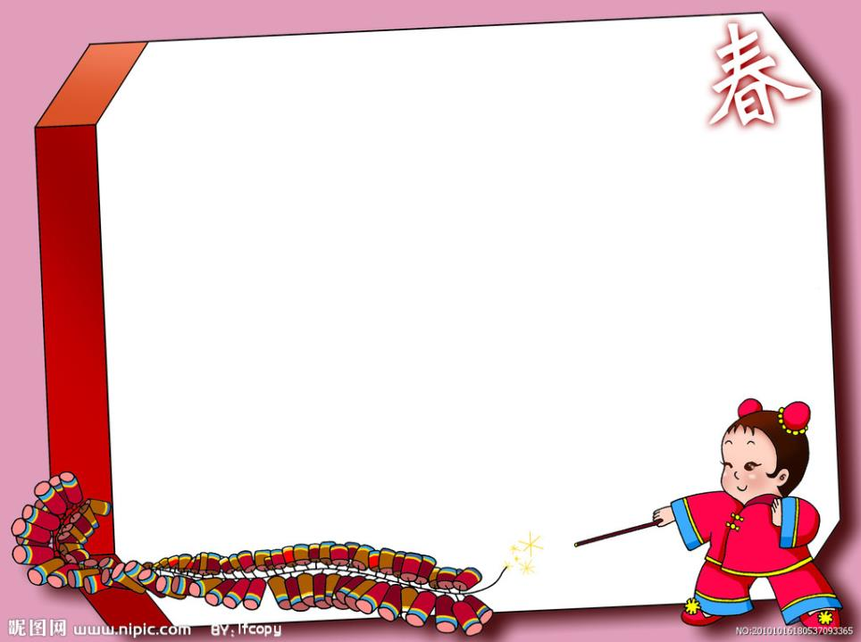
Let's sing
Rainbow purple, Rainbow blue,
Rainbow green and yellow,too.
Rainbow orange, Rainbow red, Rainbow shining overhead.

Slide 3
What colour is it?
It’s red.
It’s yellow.

Slide 4
What colour is it?
It’s blue .
and white

Slide 5
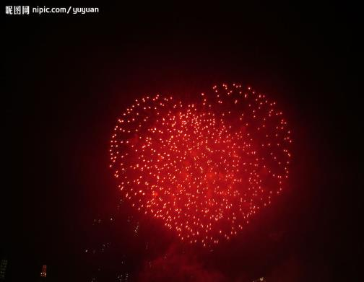
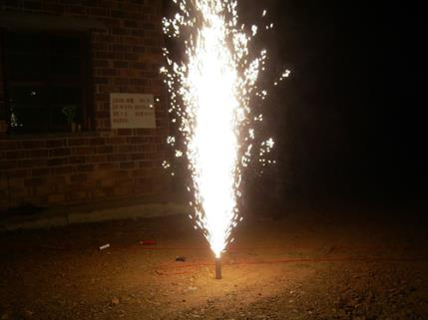
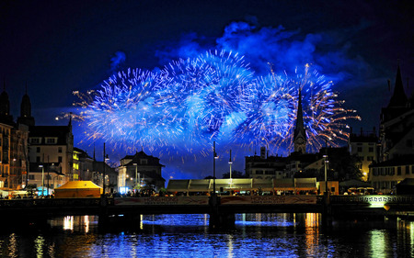
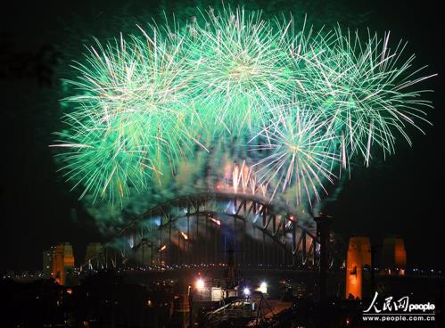

Slide 6
Look and say(快速说出颜色单词)
Great!

Slide 7
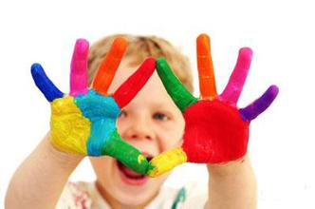
A:What colour do you like?
B:I like … .
Make a survey:

Slide 8
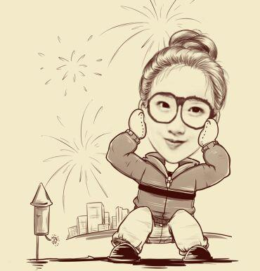
Let’s go to play, OK?
Ok,Good idea.

Slide 9
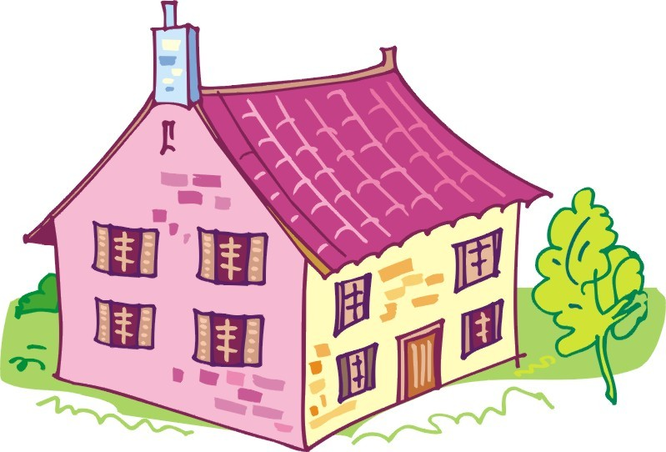
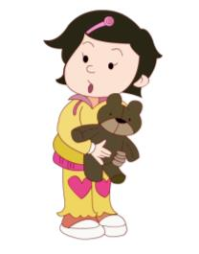
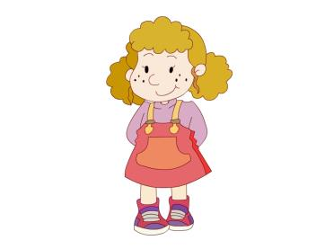

Slide 10
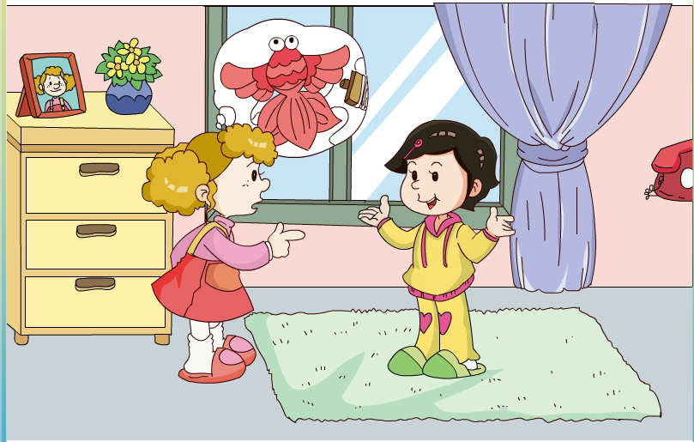
Listen and answer , “ What colour is the kite?”

Slide 11
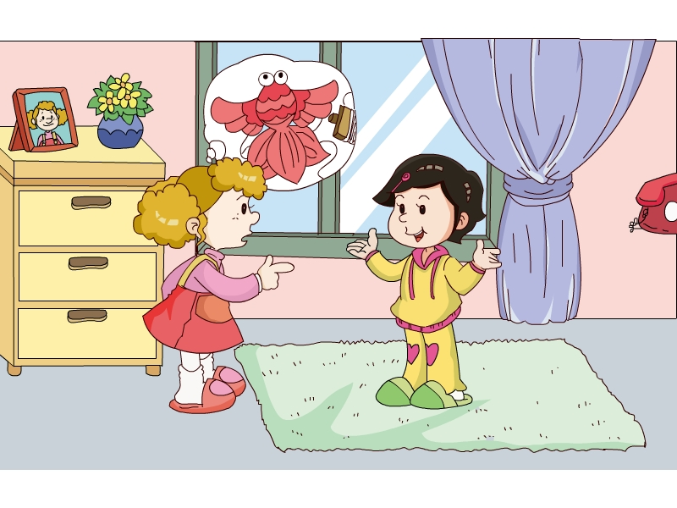
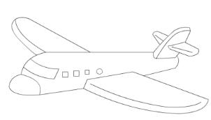
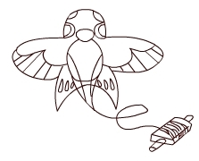
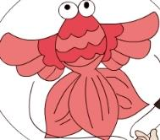
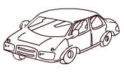
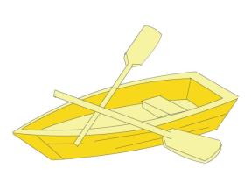
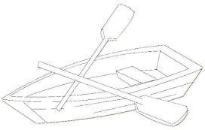
Work in pairs
A:What’s this?
B:It’s a _____.
A:What colour is the ____?
B: It’s _____.

Slide 12
What colour is the car?
Blue, bule , it’s blue.
What colour is the boat?
Yellow, yellow , yellow.
What colour is the ball?
Red, red, it’s red.
What colour is the plane?
White, white, white.

Slide 13
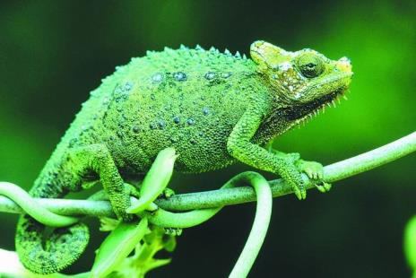
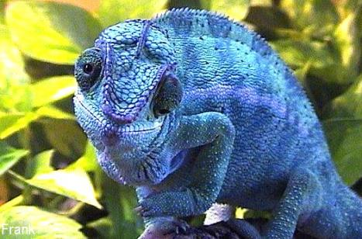
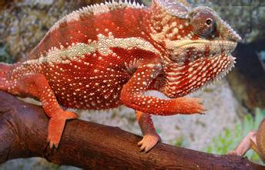
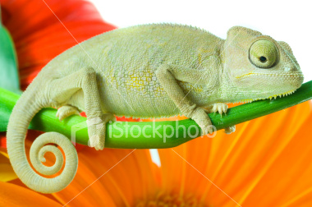
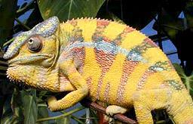
What colour is it?
It’s _____.

Slide 14
Let’s ask and tick.
P4.2

