Slide 1
Unit 1 Friends
第2课时
WWW.PPT818.COM

Slide 2
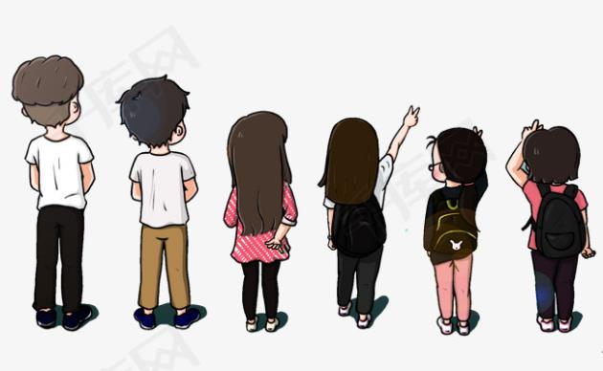
Talking about your friends.

Slide 3
Betty is one of my best friends. She is slim and has short hair.
Betty is generous. She is willing to share things with her friends. She is also helpful and ready to help people any time. She helps me with my homework and she always gives her seat on the bus to someone in need.
Betty has a good voice .She wants to be a singer when she grows up.
My best friend is Max. He is the tallest boy in our class—almost 1.75 metres. He wears small round glasses. They make him look smart.
Max has a good sense of humour. He tells funny jokes and always makes me laugh. I never feel bored with him.

Slide 4
Max's legs are very long. They do not fit well under his desk. When he walks past our desks, he often knocks our books and pens onto the floor.
Max is so interesting！
May is my best friend. She is shorter than I am. She has big bright eyes and long straight hair. Everyone thinks she is pretty.
May is sweet . She smiles often and never says a bad word about anyone.
May is a true friend. When something worries me， I can always go to her. I can tell her anything because she can keep a secret.

Slide 5
知识点
one of my best friends 我最好的朋友之一
1
one of＋...（形容词性物主代词/定冠词＋形容词的最高级）＋名词复数。one of...作主语时，谓语动词用第三人称单数形式。
考向【重点】
eg： One of his hobbies is swimming.
游泳是他的爱好之一。

Slide 6
Staying with families and friends is one of _______ things in the world.（武威）
A. the happiest B. happier
C. the happy D. happiest
典例
A

Slide 7
知识点
willing /'wɪlɪŋ/ adj. 乐意的，愿意的
2
eg： Are you willing to help me？
你愿意帮助我吗？
考向一
be willing to do sth. 愿意做某事
eg： Jack is willing to help me clean the house.
杰克乐意帮我打扫房子。

Slide 8
知识点
voice /vɔɪs/ n.嗓音
3
eg: They are talking in a low voice.
他们正在低声地交谈。
考向
【易错点】
辨析：sound，noise与voice
词条 | 含义及用法 | 示例
sound | 意为“声音，响声”，可泛指大自然的任何声音。 | At midnight he heard a strange sound. 午夜他听到奇怪的声音。

Slide 9
词条 | 含义及用法 | 示例
noise | 意为“噪音，喧闹声”，常指不悦耳、不和谐的嘈杂声。 | Don't make any noise！ 别吵闹！
vioce | 意为“嗓音”，一般指人说话、唱歌、谈笑的声音。 | The girl has a beautiful voice. 那女孩嗓音很美。

Slide 10
in a loud voice 大声地；in a low voice 低声地；
in a quiet voice 轻声地；raise one's voice 提高嗓门
搭配：
典例
—Why does Tony talk with his sister in such a low_____?
—Oh，because his grandma is sleeping in the room.
A. sound B. voice C. noise D. music
B
【点拨】词语应用法。A.“声音，响声”，B.“嗓音”，C.“噪音”，D.“音乐”。由题干中的关键词talk及题意可知答案。

Slide 11
知识点
almost /'ɔːlməʊst/ adv.几乎，差不多
4
eg: I almost forget it is Sunday today.
我差点忘了今天是周日。
考向
【易错点】
辨析：almost与nearly
词条 | 含义及用法 | 示例
almost | 意为“几乎，差不多”，是副词，常用来修饰动词、形容词、副词，可以和no, nothing, never这类否定词连用。 | Almost no one believed him.几乎没人相信他的话。

Slide 12
词条 | 含义及用法 | 示例
nearly | 意为“几乎，差不多”，nearly不能与no, none, nobody, nothing, never等词连用。 | We lost our way in the wind and I nearly fell over. 我们在风中迷了路，我差点摔倒了。
典例
According to a recent survey, ________ three fifths of working mothers in china don't want to have a second child.（广东）
A. mostly B. especially C. partly D. nearly
D

Slide 13
知识点
5
fit /fɪt/ vi.可容纳；装进
过去式和过去分词都为fitted，现在分词为fitting。
eg： I'd like to have a desk in the room but it won't fit.
我想在房间里放一张桌子，但是搁不下。
All the kids will fit in the back of the car.
所有的孩子都可以坐到车的后排。

Slide 14
The young man is so tall that his legs don't _______ well under the table.
A. walk B. run C. jump D. fit
典例
D
【点拨】词义辨析法。考查动词辨析。A.走路；B.跑；C.跳；D.可容纳，装进。

Slide 15
知识点
6
knock sth. onto... 把某物撞掉在……的上面
eg： He often knocks my books onto the floor.
他经常把我的书撞掉在地板上。
考向
knock意为“碰，撞”， knock... onto中间要用代词的宾格形式。
【易错点】
eg: Yesterday afternoon a car knocked him onto the ground. 昨天下午一辆小汽车把他撞倒在地上。

Slide 16
归纳：
knock on/at 敲
knock over 撞倒
knock off 敲掉，撞倒

Slide 17
一、根据汉语提示完成单词
1. My friend has a ________(圆形的)face.
2. I want to ________ (选择)an English book to read.
3. My friend has big bright eyes and long _______ (直的)hair.
4. The girl is always ________ (愿意的)to help people in need.
5. My cousin Lily is a generous and ________ (惹人喜爱的) girl. I like to play with her.
round
choose
straight
willing
sweet

Slide 18
二、用所给词的适当形式填空
6. He is the ________ (tall)boy in his class.
7. One of the ________ (glass)on the table is broken. （永州）
8. Our parents often make us ________ (study)all day.
9. I never feel ________ (bore)with my friend.
10. Everyone in my family ________ (get) up early in the morning.
tallest
glasses
study
bored
gets

Slide 19
三、单项选择
11. Our monitor is funny and he often_______ jokes.
A. says B. tells C. speaks D. talks
12. Sandy is so kind that she often _______ her things with her friends.
A. shows B. gives C. shares D. brings
13. He's always _______ to help his friends.
A. ready B. interesting C. hardly D. necessary
B
C
A

Slide 20
14. I ________ have no time to do my homework.
A. nearby B. almost C. nearly D. near
15. Cathy has such a good _______ that she won many prizes in singing competitions last year. （安徽）
A. sleep B. idea C. voice D. time
B
C
【点拨】根据句中信息she won many prizes in singing competitions 推测句中指的是Cathy有这么好的声音；故选C。

Slide 21
本节课主要学习了以下知识点，请同学们及时巩固练习：
one of my best friends
willing, fit, voice, almost
knock sth. onto...

