Slide 1
Module1 How to learn English
Unit 1
Let’s try to speak English as much as possible.
WWW.PPT818.COM
Notes:
1

Slide 2
学习目标
1. To understand conversations involving advice on learning English.
2. To get information about how to learn English from the conversation.
3. To understand the way of giving advice.
4. To practise giving advice on English learning.

Slide 3
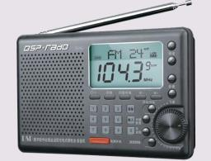
Brainstorm
Where can we see English in our daily life?

Slide 4
How do people usually learn English?
Speaking
Reading
Listening
Writing
English is like a tree.

Slide 5
Listening and vocabulary
1
Read the instructions and check (√ ) the ones you understand.
1 Work in pairs. Ask and answer the questions.
2 Correct the spelling.
3 Listen and check the words you hear.
4 Practise saying the words.
5 Match the words with their meanings.
6 Complete the sentences with the words in the box.

Slide 6
Listen and answer the questions. Use the words and
expressions in the box.
2
dictionary grammar letter look up
make a mistake understand
1. Which word did Daming not understand?
2. What mistake did Lingling make?
He didn’t understand the word “spring”.
She made a grammar mistake. She said “go”
instead of “went”

Slide 7
3. How does Daming usually check the spelling
of a word?
4. Why is it difficult for Daming to check the
spelling of Cinema?
He usually looks it up in the dictionary.
It was difficult because he didn’t know the first letter.

Slide 8
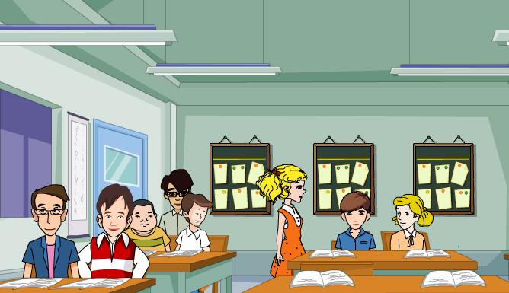
Watch and answer.
They are talking about good ways to learn English.
What’re they talking about?

Slide 9
Task1: Read and do “T” or “F”.
1. Speak Chinese in class.
2. Write the mistakes in the notebooks.
3. Write down the correct answers next to the mistakes.
4. Listen to English radio programme.
5. Read English stories.
6. Try to understand every word.
F
T
T
T
T
F

Slide 10
Task2: Find advice on learning English in the dialogue.
1. We should always speak English in class!
2. Let’s try to speak English as much as possible.
3. Why not write down the mistakes in our notebooks?
4. Don’t forget to write down the correct answers next to the mistakes.
5. It’s a good idea to spell and pronounce new words aloud every day.
6. How about listening to the radio?
7. Why don’t we try to find some English pen friends?

Slide 11
【总结归纳】提建议的常用句型
We should…
What/How about…?
提出
建议
Why don’t you(we)…?
/Why not...?
Would you like…?
It’s a good idea to do sth.
Let’s do…

Slide 12
Task3: Write notes about learning English.
Listening: listen to the radio
Speaking:
______________________________________
Reading:
______________________________________
Writing:
______________________________________
Learning new words:
______________________________________
speak English as much as possible
read English stories
write to English pen friends
spell and pronounce new words aloud everyday

Slide 13
Task4: Underline the correct words.
Here is my (1) advice / notebook on learning English. Speak English (2) always / as much as possible in class, and listen to English (3) in the newspaper / on the radio. I (4) agree / forget it is a good idea to look up new words in the (5) notebook / dictionary. You can find the (6) correct / excellent pronunciation and learn the meaning.

Slide 14
Task5: Group work
Work in groups of 6, and talk about problems in learning English and give advice.
Example
I can’t speak English well. What should I do?
I don’t know how to talk to others.
How about saying simple expressions or sentences?
Why don’t you try to talk to our classmates in English?

Slide 15
Language points
1. advice n. 意见; 建议，不可数名词，表示一条建议时用a/one piece of advice；表示一些建议时常用some advice。
常用的固定搭配有:
①give some advice on. . . “在……方面提建议”; ②take/follow one’s advice “接受某人的建议”; ③ask for one’s advice “征求某人的建议”。
知
识
探究

Slide 16
2. Let’s try to speak English as much as possible.
知
识
探究
try to do sth.“尽力，设法做某事”，强调付出一定的努力。
try doing sth.“尝试做某事”，但不一定付出很大努力。
try
try one’s best do sth.尽某人最大的努力做某事。
have a try尝试，try是名词。

Slide 17
3. Why not write down our mistakes in our notebooks?
句型Why not. . . ? 相当于Why don’t you/we. . . ? 意为“为什么不……呢? ”, 其后面跟动词原形, 是提建议的一种句型。例如: Why not ______ for a walk?
= Why don’t you _____ for a walk?
为什么不去散步呢?
知
识
探究
go
go

Slide 18
4. How about listening to the radio?
How about. . . ? 意为“……怎么样? ”, 相当于What about. . . ? “……怎么样? ”, 用来提出请求、建议或征求对方的意见, 其后可以接名词、代词或动名词形式。
如：—How about taking a rest?
—OK. Let’s go for a walk.
知
识
探究

Slide 19
Task6: Listen and mark the intonation.
1. We should always speak English in class.
2. Let’s try to speak English as much as possible.
3. Why not write down the mistakes in our notebooks?
4. It’s a good idea to spell and pronounce new words
aloud.
5. How about listening to the radio？

Slide 20
Summary
Let’s try…..
Why not…
Advice
Don’t forget to…
It’s a good idea to…
How about…
Why don’t we…
Good ways to learn English
make a mistake
as…as possible
write down
agree with
Phrases
名词：pair, spelling, meaning, sentence, dictionary, grammar, …
Words
动词：practise, match, complete, forget, pronounce, understand, agree
形容词：possible, key, main, excellent
其他词性：correct, should

Slide 21
Homework
1. Remember the key points in this unit.
2. Recite the dialogue.
3. Write at least five sentences about advice on learning English.
Notes:
21

